Slide 1
Figures for
John M. Butler’s
Advanced Topics in Forensic DNA Typing: Methodology (2012)

Slide 2
Chapter 1 – Sample Collection & Characterization

Slide 3
Crime committed
Suspect developed
Biological material transferred
Evidence (Question) sample “Q”
May match another
(K’)
Reference (Known) sample “K”
Database Search
Steps Involved
Steps Involved
Collection
Collection
Sample Storage
Q
U
A
L
I
T
Y
A
S
S
U
R
A
N
C
E
Exclusion (no match)
Sample Storage
Q
U
A
L
I
T
Y
A
S
S
U
R
A
N
C
E
Serology
Characterization
Extraction
Q ≠ K
Extraction
Q
DNA Profile
Comparison
K
Biology
Quantitation
Quantitation
Amplification
Q = K
Amplification
STR Markers
STR Markers
Inclusion (match)
Separation/
Detection
Separation/
Detection
Technology
Data
Interpretation
Report
(with statistical weight)
Data
Interpretation
Statistical Interpretation
Genetics
Plea
Court
Profile put on database
Profile put on database
Notes:
Figure 1.1 Steps involved in the Q-K comparison during forensic DNA testing.

Slide 4
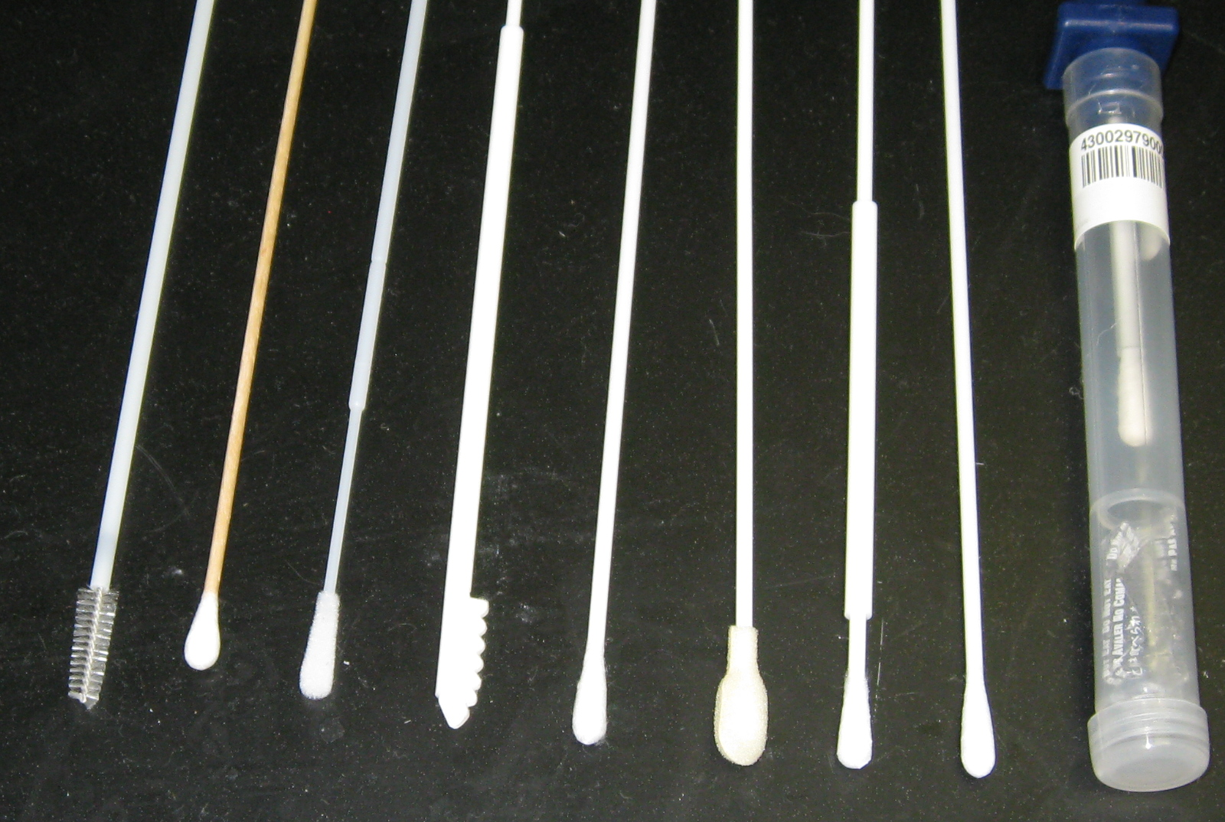
Notes:
Figure 1.2 Photo of several different buccal collectors.

Slide 5
Evidentiary Sample
(stain from crime scene)
Co-extract RNA and DNA
RNA
DNA
Reverse transcriptase (RT)-PCR
PCR
STR profiling
Body fluid ID
Notes:
Figure 1.3 RNA and DNA co-extraction enable both body fluid identification and STR profiling.

Slide 6
Real-time PCR
(for presence or absence of target gene)
Reverse transcriptase
PCR
RNA
cDNA
Capillary electrophoresis separation/detection
(for presence or absence of target gene)
Notes:
Figure 1.4 RNA profiling approaches. The reverse transcriptase step uses gene-specific primers to convert RNA into a double-stranded form (complementary DNA, cDNA) for stability. The PCR step performs exponential amplification of the cDNA targets and can be detected with either real-time PCR (see Chapter 3) or capillary electrophoresis (see Chapter 16).

Slide 7
Chapter 2 – DNA Extraction

Slide 8
ORGANIC
CHELEX
FTA Paper
Blood stain
SDS, DTT, EDTA and
proteinase K
Apply blood to paper and allow stain to dry
Blood stain
Water
INCUBATE (56 ºC)
Centrifuge
PUNCH
INCUBATE (ambient)
Phenol,
chloroform,
isoamyl alcohol
Centrifuge
REMOVE supernatant
VORTEX
5%
Chelex
WASH Multiple Times with extraction buffer
Centrifuge
TRANSFER aqueous (upper) phase to new tube
REMOVE supernatant
INCUBATE (56 ºC)
PCR Reagents
TE buffer
INCUBATE (100 ºC)
CONCENTRATE sample (Centricon/Microcon-100 or ethanol precipitation)
Centrifuge
(NO DNA QUANTITATION TYPICALLY PERFORMED WITH UNIFORM SAMPLES)
QUANTITATE DNA
Centrifuge
PERFORM PCR
QUANTITATE DNA
PERFORM PCR
PERFORM PCR
Notes:
Figure 2.1 Schematic of commonly used DNA extraction processes.

Slide 9
Lyse cells
Release DNA
Bind to Magnetic Beads
(collect beads with magnet)
Wash Beads
Elute
Clean DNA
Notes:
Figure 2.2 Bind-wash-elute method utilized in DNA IQ and PrepFiler DNA extraction and purification chemistries.

Slide 10
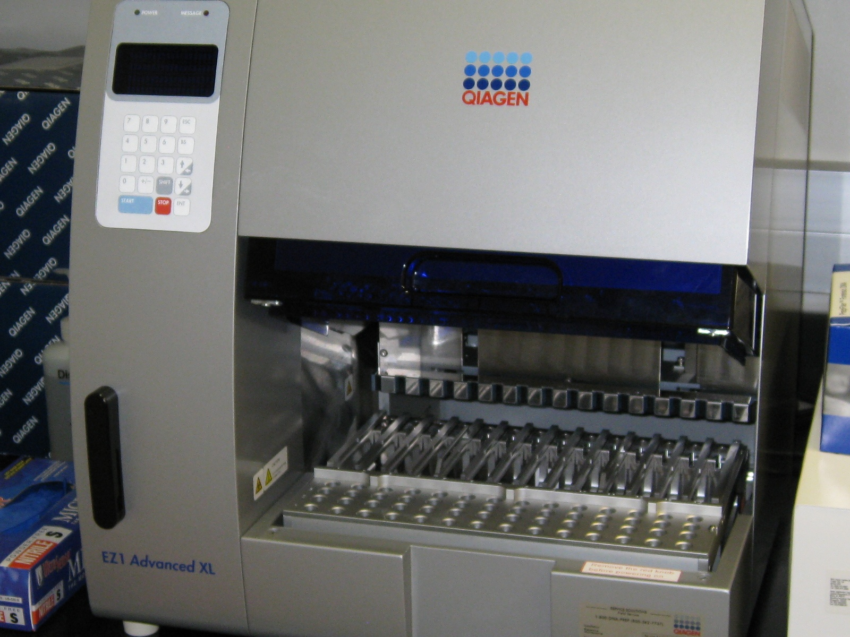
Notes:
Figure 2.3 Qiagen EZ1 DNA extraction robot.

Slide 11
Differential Extraction
Remove a portion of the mixed stain
SDS, EDTA and
proteinase K
(cell lysis buffer)
Incubate at 37 ºC
Centrifuge
Perpetrator’s sperm mixed with victim’s epithelial cells
sperm pellet
REMOVE supernatant
SDS, EDTA and
proteinase K + DTT
DTT lyses sperm heads
‘Sperm Fraction’
sperm pellet
‘Non-sperm Fraction’
Notes:
Figure 2.4 Schematic of differential extraction process used to separate male sperm cells from female epithelial cells.

Slide 12
Evidence (Q)
Reference Samples (K)
Differential extraction
(a)
(c)
non-sperm fraction
Victim
(b)
sperm fraction
(d)
Suspect
Notes:
Figure 2.5 Illustration of results from the four samples typically associated with a sexual assault case. During differential extraction, the evidence sample is divided into two fractions: (a) non-sperm or epithelial fraction and (b) the sperm fraction (see Figure 2.4). The suspect result (d) is compared to the sperm fraction (b) to see if they match. The victim’s DNA profile (c) provides confirmation of sample integrity with the non-sperm fraction (a).

Slide 13
Sexual Assault
A mixture of cells is created
Sperm
(perpetrator(s))
+
Vaginal, rectal, or buccal epithelial cells
(victim)
Differential cell lysis
Selective cell degradation with DNase digestion
Selective PCR with Y-STRs
Selective cell capture with laser microdissection
“GOLD STANDARD”
Creation of two fractions:
Non-sperm fraction
Sperm fraction
Destroys portion of evidence (female cells)
Can isolate male-portion even with high female cell background but not as informative due to paternal lineage sharing
Time-consuming; expensive equipment
Labor-intensive and some sample is lost during washes; carryover may occur between fractions
Notes:
Figure 2.6 Different methods for separating perpetrator(s)’s sperm and victim’s epithelial cells created in sexual assault DNA samples.

Slide 14
Chapter 3 – DNA Quantitation

Slide 15
(a)
(b)
(c)
Too much DNA amplified
Too little DNA amplified
Within optimal range
Notes:
Figure 3.1 Illustration of STR typing results at a single heterozygous locus for a single source sample with (a) too much DNA template showing off-scale, split peaks, (b) too little DNA template where the arrow points to allele dropout due to stochastic effects, or (c) just the right amount so that two allele peaks are balanced and on-scale.

Slide 16
Extract DNA
Quantitation
Too much DNA
Optimal range
Too little DNA
Dilute sample
(to normalize)
Concentrate sample
(to normalize)
Low template DNA approaches (e.g., more PCR cycles)
PCR
Amplification
Notes:
Figure 3.2
Flow chart illustrating role of DNA quantitation following DNA extraction. If the sample contains a DNA quantity within the optimal range, then an analyst would proceed with PCR amplification. With too much DNA, a sample could be diluted and either re-checked for DNA quantity or sent directly to the PCR amplification step. When DNA results below the optimal range are observed, the sample could be concentrated, re-extracted or treated with low template DNA approaches depending on laboratory policy and amount of available sample.

Slide 17
Unknown Samples
Calibration standards
Calibration standards
20 ng
≈2.5 ng
0.63 ng
10 ng
1.25 ng
5 ng
2.5 ng
2.5 ng
5 ng
1.25 ng
10 ng
0.63 ng
20 ng
Notes:
Figure 3.3 Illustration of a human DNA quantitation result with the slot blot procedure. A serial dilution of a human DNA standard is run on either side of the slot blot membrane for comparison purposes. The quantity of each of the unknown samples is estimated by visual comparison to the calibration standards. For example, the sample indicated by the arrow is closest in appearance to the 2.5 ng standard.

Slide 18
R
Forward primer
TaqMan probe
Q
5’
Polymerization and Strand Displacement
3’
5’
3’
5’
5’
5’
3’
Reverse primer
R
Forward primer
Q
5’
3’
Probe Cleavage
(release of reporter dye)
3’
5’
5’
5’
3’
Reverse primer
Fluorescence occurs when reporter dye and quencher dye are no longer in close proximity
R
Forward primer
Q
5’
Completion of Polymerization
3’
5’
5’
5’
3’
Reverse primer
Notes:
Figure 3.4 Schematic of TaqMan (5’ nuclease) assay.

Slide 19
Plateau
ΔR_{n}
Linear
product growth
Normalized Fluorescence
Exponential product growth
threshold
Negative control
Standard curve
a
b
c
d
e
Cycle Number
C_{T}
e
d
N_{c} = N_{o} (1 + E)^{c}
c
C_{T}
b
If efficiency is close to 100% (E = 1), then the product copy number (N_{c}) doubles the target copy number (N_{o}) with each cycle (c).
a
Log[DNA]
Notes:
Figure 3.5 Real-time PCR output and example standard curve used to determine quantity of input DNA.

Slide 20
(a)
1 ng sample
(b)
Notes:
Figure 3.6 (a) Range of DNA concentrations reported for a 1 ng DNA sample supplied to 74 laboratories in an interlaboratory study (Kline et al. 2003). Overall the median value was very close to the expected 1 ng level with 50% falling in the boxed region. However, laboratories returned values ranging from 0.1 ng to 3 ng. (b) A target plot examining concordance and apparent precision for the various laboratory methods used. Legend: A=ACES kit; q = Quantiblot with unreported visualization method; E = Quantiblot with chemiluminescent detection; T = Quantiblot with colorimetric detection; 1, 2, 3, 4, and 5 represent methods used by only one lab.

Slide 21
Apparent Precision
Concordance
Notes:
Figure 3.7
Target plot comparing inter-laboratory results from 60 data sets involving 8 different samples using 10 different qPCR methods (Kline et al. 2005). Larger characters in bold font represent the median performance for all results submitted for a particular method. Note that specific methods may exhibit a bias relative to other assays. 0 = Quantifiler, which represented 37 of the 60 data sets (see Table 1 in Kline et al. 2005 for full description of qPCR assay codes).

Slide 22
3,068 casework samples
EZ1 DNA extraction (no inhibitors seen)
DNA quantitation
Quantifiler (performed twice and results averaged)
STR amplification
Nanoplex^{QS} and SEfiler (with up to 500 pg DNA added)
Group 1
0-5 pg/µL
1564 samples
Group 2
5-10 pg/µL
279 samples
Group 3
10-30 pg/µL
371 samples
Group 4
>30 pg/µL
854 samples
No results
Full profile
Partial profile
96%
3%
1%
67%
23%
10%
26%
67%
7%
3%
96%
1%
Kremser et al. 2009
Notes:
DNA Box 3.3
Kremser, A., et al. (2009). Quantifiler Human DNA Quantification Kit (Applied Biosystems) as a screening kit for DNA profiling. Forensic Science International: Genetics Supplement Series, 2, 106-107.

Slide 23
1564 Samples
with ‘Zero’ Quantifiler Results (pg/µL)
 | 0,0 | 0,>0 | >0,>0
Number of Samples | 750 | 478 | 336
Positive results | 0% | 7% | 27%
Negative results | 100% | 93% | 63%
When both Quantifiler results were zero, then all subsequent STR testing failed to obtain a result
Kremser et al. 2009
Notes:
D.N.A. Box 3.3
Kremser, A., et al. (2009). Quantifiler Human DNA Quantification Kit (Applied Biosystems) as a screening kit for DNA profiling. Forensic Science International: Genetics Supplement Series, 2, 106-107.

Slide 24
Chapter 4 – PCR Amplification

Slide 25
94 ºC
94 ºC
94 ºC
94 ºC
72 ºC
72 ºC
72 ºC
Temperature
60 ºC
60 ºC
60 ºC
Single Cycle
Time
Typically 25-35 cycles performed during PCR
The denaturation time in the first cycle is lengthened to ≈10 minutes when using AmpliTaq Gold to perform a ‘hot-start’ PCR
Notes:
Figure 4.1
Thermal Cycling Temperature Profile for PCR. Thermal cycling typically involves 3 different temperatures that are repeated over and over again 25-35 times. At 94 oC, the DNA strands separate, or “denature”. At 60 oC, primers bind or “anneal” to the DNA template and target the region to be amplified. At 72 oC, the DNA polymerase extends the primers by copying the target region using the deoxynucleotide triphosphate building blocks. The entire PCR process is about 3 hours in duration with each cycle taking ~5 minutes on conventional thermal cyclers: 1 minute each at 94 oC, 60 oC, and 72 oC and about 2 minutes ramping between the 3 temperatures.

Slide 26
5’
3’
Starting DNA Template
3’
5’
Separate strands (denature)
Forward primer
5’
3’
5’
3’
Add primers (anneal)
5’
3’
5’
3’
Reverse primer
Make copies (extend primers)
Repeat Cycle, Copying DNA Exponentially
Notes:
Figure 4.2 DNA Amplification Process with the Polymerase Chain Reaction. In each cycle, the two DNA template strands are first separated (denatured) by heat. The sample is then cooled to an appropriate temperature to bind (anneal) the oligonucleotide primers. Finally the temperature of the sample is raised to the optimal temperature for the DNA polymerase and it extends the primers to produce a copy of each DNA template strand. For each cycle, the number of DNA molecules (with the sequence between the two PCR primers) doubles.

Slide 27
(a) Simultaneous amplification of three locations on a DNA template
Dye- labeled PCR primers
Dye-labeled
PCR products
Locus A
Locus B
Locus C
(b) Resolution of PCR products with size-based separation method
A
C
B
smallest → largest
Notes:
Figure 4.3 Schematic of multiplex PCR and how labeled PCR primers create labeled PCR products. (a) Three sets of primers, represented by arrows, are shown here to amplify three different loci on a DNA template. The primers were designed so that the PCR products for locus A, locus B, and locus C would be different sizes and therefore resolvable with a size-based separation system (b).

Slide 28
Non-nucleotide linkers
(mobility modifiers)
Fluorescent dye
High stability base analogs
A T G G C A T T A C G
5’
3’
R
D
A T G G C A T T A G G
Energy-transfer dye cassette for brighter dyes
5’
3’
Extra (degenerate) primer
to match primer binding site mutation
Notes:
Figure 4.4 Illustration of potential PCR primer modifications (see Table 4.4 on purpose of each)

Slide 29
High copy number
>20 copies per allele
Low copy number
6 copies per allele
Copies of allele 1
Copies of allele 2
True amount
What is sampled is consistent with the true amount present in the sample
What might be sampled by the PCR reaction…
OR
Resulting electropherogram
Extreme allele imbalance
Complete (and correct) genotype
Allele imbalance
Allele dropout
Notes:
Figure 4.5 An illustration of stochastic statistical sampling that may occur with low template amounts where the two alleles sampled at a genetic locus during PCR are represented as red and blue circles. Allele imbalance, allele dropout, or even locus dropout may occur resulting in an electropherogram that does not accurately reflect the original DNA sample.

Slide 30
Chapter 5 – STR loci and kits

Slide 31
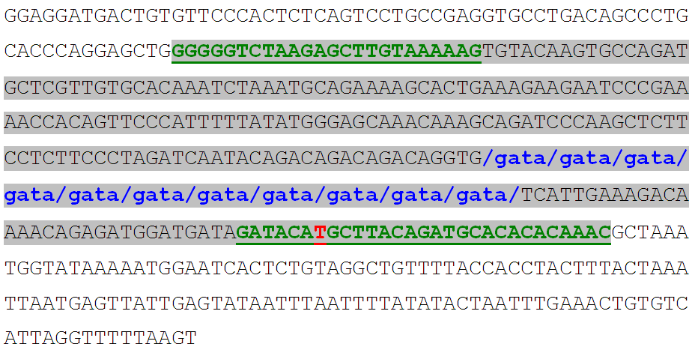
Notes:
Figure 5.1
DNA sequence of a D16S539 allele containing 11 GATA repeats (shown in blue font). The STR repeat sequence is included in lowercase font with breaks between each repeat unit for emphasis. Underlined regions in green font indicate PowerPlex 16 primer binding sites (Krenke et al. 2002) with the shaded portion showing the PCR product, which is 288 bp (see Appendix 1). This top strand of the reference sequence is the reverse complement of GenBank entry AC024591 available from http://www.cstl.nist.gov/biotech/strbase/seq_ref.htm. The ‘T’ shown in red font indicates a point mutation that resulted in a null allele with a previous primer (Nelson et al. 2002).

Slide 32
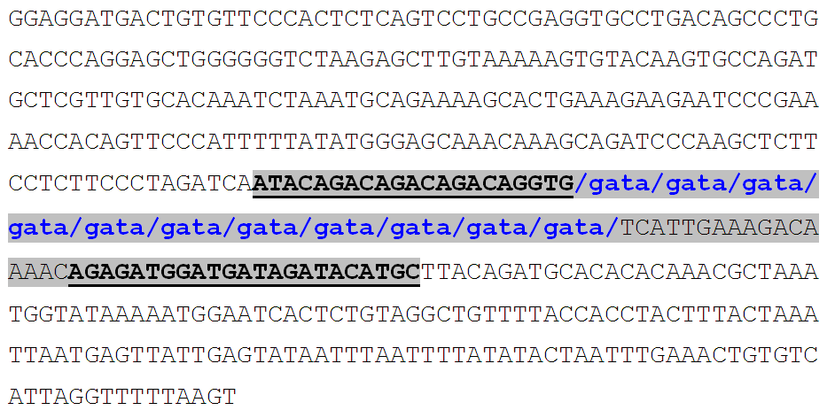
Notes:
Figure 5.2
DNA sequence of a D16S539 allele containing 11 GATA repeats. Underlined regions indicate miniSTR primer binding sites (Butler et al. 2003) with the shaded portion showing the PCR product, which is 105 bp, or a 183 bp size reduction over a PowerPlex 16 PCR product (see Figure 5.1).

Slide 33
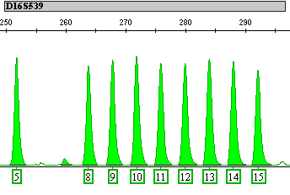
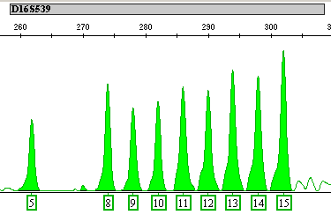
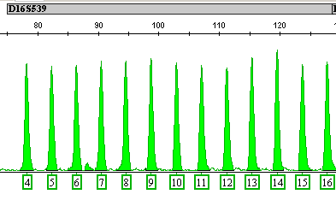
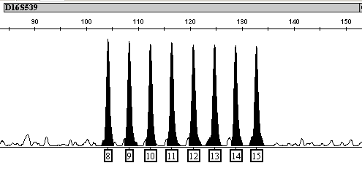
D16 Allelic Ladders
Identifiler
PowerPlex 16
PowerPlex ESI 17
IDplex
Notes:
Figure 5.3
D16S539 allelic ladders for Identifiler (ABI), PowerPlex 16 (Promega), PowerPlex ESI 17 (Promega), and IDplex (Qiagen). Figure courtesy of Becky Hill, NIST.

Slide 34
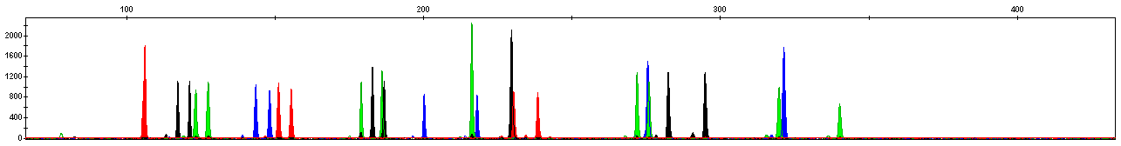
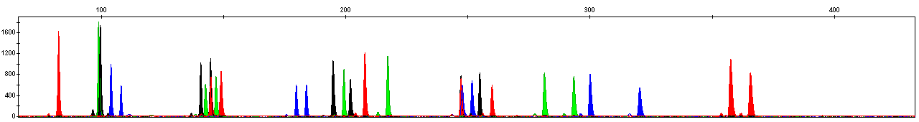
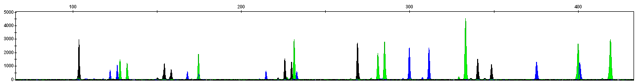
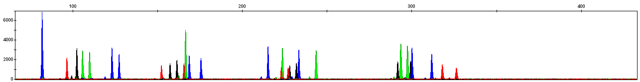
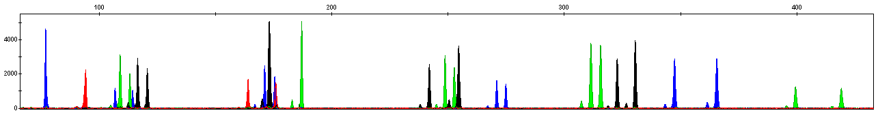
Identifiler (Applied Biosystems)
NGM SElect (Applied Biosystems)
PowerPlex 16 (Promega)
PowerPlex ESX 17 (Promega)
ESSplex (Qiagen)
Notes:
Figure 5.4
The same female DNA sample amplified with five different STR typing kits. Internal size standards are not shown. The PowerPlex 16 kit uses three fluorescent dye colors to label its PCR products while all of the other kits utilize four dyes. Figure courtesy of Becky Hill, NIST.

Slide 35
Loci |  | Amelogenin | CSF1PO | FGA | TH01 | TPOX | vWA | D3S1358 | D5S818 | D7S820 | D8S1179 | D13S317 | D16S539 | D18S51 | D21S11 | D2S1338 | D19S433 | Penta D | Penta E | D1S1656 | D2S441 | D10S1248 | D12S391 | D22S1045 | SE33
Autosomal STR Typing Kits
Applied Biosystems AmpFlSTR kits
Profiler |  | 1 | 4 | 3 | 2 | 3 | 2 | 1 | 1 | 3 |  | 2
Profiler Plus (ID) |  | 1 |  | 3 |  |  | 2 | 1 | 1 | 3 | 2 | 2 |  | 4 | 3
COfiler |  | 1 | 4 |  | 2 | 3 |  | 1 |  | 1 |  |  | 2
SGM Plus |  | 1 |  | 3 | 2 |  | 2 | 1 |  |  | 2 |  | 3 | 4 | 3 | 4 | 1
Identifiler (Direct, Plus) |  | 1 | 4 | 3 | 2 | 3 | 2 | 1 | 2 | 3 | 1 | 3 | 4 | 4 | 2 | 5 | 1
SEfiler Plus |  | 1 |  | 3 | 2 |  | 2 | 1 |  |  | 2 |  | 3 | 2 | 1 | 4 | 1 |  |  |  |  |  |  |  | 3
MiniFiler |  | 1 | 1 | 2 |  |  |  |  |  | 2 |  | 1 | 1 | 2 | 3 | 2
NGM |  | 1 |  | 4 | 3 |  | 2 | 2 |  |  | 2 |  | 3 | 4 | 3 | 4 | 2 |  |  | 3 | 1 | 1 | 4 | 1
NGM SElect |  | 1 |  | 4 | 3 |  | 2 | 2 |  |  | 2 |  | 3 | 4 | 3 | 4 | 2 |  |  | 3 | 1 | 1 | 4 | 1 | 5
Promega PowerPlex kits
PowerPlex 1.1 (1.2) |  | 3 | 5 |  | 2 | 4 | 1 |  | 1 | 3 |  | 2 | 4
PowerPlex 2.1 |  |  |  | 4 | 2 | 3 | 1 | 1 |  |  | 2 |  |  | 4 | 3 |  |  |  | 5
PowerPlex 16 (BIO, HS) |  | 1 | 5 | 5 | 2 | 4 | 2 | 1 | 1 | 3 | 3 | 2 | 4 | 4 | 3 |  |  | 6 | 5
PowerPlex S5 |  | 1 |  | 2 | 1 |  |  |  |  |  | 2 |  |  | 3
PowerPlex ES |  | 1 |  | 4 | 2 |  | 2 | 1 |  |  | 3 |  |  | 4 | 3 |  |  |  |  |  |  |  |  |  | 1
PowerPlex ESX 16 |  | 1 |  | 4 | 3 |  | 2 | 2 |  |  | 3 |  | 4 | 5 | 4 | 3 | 3 |  |  | 2 | 1 | 1 | 2 | 1
PowerPlex ESX 17 |  | 1 |  | 4 | 3 |  | 2 | 2 |  |  | 3 |  | 4 | 5 | 4 | 3 | 3 |  |  | 2 | 1 | 1 | 2 | 1 | 4
PowerPlex ESI 16 |  | 1 |  | 2 | 1 |  | 2 | 2 |  |  | 1 |  | 1 | 2 | 3 | 4 | 3 |  |  | 3 | 5 | 4 | 4 | 5
PowerPlex ESI 17 |  | 1 |  | 2 | 1 |  | 2 | 2 |  |  | 1 |  | 1 | 2 | 3 | 4 | 3 |  |  | 3 | 5 | 4 | 4 | 5 | 3
PowerPlex 18D |  | 1 | 5 | 5 | 2 | 4 | 2 | 1 | 1 | 3 | 3 | 2 | 4 | 4 | 3 | 2 | 1 | 6 | 5
Qiagen Investigator kits
ESSplex |  | 1 |  | 4 | 2 |  | 4 | 3 |  |  | 4 |  | 1 | 2 | 5 | 5 | 3 |  |  | 2 | 1 | 1 | 3 | 2
ESSplex SE |  | 1 |  | 3 | 2 |  | 4 | 3 |  |  | 4 |  | 1 | 2 | 5 | 5 | 3 |  |  | 2 | 1 | 1 | 3 | 2 | 4
Hexaplex ESS |  | 1 |  |  | 1 |  |  |  |  |  |  |  |  |  |  |  |  |  |  | 3 | 1 | 2 | 2 | 2
Nonaplex ESS |  | 1 |  | 4 | 2 |  | 4 | 3 |  |  | 2 |  |  | 1 | 5 |  |  |  |  | 2 | 1 | 1 | 3 | 2 | 3
Decaplex SE |  | 1 |  | 2 | 2 |  | 4 | 3 |  |  | 3 |  | 1 | 1 | 5 | 4 | 2 |  |  |  |  |  |  |  | 1
IDplex |  | 1 | 2 | 4 | 2 | 1 | 4 | 3 | 4 | 2 | 2 | 3 | 1 | 1 | 5 | 5 | 3
Notes:
Figure 5.5
Commercially available STR typing kits with dye labels and size positions for loci present in the kit.

Slide 36
1 2 3 4 5 6
5’-TTTCCC TCAT TCAT TCAT TCAT TCAT TCAT TCACCATGGA-3’
3’-AAAGGG AGTA AGTA AGTA AGTA AGTA AGTA AGTGGTACCT-5’
6 5 4 3 2 1
Notes:
Figure 5.6
Example of the DNA sequence in a STR repeat region. Note that using the top strand versus the bottom strand results in different repeat motifs and starting positions. In this example, the top strand has 6 TCTA repeat units while the bottom strand has 6 TGAA repeat units. Under ISFG recommendations, the top strand from GenBank should be used. Thus, this example would be described as having [TCAT] as the repeat motif. Repeat numbering, indicated above and below the sequence, proceeds in the 5’-to-3’ direction as illustrated by the arrows.

Slide 37
Notes:
Figure 5.7
Genotyping is performed through a comparison of sized peaks from PCR-amplified samples to allele size bins. These allele bins are defined with the genotyping software using size information from an allelic ladder run with each batch of samples. Any peak falling in a particular dye color and allele bin size range is designated as an allele for that locus. Peaks in both the allelic ladder and the PCR-amplified samples are sized using the same internal size standard so that they may be compared to one another.

Slide 38
6 bp deletion
X
Y
Normal
Male: X,Y
X
Y
X
Normal Female: X,X
X
Male
(AMEL Y null)
Y
Male
(AMEL X null)
Notes:
Figure 5.8
Schematic of the amelogenin sex-typing assay. The X and Y chromosomes contain a high degree of sequence homology at the amelogenin (AMEL) locus and primers, as depicted by the arrows, can target a 6 bp deletion that is present only on the X chromosome (Sullivan et al. 1993). In most circumstances, the presence of a single X peak indicates that the sample comes from a female while two peaks identifies the sample’s source as male. Both AMEL Y and AMEL X null alleles have been reported.

Slide 39
Chapter 6 – CE Instrumentation

Slide 40
Laser
Capillary filled with polymer solution
Detection window
-
+
5-20 kV
(cathode)
(anode)
Inlet
Buffer
Outlet
Buffer
Data Acquisition
Sample tray
Sample tray moves automatically beneath the cathode end of the capillary to deliver each sample in succession
Notes:
Figure 6.1 Schematic of capillary electrophoresis instruments used for DNA analysis. The capillary is a narrow glass tube approximately 50 cm long and 50 microns in diameter. It is filled with a viscous polymer solution that acts much like a gel in creating a sieving environment for DNA molecules. Samples are placed into a tray and injected onto the capillary by applying a voltage to each sample sequentially. A high voltage (e.g., 15,000 volts) is applied across the capillary after the injection in order to separate the DNA fragments in a matter of minutes. Fluorescent dye-labeled products are analyzed as they pass by the detection window and are excited by a laser beam. Computerized data acquisition enables rapid analysis and digital storage of separation results.

Slide 41

Argon ion LASER (488 nm)
Steps in STR Typing with ABI 310/3100
Size
Separation
ABI Prism spectrograph
Color
Separation
Fluorescence
Sample Separation
Capillary
(filled with polymer solution)
CCD Panel (with virtual filters)
Sample Detection
Sample Injection
Processing with GeneMapperID software
Mixture of dye-labeled PCR products from multiplex PCR reaction
Sample Preparation
Sample Interpretation
Notes:
Figure 6.2 Schematic illustration of the separation and detection of STR alleles with an ABI Prism 310 Genetic Analyzer.

Slide 42
(a)
(b)
Multi-Capillary
Electrode Configuration
Capillary
Electrode
-
DNA⁻
-
PCR products in formamide
or water
DNA⁻
Sample Tube
Notes:
Figure 6.3 Comparison of capillary and electrode configurations with (a) single capillary ABI 310 and (b) multi-capillary systems. In (a) the electrode is adjacent to the capillary and in (b) the electrode surrounds the capillary.

Slide 43
Electrophoretic flow
+
+
+
+
+
+
+
+
+
+
+
+
+
+
+
-
DNA⁻
+
EOF Bulk Flow
DNA⁻
DNA⁻
+
+
+
+
+
+
+
+
+
+
+
+
+
+
+
Capillary Wall
SiOH
SiO- + H⁺
Electroosmotic flow (EOF)
Notes:
Figure 6.4 Illustration of internal capillary environment and forces at play with moving DNA molecules through a sieving polymer buffer.

Slide 44
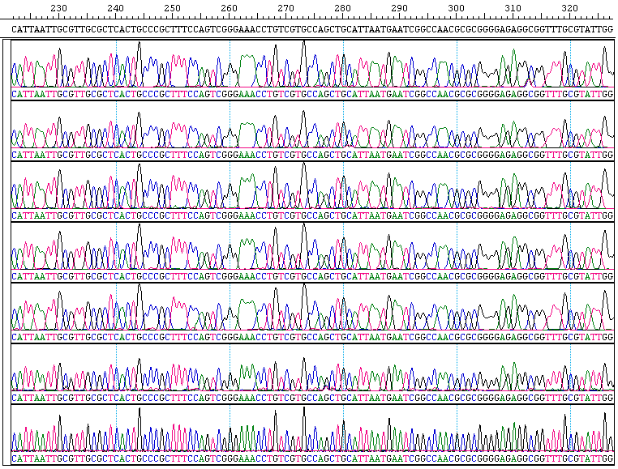
(a)
(b)
(c)
Notes:
Figure 6.5 Impact of capillary length and polymer concentration on obtaining single base resolution in DNA sequencing. (a) POP-4 with 36 cm ABI 310 capillary (20 minute run time); (b) POP-6 with 50 cm ABI 310 capillary (120 minute run time); (c) POP-7 with 80 cm ABI 3130xl array (120 minute run time). Data courtesy of Tomohiro Takayama (NIST Japanese guest researcher).

Slide 45
CCD Detector
Diffraction Grating
Focusing Mirror
Re-imaging Lens
Long Pass Filter
Argon-Ion Laser
(488/514 nm)
Capillary Holder
Capillary
Laser Shutters
Microscope Objective Lens
Laser Filter
Diverging Lens
Dichroic Mirror
Notes:
45
Figure 6.6 Optics in ABI 310 Genetic Analyzer. Argon ion laser with 488 nm and 514.5 nm light (blue line) excites fluorophores passing through the capillary (green circle). Emitted light is projected through lens, mirrors, and filters to a diffraction grating that spreads the wavelengths of light and then to a charged-coupled device (CCD) detector that simultaneously detects all wavelengths from 525 nm to 680 nm. Image adapted from Watts (1998). Figure courtesy of Bruce McCord, Florida International University.

Slide 46
LASER Excitation (488 nm)
LASER Excitation (488 nm)
LASER Excitation (488 nm)
Capillary Array
Side irradiation (on-capillary)
Fixed laser, moving capillaries
Sheath flow detection
ABI 3100, 3130, 3100Avant
ABI 3700
MegaBACE
Notes:
Figure 6.7 Different strategies for fluorescence excitation and detection with capillary array systems. The excitation beam is actually split and brought into both sides of the array with the 3100.

Slide 47
Visible spectrum range seen in CCD camera
500
525
550
575
600
625
650
675
700 nm
(a)
HEX
NED
PET
ROX
LIZ
FL
TET
JOE
TMR
FAM
VIC
(b)
Filter A
Filter C
Filter F
Filter G5
Notes:
Figure 6.8 (a) Commonly used fluorescent dyes in STR typing kits shown by color with their spectral emission maxima (arrows). (b) Virtual filter sets used in the ABI 310 determine from which regions of the CCD camera visible light is collected for data interpretation.

Slide 48
5-FAM
JOE
NED
ROX
100
80
60
Normalized Fluorescent Intensity
40
20
0
520
540
560
580
600
620
640
WAVELENGTH (nm)
310 Filter Set F
with color contributions
Laser excitation
(488, 514.5 nm)
Notes:
Figure 6.9 Fluorescent emission spectra of ABI dyes used with AmpFlSTR kits. ABI 310 Filter Set F is represented by the 4 boxes centered on each of the 4 dye spectra. Each dye filter contains color contributions from adjacent overlapping dyes that must be removed by a matrix deconvolution. The dyes are excited by an argon ion laser, which emits light at 488 and 514.5 nm.

Slide 49
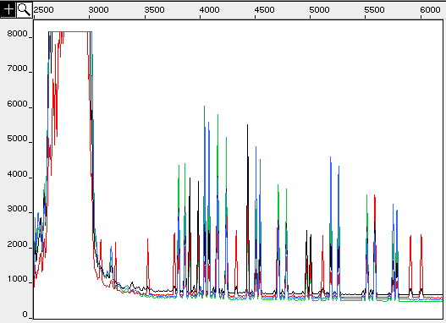
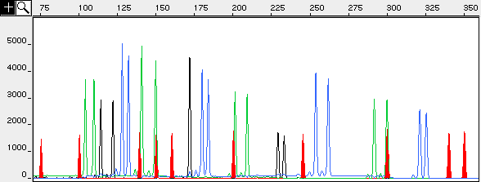
(a)
Primer peak
Scan number
Region shown below
Relative Fluorescence Units
(b)
DNA size in base pairs
Relative Fluorescence Units
Notes:
Figure 6.10 STR data from ABI Prism 310 Genetic Analyzer. This sample was amplified with the AmpFlSTR SGM Plus kit. Raw data prior to color separation (a) compared with GeneScan 3.1 color separated allele peaks (b). The red-labeled peaks are from the internal sizing standard GS500-ROX.

Slide 50

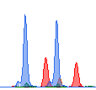
(a)
(b)
ABI 3100
Data Collection v1.0.1
ABI 3130xl
Data Collection v3.0
Notes:
Figure 6.11 A portion of the same Identifiler DNA profile analyzed using different ABI 3100 and 3130xl data collection versions. The relative peak height differences (y-axis) are due to ‘variable binning’ with newer ABI data collection versions that increase the amount of emitted light collected from the red dye region to improve the balance between the color channels in a DNA profile. The difference in STR allele relative mobilities as exhibited by the relative peak positions (x-axis) in this particular example are due to using different polymers for separation (POP-6 with the ABI 3100 and POP-7 with the ABI 3130xl).

Slide 51
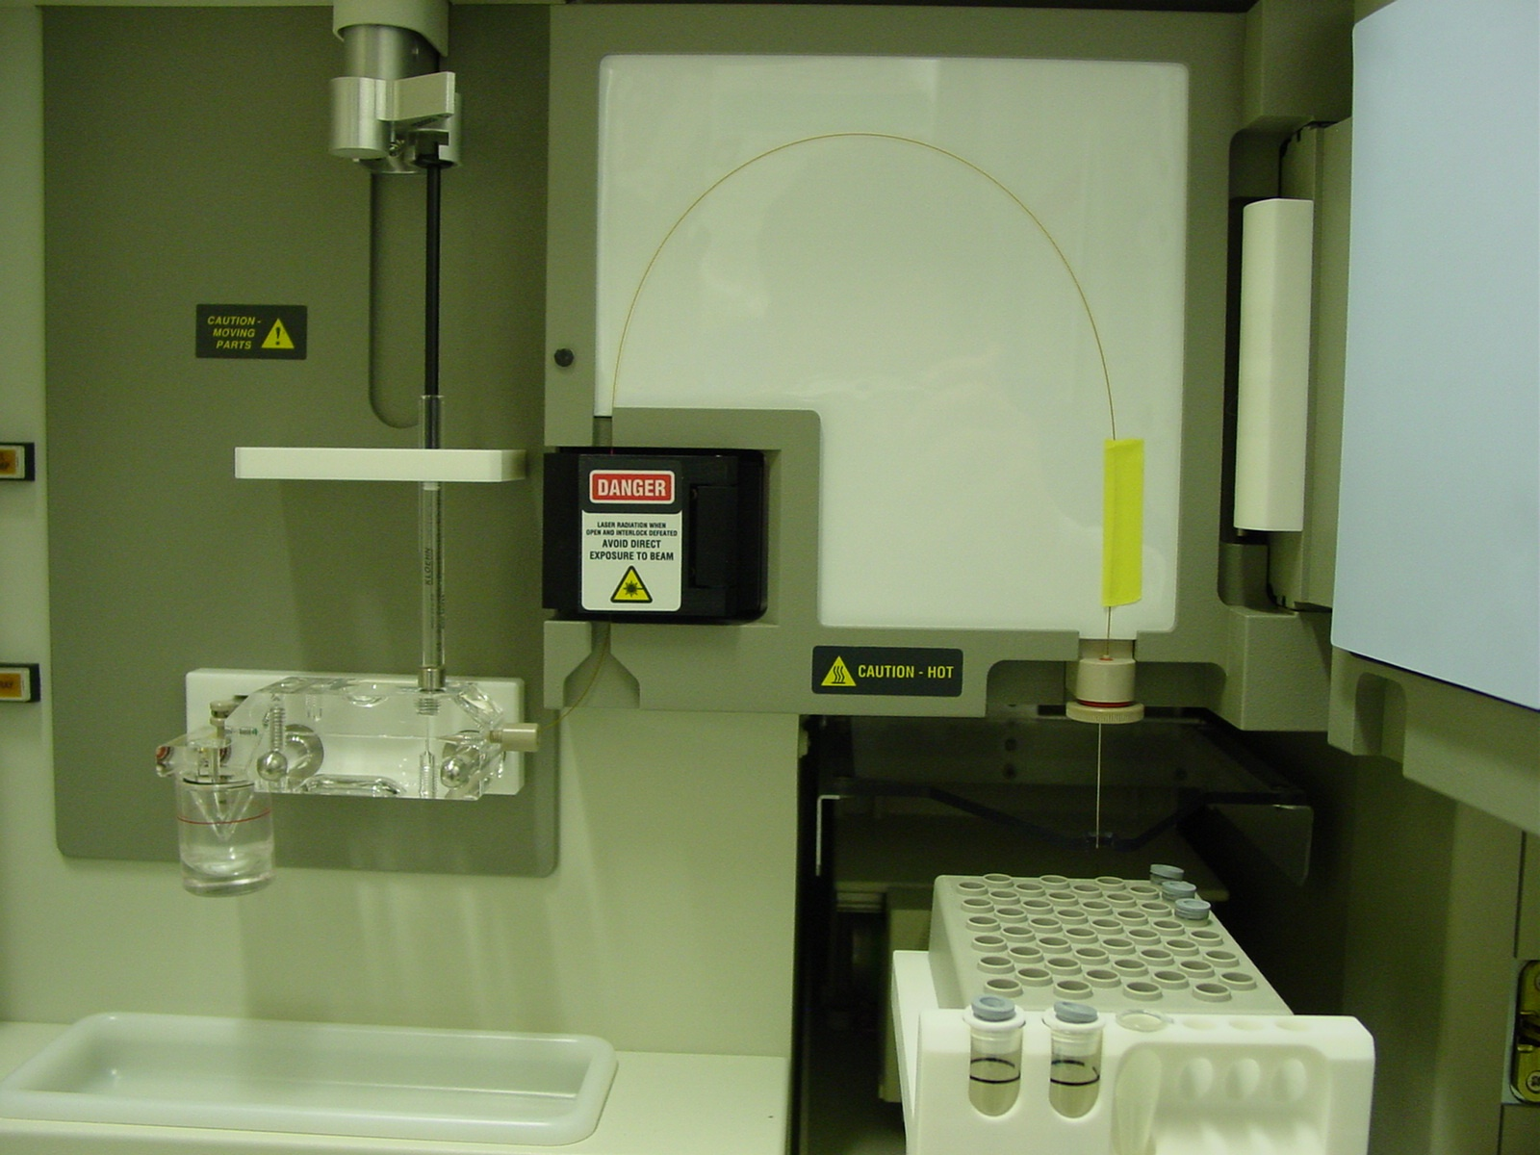
Capillary
Detection window
Heat plate
Syringe
(with polymer)
Gel block
electrode
Samples
Outlet buffer reservoir
Inlet buffer reservoir
Sample tray
Autosampler
Notes:
Figure 6.12 Photograph of ABI Prism 310 Genetic Analyzer with a single capillary.

Slide 52
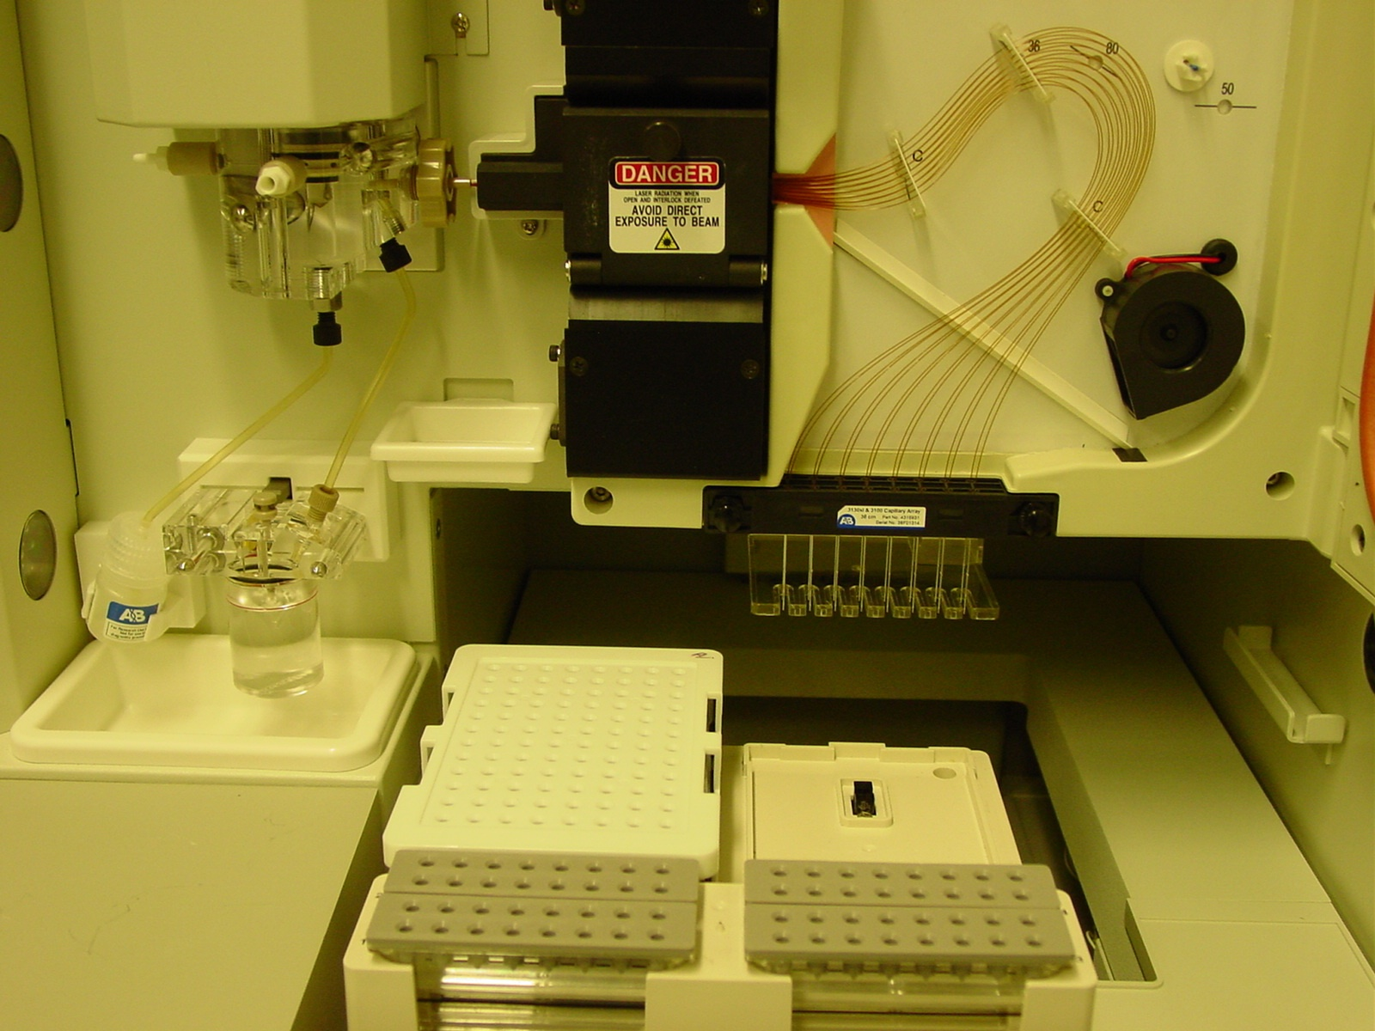
Mechanical pump
(with polymer)
Detection window
Capillary
array
Oven
Lower gel block
Fan
electrodes
Polymer bottle
Outlet buffer reservoir
Sample tray
Autosampler
Inlet buffer reservoir
Notes:
Figure 6.13 Photograph of ABI 3130xl Genetic Analyzer with a 16-capillary array.

Slide 53
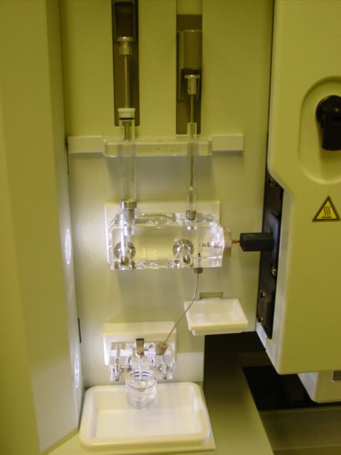
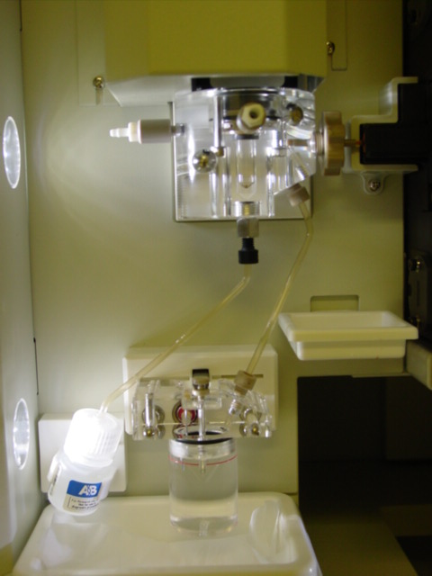
(a) ABI 3100
(b) ABI 3130xl
Mechanical pump
(for polymer delivery)
Dual syringes
(for polymer delivery)
Polymer bottle
Outlet buffer reservoir
Outlet buffer reservoir
Notes:
Figure 6.14 (a) ABI 3100 syringe used to fill 16-capillary array. (b) ABI 3130xl mechanical pump used for polymer delivery from bottle

Slide 54
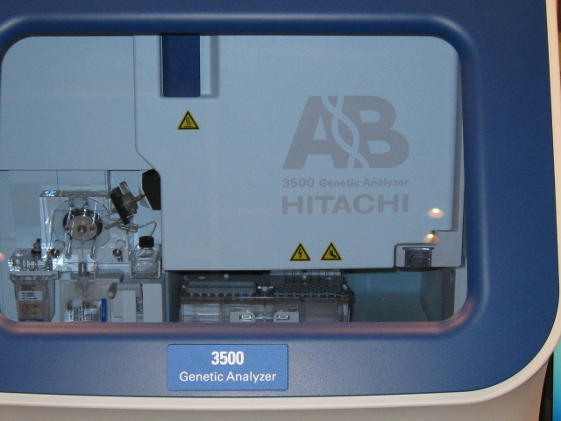
Oven door
Mechanical pump
(with polymer)
Capillary array (behind oven door)
Autosampler
Inlet buffer reservoir
Outlet buffer reservoir (with RFID)
Polymer pack
Notes:
Figure 6.15 Photograph of ABI 3500 Genetic Analyzer (8-capillary array not shown).

Slide 55
S’₁
2
S₁
energy
hν_{ex}
1
hν_{em}
3
S_{o}
Excitation
Emission
Stokes shift
1
3
Fluorescence
λ_{ex max}
λ_{em max}
Wavelength (nm)
Notes:
Box 6.2
Illustration of the fluorescence process (a) and excitation/emission spectra (b). In the first step of the fluorescence process, a photon (hνex) from a laser source excites the fluorophore (dye molecule) from its ground energy state (So) to an excited transition state (S’1). The fluorophore then undergoes conformational changes and interacts with its environment resulting in the relaxed singlet excitation state (S1). During the final step of the process, a photon (hνem) is emitted at a lower energy. Because energy and wavelength are inversely related to one another, the emission photon has a higher wavelength than the excitation photon.

Slide 56
Chapter 7 – Validation and QA

Slide 57
3 | 4.30
4 | 3.18
5 | 2.78
6 | 2.57
7 | 2.45
8 | 2.36
9 | 2.31
10 | 2.26
50 | 2.01
100 | 1.98
500 | 1.96
10000 | 1.96
infinity | 1.96
Notes:
Figure 7.1 Student’s t-test curve showing impact of the number of experiments on capturing variability in a population of data. Five replicate experiments works well as a minimum sample number because there are diminishing returns with each successive experiment.

Slide 58
PCR primer set 1
PCR primer set 2
*
allele a
STR repeat region
PCR primer set 1
PCR primer set 2
PCR primer set 1
PCR primer set 2
allele b
STR repeat region
PCR primer set 1
PCR primer set 2
*
If no primer binding site mutations
If a primer binding site mutation ( )exists
a
b
a
a
b
b
b
≠
=
Set 1 Amplicons
Set 2 Amplicons
Set 1 Amplicons
Set 2 Amplicons
Notes:
Figure 7.2 When different PCR primer sets are utilized to amplify the same genetic marker, sequence variability in the primer binding regions (represented as an asterisk upstream of the STR repeat region in allele a) could cause one of the primers to not fully anneal to the DNA template. In this case, PCR could fail to amplify this DNA target and result in allele drop-out that reproducibly impacts one set of primers but not another.

Slide 59
Chapter 8 – DNA Databases

Slide 60
National Level
NDIS
(FBI Laboratory)
State Level
SDIS
(Tallahassee, Florida)
SDIS
(Richmond, Virginia)
Local
Level
LDIS
(Tampa)
LDIS
(Orlando)
LDIS
(Roanoke)
LDIS
(Norfolk)
LDIS
(Broward County)
LDIS
(Fairfax)
Notes:
Figure 8.1 Schematic of the three tiers in the Combined DNA Index System (CODIS). DNA profile information begins at the local level, or Local DNA Index System (LDIS), and then can be uploaded to the state level, or State DNA Index System (SDIS), and finally to the national level, or National DNA Index System (NDIS). Each local or state laboratory maintains its portion of CODIS while the FBI Laboratory maintains the national portion (NDIS).

Slide 61
Primary Searches Conducted
1b
‘Offender Hit’
New offender profiles
Crime Profiles (C)
Offenders Profiles (N)
Forensic Index
2
New crime profiles
Offender Index
‘Forensic Hit’
1a
‘Offender Hit’
Notes:
Figure 8.2 Primary searches conducted with the three largest indices of the U.S. national DNA database. (1) ‘Offender hit’ produced by conducting a search of offenders against the crime scene samples present in the forensic index. (2) ‘Forensic hit’ from searching DNA profiles in the forensic index against other crime scene profiles looking for serial crimes. (3) Arrestee search against forensic index—usually classified as ‘offender hit’.

Slide 62
Number of Comparisons
Crime scene
profile
Suspect
profile
(a)
one-to-one
1
1
1
Crime scene
profile
Offender index
1
1
(b)
2
one-to-many
3
N
4
N
Forensic index
Offender index
(c)
1
1
many-to-many
(between indices)
2
2
C x N
3
3
C
4
N
7
N
Offender index
(d)
all-to-all
(within indices)
6
1
N x (N-1)
2
5
2
4
3
Notes:
Figure 8.3 Illustration of various types and numbers of comparisons that may be performed in forensic DNA analysis with each dot representing a DNA profile: ranging from (a) a crime scene to suspect one-to-one comparison, (b) a ‘keyboard search’ with one-to-many, (c) the typical database search between two indices containing C and N profiles, and (d) an all-to-all ‘Arizona search’ within an index for quality control purposes.

Slide 63
Possible scenarios for extending sets of genetic markers to be used in national DNA databases
Core set of markers
(e.g., CODIS 13 STRs)
Past and Present
(a)
(b)
Future
(c)
(d)
Notes:
Figure 8.4 Possible scenarios for extending sets of genetic markers to be used in national DNA databases. (a) A core set of markers have been established for past and present DNA profiles now numbering in some cases in the millions of profiles (e.g., in the U.S., 13 CODIS core STR loci). Three future scenarios exist: (b) keep all of the current core loci and add some additional supplemental loci (e.g., Identifiler or PowerPlex 16 add two additional STRs), (c) only retain some of the current core loci and add more additional supplemental loci, or (d) abandon the previous genetic markers and have no overlap with current core loci.

Slide 64
Chapter 9 – Missing persons & mass disasters

Slide 65
4
Confirmation of relatives and MP relationship
MP Index
UHR Index
Relatives Index
Personal Effects from Missing Persons (MP)
Unidentified Human Remains (UHR)
Biological Relatives of Missing Persons
1
2
3
Re-association of remains
Searching for Kinship Association
Searching for Direct Match
Notes:
Figure 9.1 Searches conducted with missing persons DNA databases.

Slide 66
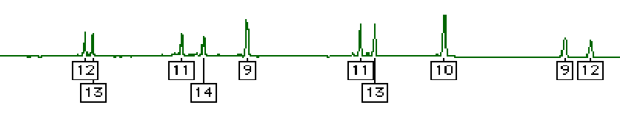
(a) Direct comparison
D7S820
CSF1PO
DNA profile from
mass disaster victim
D5S818
D13S317
D16S539
Penta D
DNA profile from
direct reference
(toothbrush believed to have belonged to the victim)
(b) Kinship analysis
victim
D5S818
D13S317
D7S820
D16S539
CSF1PO
Penta D
?
wife
11,13
8,12
8,12
8,9
10,12
8,10
wife
son
11,13
8,14
8,9
9,13
10,10
9,10
son
Predicted victim profile
victim (father)
11,? or ?,13
?,14
9,?
?,13
?,10
9,?
mass disaster victim profile
12,13
11,14
9,9
11,13
10,10
9,12
actual profile
Figure 24.1, J.M. Butler (2005) Forensic DNA Typing, 2nd Edition © 2005 Elsevier Academic Press
Notes:
Figure 9.2 Example demonstrating the use of reference samples in mass disaster victim identification using DNA typing. (A) Direct comparison involves analysis of a direct reference sample from some kind of personal effect of the victim. (B) Kinship analysis utilizes close biological relatives, such as those illustrated in Figure 24.2, to reconstruct a victim’s DNA profile.

Slide 67
Grandmother
Aunt
Uncle
Mother
Father
Cousin
Spouse
Sister
Brother
Missing Individual
Niece
Nephew
Son
Daughter
Figure 24.2, J.M. Butler (2005) Forensic DNA Typing, 2nd Edition © 2005 Elsevier Academic Press
Notes:
Figure 9.3 Direct biological relatives that can provide valuable reference samples for aiding identification of the missing individual. Ideally samples are available from multiple relatives to help establish robust kinship. A sample from a spouse is only valuable in connection with a child’s sample in order to determine the expected alleles coming from the missing individual. Of course, more extended family members, with direct maternal or paternal linkage, can provide helpful samples when mitochondrial DNA or Y-chromosome testing is performed. Samples that would be valuable for the maternally transmitted mitochondrial DNA are indicated in dashed boxes.

Slide 68
Collections using FTA paper
(from 22 countries)
229 VICTIMS
310 Relative Reference Samples
1277 crash scene samples
9 STR loci typed (Profiler Plus)
89 Personal Effects
9 STR loci tested (Profiler Plus)
4 additional STR loci tested (COfiler)
Sorted groups
RELATIONAL DATABASE
Database query
4 additional
STR loci tested (COfiler)
Identification of 229 victims
Figure 24.3, J.M. Butler (2005) Forensic DNA Typing, 2nd Edition © 2005 Elsevier Academic Press
Notes:
Figure 9.4 Strategy for disaster victim identification in the Swissair Flight 111 crash scene investigation. Most samples were tested with 9 STRs and amelogenin using the AmpFlSTR Profiler Plus kit and then 4 additional STRs were added with the COfiler kit as needed to obtain a higher power of discrimination between closely related individuals. The relational database compared genotypes of 1277 crash scene samples to genotypes of all 229 victims and family relatives, a total of 71,490 genotype comparisons (Leclair et al. 1999).

Slide 69
(a) Material Flow
NYSP
(Albany)
OCME
Myriad
Bode
Orchid
Cellmark
Celera
Extract
Swab
Personal Effect
Bone
Tissue
Notes:
Figure 9.5 Illustration of (a) material and (b) data flow between laboratories involved in processing World Trade Center samples. Laboratories included Office of the Chief Medical Examiner (OCME, New York City), New York State Police (NYSP, Albany, NY), Myriad Genetics (Salt Lake City, UT), Orchid Cellmark (Dallas, TX), Celera Genomics (Rockville, MD), and Bode Technology Group (Springfield, VA). Physical materials shipped between laboratories included DNA extracts (solid red line), buccal swabs from biological relative reference samples (dashed red line), personal effects (dotted red line), recovered bones (solid blue line), and recovered tissue (dashed blue line). Note that most of the DNA samples were extracted at the NYSP and OCME laboratories although some tissue and bone were shipped directly to Myriad and Bode. All bones were extracted at Bode. Figure courtesy of National Institute of Justice World Trade Center Kinship and Data Analysis Panel and New York City Office of the Chief Medical Examiner.

Slide 70
(b) Data Flow
NYSP
(Albany)
OCME
Myriad
Bode
Orchid
Cellmark
Celera
QC
Check
QC
Check
WTC CODIS
M-FISys
Notes:
Figure 9.5 (cont.) SEE PREVIOUS SLIDE FOR FIGURE CAPTION

Slide 71
Chapter 10 – DNA Degradation

Slide 72
Size of Intact
DNA Molecules Needed (bp)
RFLP
1000
D1S80
500
STRs
100
miniSTRs
50
mtDNA
Various DNA Tests
Notes:
Figure 10.1 Illustration of required DNA fragment sizes for various DNA tests.

Slide 73


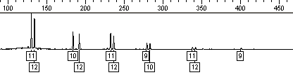
(a)
Agarose yield gel results
High relative molecular mass DNA in a tight band
Smear of degraded DNA fragments
Good quality DNA
Degraded DNA
(b)
Degraded DNA sample
D5S818
D13S317
D7S820
D16S539
Penta D
CSF1PO
Notes:
Figure 10.2 Impact of degraded DNA on (a) agarose yield gel results and (b) STR typing. (a) Degraded DNA is broken up into small pieces that appear as a smear on a scanned yield gel compared to good-quality DNA possessing intact high relative molecular mass DNA. (b) Signal strength is generally lost with larger-size PCR products when STR typing is performed on degraded DNA, such as is shown from the green dye-labeled loci in the PowerPlex 16 kit. Thus, 180bp D13S317 PCR products have a higher signal than 400 bp Penta D amplicons because more DNA molecules are intact in the 200 bp versus the 400 bp size range.

Slide 74
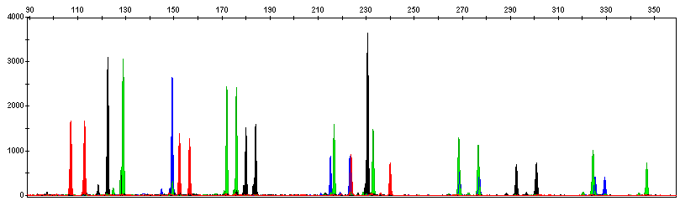
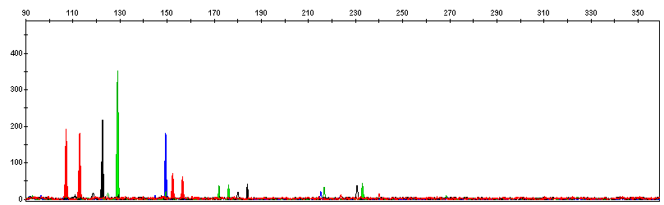
DNA size (bp) relative to an internal size standard (not shown)
(a)
Full Profile (Good Quality)
Relative fluorescence units (RFUs)
(b)
Partial Profile (Poor Quality)
Notes:
Figure 10.3 A comparison of DNA profiles originating from the same biological source but of different qualities. (a) Intact, good quality DNA yields a full profile. (b) Degraded, poor-quality DNA yields a partial profile with only the lower size PCR products producing detectable signal. With the degraded DNA sample shown in (b), information is lost at the larger sized STR loci. Also note the lower relative fluorescence units with the poor quality partial profile in (b). Figure courtesy of Margaret Kline, NIST.

Slide 75
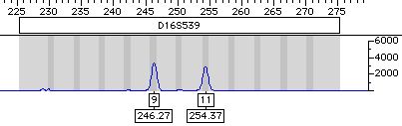
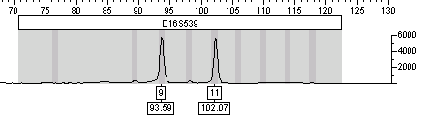
(a)
Conventional PCR primer
miniSTR primer
STR repeat region
miniSTR primer
Conventional PCR primer
(b)
Conventional STR test (COfiler kit)
MiniSTR assay (using Butler et al. 2003 primers)
150 bp smaller
Notes:
Figure 10.4 (a) MiniSTRs, or reduced sized amplicons for STR typing, are created by designing PCR primers that anneal closer to the repeat region than conventional STR kit primers. (b) PCR product sizes, such as demonstrated here with D16S539, can be reduced by over 150 bp relative to conventional tests. MiniSTR assays can produce the same typing result as those from larger STR amplicons produced by kits often with greater success on degraded DNA samples.

Slide 76
Chapter 11 – Low-level DNA

Slide 77
Off-scale data
(leads to artifacts)
DNA amount
(log scale)
10 ng
Optimal data
1 ng
Allele drop-out
0.1 ng
Allele imbalance
(100 pg)
Locus drop-out
Allele drop-in
0.01 ng
(10 pg)
28 cycles
31 cycles
34 cycles
Detection Sensitivity
Notes:
Figure 11.1 Illustration of hypothetical results at a heterozygous locus (two alleles expected in each box) with various levels of input DNA and detection sensitivity that is modulated through increasing the number of PCR cycles. Note that off-scale data occurs with lower amounts of DNA as the detection sensitivity is increased.

Slide 78
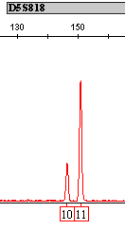
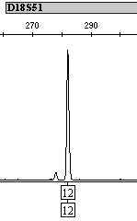
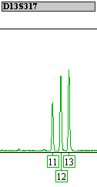
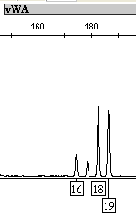
Severe
Peak Imbalance
Allelic
Drop-out
High
Stutter
Allelic
Drop-in
30% peak height ratio
64%
stutter
16 allele drop-in
14 allele
drop-out
Identifiler, 30 pg DNA, 31 cycles
Identifiler, 30 pg DNA, 31 cycles
Identifiler, 10 pg DNA, 31 cycles
Identifiler, 10 pg DNA, 31 cycles
Correct genotype:
10,11
12,14
12,13
18,19
Notes:
Figure 11.2 Stochastic effects that randomly occur when PCR amplifying low amounts of DNA using an increased number of PCR cycles. The STR typing kit, amount of DNA, and number of PCR cycles along with the correct genotype for each example are listed at the bottom. For further information on these samples, see http://www.cstl.nist.gov/biotech/strbase/LTDNA.htm.

Slide 79
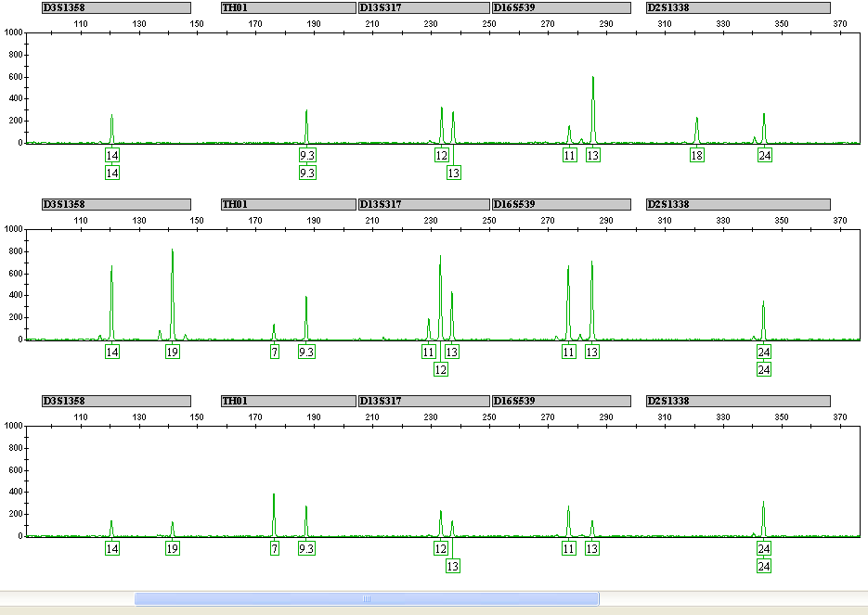
Replicate #1
Replicate #2
High stutter
Replicate #3
Consensus Profile:
14,19
7,9.3
12,13
11,13
24,Z
Correct Profile:
14,19
7,9.3
12,13
11,13
18,24
Notes:
Figure 11.3 Three replicate PCR amplifications of a 10 pg single source DNA template using the Identifiler kit (only green loci shown) and 31 cycles. The consensus profile, produced by recording all alleles that occurred at least two out of three times, matched the correct profile (note that the consensus wildcard “Z” for D2S1338 appropriately covers the allele 18 that has drop-out twice). The red arrows indicate positions of allele dropout and the blue arrows where severe peak height imbalance was observed.

Slide 80
Replicate Amplification with Consensus Profile
Single Amplification
Low amount of DNA examined
Low amount of DNA examined
Stochastic effects
Stochastic effects
Amplification #1
Amplification #2
Amplification #3
Amplification #1
(only a single test)
Consensus Profile Developed
(from repeated alleles observed)
Result can be Unreliable
Interpretation Rules Applied (based on validation experience) e.g., specific loci may dropout more
Result can be and usually is Reliable & Reproducible
Notes:
Figure 11.4 Comparison of approaches when examining low amounts of DNA. Replicate amplification with development of consensus profiles and application of interpretation rules based on validation experience can lead to reliable results.

Slide 81
28 Cycles
31 Cycles
10 pg
10 pg
30 pg
30 pg
100 pg
100 pg
Notes:
Figure 11.5 Sensitivity and performance summaries for Identifiler replicates with 28 cycle (standard) and 31 cycle (enhanced) data. A horizontal slice represents information from a single sample whereas a vertical slice represents the results from each of 10 replicates with the three different DNA template amounts. Green squares indicate that the full correct type was observed for that locus and PCR replicate. Yellow squares denote allele drop-out where one of the expected alleles is missing. Red squares highlight locus dropout where both expected alleles are missing. Black squares indicate allele drop-in where an incorrect allele is observed above a 50 RFU (relative fluorescence unit) analytical threshold.

Slide 82
Chapter 12 – SNPs and AIMs

Slide 83
Protocol Steps for Allele-Specific Primer Extension SNP Assay
Genomic DNA sample
(Multiplex) PCR
ExoSAP Digestion
Amplification
Add SNP primer(s) and SNaPshot mix
SNP Extension (cycle sequencing)
SAP treatment
Primer Extension
Sample prep for 310/3100
Run on ABI 310/3100
Data Analysis (GeneScan)
Analysis
Add GS120 LIZ size standard
Use E5 filter (5-dye) and POP4 standard conditions
Type Sample (Genotyper or GeneMapperID)
Notes:
Figure 12.1 Steps in allele-specific primer extension SNP detection (e.g., minisequencing or SNaPshot) assay. The boxed portions illustrate additional steps performed in this assay relative to STR typing.

Slide 84
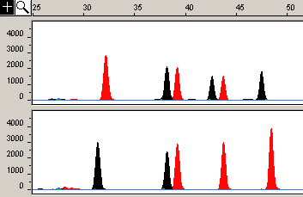
(a)
Sample 1
TT
CT
CT
CC
Sample 2
TT
TT
CC
CT
(b)
(TTTTT)–primer1(chromosome 20)-ddT/ddT
(TTTTT)–(TTTTT)-primer2(chromosome 6)-ddC/ddT
(TTTTT)–(TTTTT)–(TTTTT)-primer3(chromosome 14)-ddC/ddT
(TTTTT)–(TTTTT)–(TTTTT)–(TTTTT)-primer4(chromosome 1)-ddC/ddC
Notes:
Figure 12.2 Allele-specific primer extension results using four autosomal SNP markers on two different samples (a). SNP loci are from separate chromosomes (1, 6, 14, and 20) and therefore unlinked. Electrophoretic resolution of the SNP primer extension products occurs due to poly-T tails that are 5 nucleotides different from one another (B).

Slide 85
Chapter 13 – Y-chromosome

Slide 86
Lineage Markers
Autosomal
(passed on in part,
from all ancestors)
Y-Chromosome
(passed on complete, but only by sons)
Mitochondrial
(passed on complete,
but only by daughters)
Notes:
Figure 13.1 Illustration of inheritance patterns from recombining autosomal genetic markers and the lineage markers from the Y-chromosome and mitochondrial DNA.

Slide 87
Female-Male Mixture Performance with Autosomal vs. Y-Chromosome DNA Markers
Female Victim DNA Profile
No signal observed
Male Perpetrator DNA Profile
DNA Profile from Crime Scene
Autosomal STR
Profile
Y-Chromosome STR Profile
Notes:
Figure 13.2 Schematic illustrating the types of autosomal or Y-STR profiles that might be observed with sexual assault evidence where mixtures of high amounts of female DNA may mask the STR profile of the perpetrator. In some cases, Y-STR testing permits isolation of the male component without having to perform a differential lysis.

Slide 88
uncle
3rd cousin
?
Notes:
Figure 13.3 An example pedigree showing patrilineal inheritance where all shaded males have the same Y-chromosome barring any mutations. To help identify the person in question, any of the other males with the same patrilineage could provide a reference sample to assist in a missing persons investigation, mass disaster victim identification, or deficient paternity test (boxed region) where the father is deceased or not available for testing.

Slide 89
(a)
X
154 Mb
recombination
recombination
Y
50 Mb
Pseudoautosomal Region 1 (PAR1)
Non-Recombining
Portion of Y Chromosome
(NRY)
Pseudoautosomal Region 2 (PAR2)
Male-specific region of the Y (MSY)
(b)
Yp
Yq
centromere
Euchromatic region
(23 Mb)
Heterochromatic region (not sequenced)
~30 Mb
Notes:
Figure 13.4 (a) Schematic of X and Y sex chromosomes. The two tips of the Y-chromosome known as the pseudoautosomal region 1 (PAR1) and 2 (PAR2) recombine with the tips of the X-chromosome. The remaining 95% of the Y-chromosome is referred to as the non-recombining portion of the Y-chromosome (NRY) or male-specific region of the Y (MSY). (b) The Y-chromosome is composed of both euchromatic and heterochromatic regions of which only the 23 megabases of euchromatin has been sequenced.

Slide 90
(a)
DYS385 a/b
Multi-Copy (Duplicated) Marker
R primer
R primer
a
b
F primer
F primer
Duplicated regions are 40,775 bp apart and facing away from each other
a = b
a ≠ b
(b)
DYS389 I/II
Single Region but Two PCR Products (because forward primers bind twice)
I
II
DYS389I
DYS389II
F primer
F primer
R primer
Notes:
Figure 13.5 Schematic illustration of how multiple PCR primer binding sites give rise to multi-copy PCR products for (A) DYS385 a/b and (B) DYS389I/II. Arrows represent either forward “F” or reverse “R” primers. In the case of DYS385 a/b, the entire region around the STR repeat is duplicated and spaced about 40,775 bp apart on the long arm of the Y-chromosome. Thus, amplification with a single set of primers gives rise to one peak if the “a” repeat region is equal in size to the “b” repeat region or separate peaks if “a” and “b” differ in length. DYS389 possess two primary repeat regions that are flanked on one side by a similar sequence. Widely used forward primers bind adjacent to both repeats generating amplicons that differ in size by ~120 bp. Note that DYS389II is inclusive of the DYS389I repeat region and therefore some analyses subtract DYS389II-DYS389I repeats.

Slide 91
Y
Mb
PAR1
DYS393
p
5
DYS456
AMEL Y
DYS458
DYS635
centromere
10
DYS19
DYS437
DYS391
DYS439
q
15
DYS390
DYS389I/II
GATA-H4
DYS438
20
DYS385a
DYS385b
DYS392
25
DYS448
heterochromatin
30
PAR2
Notes:
Figure 13.6 Relative positions of 17 Y-STR loci commonly used in ChrY testing. DYS458 is closest to amelogenin (AMEL Y) and thus may be lost with AMEL Y null alleles due to deletion of that portion of ChrY.

Slide 92
(a)
PowerPlex Y
100 bp
200 bp
300 bp
400 bp
FL
DYS391
DYS389I
DYS439
DYS389II
JOE
DYS438
DYS437
DYS19
DYS392
TMR
DYS393
DYS390
DYS385a/b
(b)
AmpFlSTR Yfiler
100 bp
200 bp
300 bp
400 bp
6-FAM
DYS456
DYS389I
DYS390
DYS389II
VIC
DYS458
DYS19
DYS385a/b
NED
DYS393
DYS391
DYS439
DYS635
DYS392
PET
H4
DYS437
DYS438
DYS448
Notes:
Figure 13.7 Comparison of relative size ranges and fluorescent dye labels for Y-STR loci present in (a) PowerPlex Y from Promega Corporation and (b) Yfiler from Applied Biosystems. The highlighted locus boxes are those additional loci included in the multiplex beyond the SWGDAM-recommended set.

Slide 93
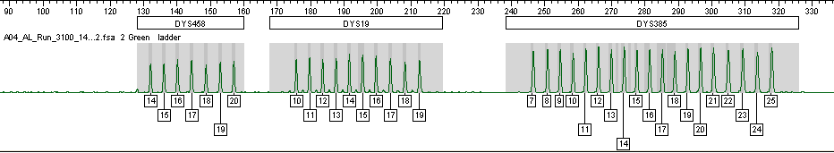
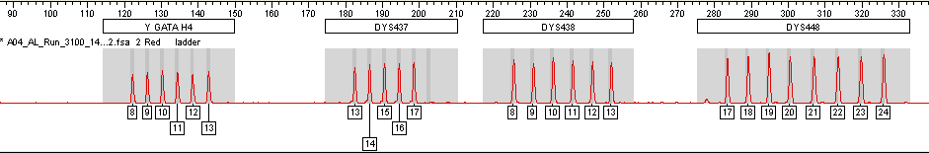
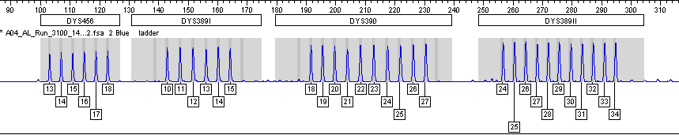
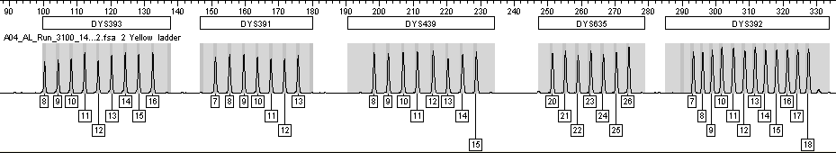
Notes:
Figure 13.8 Yfiler kit allelic ladders.

Slide 94
(a)
ATCTATCTTGAATTAATAGATTCAAGGTGATAGATATACAGATAGATAGATACATAGGTGGAGACAGATAGATGATAAATAGAAGATAGATAGATAGATAGATAGATAGATAGATAGATAGATAGATAGATAGATAGATA
(b)
9-14
[GATA]
(c)
2
3
1
1
9-14
[GATA]
[GATA]
[GATA]
[GATA]
[GATA]
N₄
N₁₄
N₃
N₇
16-21
(d)
9-14
2
2
3
2
[ATCT]
[GATA]
[AGAT]
[AGAT]
[AGAT]
N₂₀
N₃
N₁₄
N₁₀
18-23
Notes:
Figure 13.9 Various published allele nomenclatures for DYS439. (a) Sequence from DYS439 spanning the repeat regions used in the various nomenclatures; (b) Schematic of allele designation by Ayub et al. 2000—repeat range is 9-14; (c) Schematic of allele designation by Grignani et al. 2000—repeat range is 16-21; (d) Schematic of allele designation by Gonzalez-Neira et al. 2001—repeat range is 18-23. The most widely accepted designation and what is used in commercial Y-STR kits is (b)--that of Ayub et al. 2000.

Slide 95
YHRD
US Y-STR
http://www.yhrd.org
http://www.usystrdatabase.org
Release 35
Release 2.4
710 Populations (106 countries)
91601 samples
6885 Caucasian (US, Canada, Europe)
6286 African American
3397 Hispanic
983 Native American (Apache, Navajo, Shoshone, Sioux)
996 Asian (Chinese, Filipino, Oriental, S. Indian, Vietnamese)
89804 samples
9 MHL
62548 samples
11 SWGDAM
# Samples in Database
42277 samples
# Samples in Database
12 PPY
30300 samples
17 Yfiler
18547 samples
11 SWGDAM
15223 samples
12 PPY
8376 samples
17 Yfiler
# Loci in Haplotype
# Loci in Haplotype
Notes:
Figure 13.10 Comparison of two forensic Y-STR haplotype databases illustrating numbers of samples with various sets of Y-STR markers (as of January 2011).

Slide 96
M42
M91
M168
M60
M89
YAP
M9
RPS4Y (M130)
12f2
M201
M170
M45
M52
M174
M96
M172
M5
M207
M2
M11
M175
LLY22g
M173
P36
P25
M269
A
B
C
D
E
E3a
F*
G
H
I
J
J2
K*
L
M
N
O
P*
Q
R
R1
R1b
R1b3
Notes:
Figure 13.11 Y Chromosome Consortium Tree with 18 major haplogroups (A-R). Representative Y-SNP markers that define each haplogroup are listed next to the branch point. The most common African American haplogroup is E3a. The most common Caucasian (European) haplogroup is R1b/R1b3. Examination of additional samples and markers since 2002 has expanded the branches on this tree. For an up-to-date version, see http://www.isogg.org/tree/.

Slide 97
Chapter 14 - mtDNA

Slide 98
16024
16365
1
73
340
438
574
HV1
HV2
HV3
16024
Control region (D-loop)
576
22 tRNAs
O_{H}
2 rRNAs
12S
rRNA
T
F
Heavy (H) strand
cyt b
V
13 genes
1/16,569
16S
rRNA
P
E
L1
ND6
ND5
ND1
L2
‘16 569’ bp
I
S2
H
Q
M
ND4
Light (L) strand
O_{L}
A
N
ND2
C
Y
W
ND4L
R
S1
9-bp deletion
ND3
G
COI
COIII
ATP6
COII
D
ATP8
K
Notes:
Figure 14.1 Illustration of the circular mitochondrial DNA genome (mtGenome). The heavy (H) strand is represented by the outside line and contains a higher number of C-G residues than the light (L) strand. The 37 RNA and protein coding gene regions are abbreviated around the mtGenome next to the strand from which they are synthesized (see Table 14.2). Most forensic mtDNA analyses presently examine only HV1 and HV2 (and occasionally HV3) in the non-coding control region or displacement loop (D-loop) shown at the top of the figure. Due to insertions and deletions that exist around the mtGenome in different individuals, it is not always 16,569 bp in length.

Slide 99
1
A
B
2
3
4
5
6
7
8
B
C
D
B
E
B
9
10
11
12
13
14
C
C
B
F
B
G
MtDNA Haplotype Groups:
1
2,3,6,8,11,13,15,16
4,9,10
5
7
12
14,17,18
15
16
17
18
B
B
G
G
Notes:
Figure 14.2 Illustration of maternal mitochondrial DNA inheritance for 18 individuals in a hypothetical pedigree. Squares represent males and circles females. Each unique mtDNA type is represented by a different letter.

Slide 100
VR1
VR2
342 bp
16569/1
268 bp
137 bp
HV1
HV2
HV3
16024
C-stretch
16365
73
340
438
574
16519
C-stretch
F15989
PSI (263 bp)
F15
PSIII (271 bp)
R16251
R285
F16190
PSII (221 bp)
F155
PSIV (227 bp)
R16410
AFDIL primer set
R381
MPS1A (170 bp)
MPS3A (126 bp)
MPS1B (126 bp)
MPS3B (132 bp)
MPS2A (133 bp)
MPS4A (142 bp)
MPS2B (143 bp)
MPS4B (158 bp)
AFDIL “mini-primer” set
Notes:
Figure 14.3 The three hypervariable (HV) regions of the mtDNA control region. HV1 spans nucleotide positions 16024-16365 (342 bp), HV2 spans positions 73-340 (268 bp), and HV3, which is rarely examined in forensic testing, spans positions 438-574 (137 bp). The general positions for variable regions VR1 and VR2 are noted although these are rarely used. PCR primer sets (PS) commonly used by the Armed Forces DNA Identification Laboratory (AFDIL) are illustrated. Primer nomenclature designates the 5’-nucleotide for each primer. PCR product sizes for each set of primers is noted in parentheses. The bottom section shows “mini-primer” PCR product sizes that are used with highly degraded DNA samples to enable greater recovery of sequence information (see Gabriel et al. 2001a).

Slide 101
Performed separately and preferably after evidence is completed
Extract mtDNA from evidence (Q) sample
Extract mtDNA from reference (K) sample
PCR Amplify
HV1 and HV2 Regions
PCR Amplify
HV1 and HV2 Regions
Sequence HV1 and HV2 Amplicons
(both strands)
Sequence HV1 and HV2 Amplicons
(both strands)
Confirm sequence with forward and reverse strands
Confirm sequence with forward and reverse strands
Note differences from Anderson (reference) sequence
Note differences from Anderson (reference) sequence
Compare Q and K sequences
Compare with database to determine haplotype frequency
Notes:
Figure 14.4 Process for evaluation of mtDNA samples. The evidence or question (Q) sample may come from a crime scene or a mass disaster. The reference or known (K) sample may be a maternal relative or the suspect in a criminal investigation. In a criminal investigation, the victim may also be tested and compared to the Q and K results.

Slide 102
Roche (F15975)
GAAAAAGTCT TTAACTCCAC CATTAGCACC CAAAGCTAAG ATTCTAATTT AAACTATTCT
CTTTTTCAGA AATTGAGGTG GTAATCGTGG GTTTCGATTC TAAGATTAAA TTTGATAAGA
15970 15980 15990 16000 16010 16020
CTGTTCTTTC ATGGGGAAGC AGATTTGGGT ACCACCCAAG TATTGACTCA CCCATCAACA
GACAAGAAAG TACCCCTTCG TCTAAACCCA TGGTGGGTTC ATAACTGAGT GGGTAGTTGT
16030 16040 16050 16060 16070 16080
C C A
ACCGCTATGT ATTTCGTACA TTACTGCCAG CCACCATGAA TATTGTACGG TACCATAAAT
TGGCGATACA TAAAGCATGT AATGACGGTC GGTGGTACTT ATAACATGCC ATGGTATTTA
16090 16100 16110 16120 16130 16140
ACTTGACCAC CTGTAGTACA TAAAAACCCA ATCCACATCA AAACCCCCTC CCCATGCTTA
TGAACTGGTG GACATCATGT ATTTTTGGGT TAGGTGTAGT TTTGGGGGAG GGGTACGAAT
16150 16160 16170 16180 16190 16200
CAAGCAAGTA CAGCAATCAA CCCTCAACTA TCACACATCA ACTGCAACTC CAAAGCCACC
GTTCGTTCAT GTCGTTAGTT GGGAGTTGAT AGTGTGTAGT TGACGTTGAG GTTTCGGTGG
16210 16220 16230 16240 16250 16260
T T C G C
CCTCACCCAC TAGGATACCA ACAAACCTAC CCACCCTTAA CAGTACATAG TACATAAAGC
GGAGTGGGTG ATCCTATGGT TGTTTGGATG GGTGGGAATT GTCATGTATC ATGTATTTCG
16270 16280 16290 16300 16310 16320
C
CATTTACCGT ACATAGCACA TTACAGTCAA ATCCCTTCTC GTCCCCATGG ATGACCCCCC
GTAAATGGCA TGTATCGTGT AATGTCAGTT TAGGGAAGAG CAGGGGTACC TACTGGGGGG
16330 16340 16350 16360 16370 16380
TCAGATAGGG GTCCCTTGAC CACCATCCTC CGTGAAATCA ATATCCCGCA CAAGAGTGCT
AGTCTATCCC CAGGGAACTG GTGGTAGGAG GCACTTTAGT TATAGGGCGT GTTCTCACGA
16390 16400 16410 16420 16430 16440
FBI A1 (L15997)
Hypervariable Region I
16024-16365
HV1
342 bp examined
16024
Roche IA
SSO Probes
16093
16126
16129
16270
16278
16304
16309
16311
16362
16093
16126
16129
HVI C-stretch
Roche IE
Roche IC
Only 9 sites examined
Roche ID
HV1
16365
FBI B1 (H16391)
Roche (R16418)
Notes:
Figure 14.5 (a)

Slide 103
Roche (F15)
FBI C1 (L048)
Hypervariable Region II
GATCACAGGT CTATCACCCT ATTAACCACT CACGGGAGCT CTCCATGCAT TTGGTATTTT
CTAGTGTCCA GATAGTGGGA TAATTGGTGA GTGCCCTCGA GAGGTACGTA AACCATAAAA
10 20 30 40 50 60
G
CGTCTGGGGG GTATGCACGC GATAGCATTG CGAGACGCTG GAGCCGGAGC ACCCTATGTC
GCAGACCCCC CATACGTGCG CTATCGTAAC GCTCTGCGAC CTCGGCCTCG TGGGATACAG
70 80 90 100 110 120
C T C
GCAGTATCTG TCTTTGATTC CTGCCTCATC CTATTATTTA TCGCACCTAC GTTCAATATT
CGTCATAGAC AGAAACTAAG GACGGAGTAG GATAATAAAT AGCGTGGATG CAAGTTATAA
130 140 150 160 170 180
G C T G
ACAGGCGAAC ATACTTACTA AAGTGTGTTA ATTAATTAAT GCTTGTAGGA CATAATAATA
TGTCCGCTTG TATGAATGAT TTCACACAAT TAATTAATTA CGAACATCCT GTATTATTAT
190 200 210 220 230 240
A
ACAATTGAAT GTCTGCACAG CCACTTTCCA CACAGACATC ATAACAAAAA ATTTCCACCA
TGTTAACTTA CAGACGTGTC GGTGAAAGGT GTGTCTGTAG TATTGTTTTT TAAAGGTGGT
250 260 270 280 290 300
AACCCCCCCT CCCCCGCTTC TGGCCACAGC ACTTAAACAC ATCTCTGCCA AACCCCAAAA
TTGGGGGGGA GGGGGCGAAG ACCGGTGTCG TGAATTTGTG TAGAGACGGT TTGGGGTTTT
310 320 330 340 350 360
ACAAAGAACC CTAACACCAG CCTAACCAGA TTTCAAATTT TATCTTTTGG CGGTATGCAC
TGTTTCTTGG GATTGTGGTC GGATTGGTCT AAAGTTTAAA ATAGAAAACC GCCATACGTG
370 380 390 400 410 420
TTTTAACAGT CACCCCCCAA CTAACACATT ATTTTCCCCT CCCACTCCCA TACTACTAAT
AAAATTGTCA GTGGGGGGTT GATTGTGTAA TAAAAGGGGA GGGTGAGGGT ATGATGATTA
430 440 450 460 470 480
73-340
Roche IIA
HV2
73
268 bp examined
73
Roche IIB
SSO Probes
73
146
150
152
189
195
198
200
247
146
150
152
Roche IIC
198
189
195
200
Roche IID
247
HV2 C-stretch
HV2
Only 9 sites examined
340
FBI D1 (H408)
Roche (RR429)
Notes:
Figure 14.5 (b)

Slide 104
(a)
16189T
Good quality sequence
(b)
Poor quality sequence
(two length variants out of phase)
HV1 C-stretch
(c)
Primer strategies typically used with C-stretch containing samples
C-stretch
C-stretch
Use of internal primers
Double reactions from the same strand
Notes:
Figure 14.6 Comparison of a sample with (a) 16189T (no HV1 C-stretch) to (b) one with the C-stretch. Notice how the sequence quality quickly drops after the string of cytosine residues due to the presence of two or more length variants that creates a situation where the extension products are out of phase or register with one another. Different primer combinations are typically used on samples containing a C-stretch as illustrated in (c) to recover sequence information from both strands or to provide a double read of the same strand.

Slide 105
(a) mtDNA Sequences Aligned with rCRS (positions 16071-16140)
rCRS
16090 16100 16110 16120 16130 16140
ACCGCTATGT ATTTCGTACA TTACTGCCAG CCACCATGAA TATTGTACGG TACCATAAAT
Q
ACCGCTATGT ATCTCGTACA TTACTGCCAG CCACCATGAA TATTGTACAG TACCATAAAT
K
ACCGCTATGT ATCTCGTACA TTACTGCCAG CCACCATGAA TATTGTACAG TACCATAAAT
(b) Reporting Format with Differences from rCRS
Sample Q
16093C
16129A
Sample K
16093C
16129A
Notes:
Figure 14.7 (a) Comparison of sequence alignments for hypothetical Q and K samples with (b) conversion to the revised Cambridge Reference Sequence (rCRS) differences for reporting purposes.

Slide 106
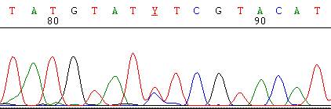
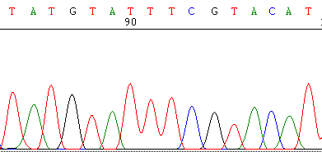
16086
16093 (C/T)
16101
Notes:
Figure 14.8 (a) Sequence heteroplasmy at position 16093 possessing both C and T nucleotides compared to (b) the same region (positions 16086-16101) on a different sample containing only a T at position 16093.

Slide 107
(a)
HVI
HVII
IA
ID
IIA
IIC
16093
IC
IE
IIB
IID
189
1
2
3
1
2
1
2
1
2
4
5
1
2
Ref
1
2
1
2
3
4
1
2
3
1
2
3
4
5
6
7
1
2
K
Q
“blank”
(b) Reported Types
K: 1-1-1-1-1-1-1-1-1-1
Q: 1-2-3-2-0-1-4-2-2-w1
Notes:
Figure 14.9 (a) Results schematically displayed of a known (K) reference and a question (Q) sample that do not match one another using the Roche LINEAR ARRAY mtDNA HVI/HVII Region-Sequence Typing Strips. (b) Types are reported as a string of numbers representing the LINEAR ARRAY probe results. Failure of the PCR product to bind to a probe region (e.g., HVIE in sample Q) is referred to as a “blank”, is reported as a zero in the string of numbers, and is due to polymorphisms in the sample near the probe site that disrupt hybridization. Weak signals such as indicated by the arrow for 189 in sample Q are also due to a closely spaced polymorphism that disrupts full hybridization of the PCR product to the sequence-specific probe present on the LINEAR ARRAY.

Slide 108
Chapter 15 – X-chromosome

Slide 109
X_{A}
X_{A}
X_{A}X_{B}
X_{A}
X_{A}
X_{A}
X_{A}
X_{A} or X_{B}
X_{A}
Deficiency cases
Paternal grandmother-granddaughter
X_{A}
X_{A}
X_{A}
Half-sisters testing
Notes:
Figure 15.1 Some example pedigrees where ChrX testing could be helpful.

Slide 110
X_{A}Y
X_{B}X_{C}
H₁
X_{A}X_{B,C}
X_{B,C}Y
H₂
X_{A,B,C}X?
Notes:
Figure 15.2 Use of ChrX testing in an incest case to help distinguish whether the victim’s father (H₁) or brother (H₂) fathered the victim’s daughter. If X_{A} is more abundant in the victim’s daughter, then H₁ is more likely. If either X_{B} or X_{C} is more abundant in the victim’s daughter, then H₂ is more likely.

Slide 111
Investigator Argus X-12 Kit
PCR product sizes (bp)
100 bp
200 bp
300 bp
400 bp
A
DXS10103
DXS8378
DXS7132
DXS10134
DXS10074
DXS10101
DXS10135
DXS7423
DXS10146
DXS10079
HPRTB
DXS10148
Notes:
Figure 15.3 Investigator Argus X-12 kit (Qiagen, Hilden, Germany) PCR product size ranges and dye color labels used for 12 X-STR loci and amelogenin (A).

Slide 112
Chapter 16 – Nonhuman DNA

Slide 113
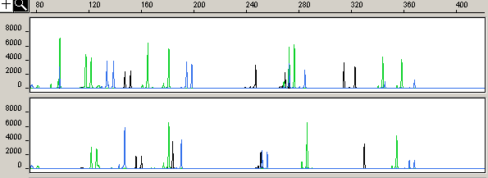
SRY (male)
4
7
Male cat
1
2
5
9
10
3
6
8
11
2
4
7
Female cat
1
5
6
9
10
3
8
11
Notes:
Figure 16.1 DNA profiles produced from male (top panel) and female (bottom panel) cat DNA using a multiplex STR typing assay dubbed the “MeowPlex” (Butler et al. 2002). This test examines 11 autosomal STRs and a region of the SRY gene contained on the Y-chromosome that can be used for sex determination.

Slide 114
Chapter 17 – New Technologies

Slide 115
(a)
Fluorescein scan
D5S818
D13S317
D7S820
11
11
11
12
13
D16S539
12
Fluorescence (arb.)
CSF1P0
TMR scan
TH01
TP0X
(b)
11
11
vWA
9.3/10
15
19
1.4
1.6
1.8
2.0
2.2
Separation Time (minutes)
Notes:
Figure 17.1 Rapid microchip CE separation of the 8 STR loci from PowerPlex 1.1 (Schmalzing 1999). The electropherograms from scanning each color of a simultaneous two-color analysis are divided. The PCR-amplified sample is mixed with the allelic ladders prior to injection to provide a frame of reference for genotyping the sample. The allele calls for each locus are listed next to the corresponding peak. Figure courtesy of Dr. Daniel Ehrlich, Whitehead Institute.

Slide 116
CGCTTTCCA
GAATCGGCC
(a) Electrophoresis
≈9 nucleotides
(compared to
size standard)
≈9 nucleotides
(compared to
size standard)
(fragment migration)
(b) Mass spectrometry
2566 Da
2640 Da
(base composition)
A₁G₁C₄T₃
A₂G₃C₃T₁
(c) DNA sequencing
(base position)
Notes:
Figure 17.2 Comparison of measurement techniques with ability to resolve two 9-base sequences. (a) Electrophoresis measures DNA fragment migration relative to a size standard. (b) Mass spectrometry measures the DNA fragment mass and can determine base composition using mass measurement conversion to numbers of individual nucleotides, which have different individual masses. (c) DNA sequencing measures base position in a DNA fragment.

Slide 117
5’-CTTTGCC-3’
5’-CTATTGC-3’
Nucleotide sequence
Nucleotide sequence
C
T
--
TT
G
CC
--
C
T
A
TT
G
C
--
Signal intensity
Signal intensity
C
T
A
T
G
C
T
C
T
A
T
G
C
T
Nucleotide added
Nucleotide added
Notes:
Figure 17.3
Schematic illustration of Pyrosequencing (sequencing-by-synthesis) results. These pyrograms are based on light produced during nucleotide incorporation following a directed dispensation of nucleotides.

Slide 118
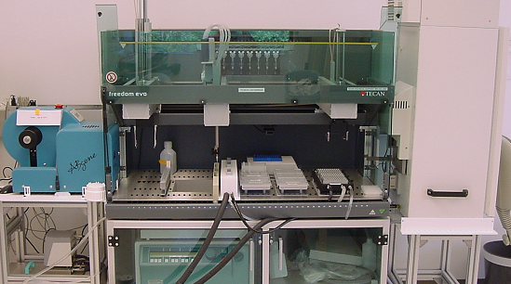
Tecan Freedom EVO 150 robotic workstation
Plate sealer
Notes:
Figure 17.4 Tecan Freedom EVO 150 robotic workstation used for preparation of capillary electrophoresis sample plates. Photo courtesy of FBI Laboratory Federal DNA Database Unit.

