Slide 1
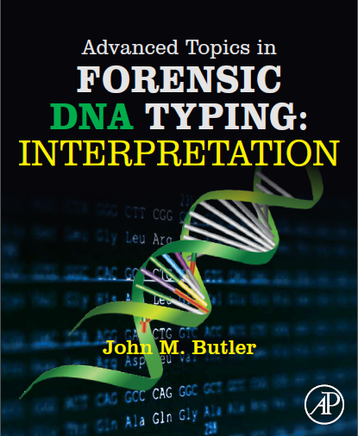
Advanced Topics in Forensic DNA Typing: Interpretation
Published by Elsevier Academic Press (San Diego) in 2015
John M. Butler, Ph.D.
National Institute of Standards and Technology
Slides from figures in the book provided for teaching purposes
http://www.cstl.nist.gov/strbase/training/Figures-Advanced-Topics-Forensic-DNA-Typing-Interpretation.pptx

Slide 2
Chapter 1 – Data Interpretation Overview

Slide 3

Steps in Forensic DNA Testing
Understanding Results Obtained & Sharing Them
Gathering the Data
Collection/Storage/ Characterization
Extraction/
Quantitation
Amplification/ Marker Sets
Separation/
Detection
Data
Stats
Report
Advanced Topics: Methodology
Interpretation
Advanced Topics: Interpretation
August 2011
Fall 2014
Notes:
Figure 1.1 Steps involved in the overall process of forensic DNA typing. This book focuses on understanding the data through data interpretation and statistical interpretation.

Slide 4
Overview of Data Interpretation Process
Allelic Ladder Data File
(with internal size standard)
Bins & Panels
Sample Data File
(with internal size standard)
Genotyping Software
Analyst or
Expert System
Decisions
Sample
DNA Profile
Laboratory SOPs
with parameters/thresholds
established from validation studies
Notes:
Figure 1.2 Overview of DNA interpretation process illustrating that sample data files, at least one allelic ladder data file, and information from laboratory SOPs are entered into genotyping software. Analysts (or expert system software) review the information from the software to produce the final sample DNA profile.

Slide 5
Steps in DNA Interpretation
Question sample
Match probability
Peak
(vs. noise)
Allele
(vs. artifact)
Genotype
(allele pairing)
Profile
(genotype combining)
Weight
of
Evidence
Known sample
Report Written & Reviewed
Notes:
Figure 1.3 Steps in DNA interpretation. The evidentiary (Q) sample and reference (K) sample are processed from peaks to profile and then compared. If Q and K match, then a match probability is computed to assess the weight of this evidence. Finally, a report is written describing the results obtained. A separate technical review by another analyst in the originating laboratory is performed prior to the casework report being finalized and released by the laboratory.

Slide 6
Expert System
(for single-source samples)
Software (e.g., GeneMapperID)
Analyst Manual Review
Color-separated
Time Points
Raw Data
DNA Sizes
STR Alleles
Genotype
Color separation
Sizing
Allele Calling
14,16
Interpretation
Scan numbers
Scan numbers
Nucleotide length
Repeat number
Validated thresholds
for stutter, peak height
ratios, etc.
Kit-specific
allelic ladders,
bins & panels
Spectral calibration
Internal size standard
Notes:
Figure 1.4 An example of the transformation of sample information that occurs at a single STR locus during the course of data interpretation. This same transformation occurs with all other STR loci that are PCR amplified in a multiplex kit. Additional information (indicated across the bottom) helps convert the initial data through steps of color separation, sizing, and allele calling. An analyst must review the initial software results as part of the interpretation process. Expert system software can take a sample from raw data to genotype for high-quality single-source samples.

Slide 7
Locus 1
Locus 2
Locus 3
Locus 4
8,8
13
14
29
31
10
13
Notes:
Figure 1.5 An artificial electropherogram with ideal STR typing data demonstrating perfect intra-locus (100% peak height ratios) and perfect inter-locus balance (heterozygous alleles from different loci are the exact same height). With this electropherogram, homozygous alleles in Locus 3 stack to produce a peak height exactly twice that of heterozygous alleles in other loci. Shaded vertical bins reflect potential alleles defined by a previously run allelic ladder. Horizontal dashed lines represent potential stochastic and analytical thresholds. Numbers above the peaks represent STR allele calls. The y-axis is in relative fluorescence units (RFUs). Hypothetical data image created with EPG Maker (SPM v3) kindly provided by Steven Myers.

Slide 8
Notes:
Table 1.2 Characteristics of Autosomal STR Loci Present in 31 Commercially Available STR Kits

Slide 9
Life Technologies/ABI STR Kits (Internal Size Standard LIZ GS500 – 5-dye; LIZ GS600 – 6-dye)
100 bp
200 bp
300 bp
400 bp
D8S1179
D21S11
D7S820
CSF1PO
16plex
(5-dye)
D3S1358
TH01
D13S317
D16S539
D2S1338
Identifiler
D19S433
vWA
TPOX
D18S51
AM
D5S818
FGA
D10S1248
vWA
D16S539
D2S1338
17plex
(5-dye)
AM
D8S1179
D21S11
D18S51
NGM SElect
D22S1045
D19S433
TH01
FGA
D2S441
D3S1358
D1S1656
D12S391
SE33
D3S1358
vWA
D16S539
CSF1PO
TPOX
24plex
(6-dye)
Y±
AM
D8S1179
D21S11
D18S51
DYS391
D2S441
D19S433
TH01
FGA
GlobalFiler
D22S1045
D5S818
D13S317
D7S820
SE33
D10S1248
D1S1656
D12S391
D2S1338
Notes:
Figure 1.6 Layout of loci by dye channel and relative size in selected Life Technologies (Applied Biosystems, ABI) STR kits.

Slide 10
Promega STR Kits (Internal Size Standard CXR ILS600 – 4-dye; CXR ILS 550 – 5-dye)
100 bp
200 bp
300 bp
400 bp
16plex
(4-dye)
D3S1358
TH01
D21S11
D18S51
Penta E
PowerPlex 16
D5S818
D13S317
D7S820
D16S539
CSF1PO
Penta D
AM
vWA
D8S1179
TPOX
FGA
AM
D3S1358
D19S433
D2S1338
D22S1045
17plex
(5-dye)
D16S539
D18S51
D1S1656
D10S1248
D2S441
PowerPlex ESI 17 Pro
TH01
vWA
D21S11
D12S391
D8S1179
FGA
SE33
24plex
(5-dye)
AM
D3S1358
D1S1656
D2S441
D10S1248
D13S317
Penta E
D16S539
D18S51
D2S1338
CSF1PO
Penta D
PowerPlex Fusion
TH01
vWA
D21S11
D7S820
D5S818
TPOX
DYS391
D8S1179
D12S391
D19S433
FGA
D22S1045
Notes:
Figure 1.7 Layout of loci by dye channel and relative size in selected Promega PowerPlex STR kits.

Slide 11
Y-STR Kits
100 bp
200 bp
300 bp
400 bp
DYS456
DYS389I
DYS390
DYS389II
DYS458
DYS19
DYS385 a/b
17plex
(5-dye)
Yfiler
DYS393
DYS391
DYS439
DYS635
DYS392
Y-GATA-H4
DYS437
DYS438
DYS448
DYS576
DYS389I
DYS448
DYS389II
DYS19
DYS391
DYS481
DYS549
DYS533
DYS438
DYS437
23plex
(5-dye)
PowerPlex Y23
DYS570
DYS635
DYS390
DYS439
DYS392
DYS643
DYS393
DYS458
DYS385 a/b
DYS456
Y-GATA-H4
DYS576
DYS389I
DYS635
DYS389II
DYS627
DYS460
DYS458
DYS19
Y-GATA-H4
DYS448
DYS391
Yfiler Plus
DYS456
DYS390
DYS438
DYS392
DYS518
27plex
(6-dye)
DYS570
DYS437
DYS385 a/b
DYS449
DYS393
DYS439
DYS481
DYF387S1a/b
DYS533
Notes:
Figure 1.8 Layout of loci by dye channel and relative size in Y-chromosome STR kits from Life Technologies and Promega.

Slide 12
Chapter 2 – Thresholds

Slide 13
(a)
A single data “frame”
(b)
Spectral calibration
Spatial calibration →
Capillary 1
Capillary 2
Capillary 3
Capillary 4
Pixel number
520 nm
0
30
60
90
120
160
200
240
Blue
1.0
550
Green
Intensity
0.5
575
Yellow
Spectral calibration →
600
0.0
Red
625
6th dye
(c)
Variable binning
650
Orange
690
CCD camera image
even bins
larger “red” bin
Notes:
Figure 2.1 (a) Depiction of a CCD camera image from a multi-capillary electrophoresis system that collects fluorescence signal at a single point in time (a “frame”). Spatial calibration defines the position of capillaries along the x-axis of the CCD camera image. Spectral calibration with virtual filters (open boxes) assign y-axis positions to dye colors. A sixth dye position, which can be activated in ABI 3500 series instruments, is available between the red and orange dye channels. (b) Illustration of overlapping dye emission spectra requiring spectral deconvolution by the data collection software. Spectral calibration helps define, for example, how much “green” dye signal is in the “blue” region (colored box), in order to reduce or eliminate pull-up (bleedthrough) between the dye colors depicted in the sample electropherogram. (c) Variable binning of the red channel involves collecting more signal along the y-axis of the CCD camera image to even signal peak balance between red dye labeled and other STR kit amplicons. See also Figure 2.2.

Slide 14
(a)
Frame 1
(b)
Frame 2
Capillary positions
Frame 3
1 2 3 4
Frame 4
Frame 5
Sample
Electropherogram
(colors overlaid)
Blue
Green
Yellow
Red
Orange
CCD camera images
CCD camera images (collected as frames)
Color-separated electropherogram
Notes:
Figure 2.2 (a) A series of CCD camera images (see also Figure 2.1) are used to create a sample electropherogram through signal collection at virtual filter points defined on the CCD camera image with spatial and spectral calibration. (b) Data points in sample electropherogram come from combining signal from multiple pixels within the virtual filter window. Typically around 8000 frames are collected in a 30 to 40 minute CE run.

Slide 15
Useful Range of an Analytical Method
limit of linearity
LOL
limit of quantitation
Instrument Response
LOQ
limit of detection
LOD
Dynamic Range
Amount of Substance Being Analyzed
Notes:
Figure 2.3 Graphical representation of signal range and limitations when determining instrument response to amount of substance being analyzed. Signal saturation often prevents a linear response at the upper end of a reliable dynamic range. Staying above the limit of quantitation and limit of detection ensures sufficient signal exists to reliably distinguish instrument signal from background noise.

Slide 16
(a)
(b)
threshold
data
considered reliable
1
Data signal behaves as a continually upward sloping hill
data not considered reliable
0
Increasing signal strength
Notes:
Figure 2.4 Illustration of the step-like function of (a) a binary threshold based approach where data are considered unreliable (probability of 0) below a threshold and considered reliable (probability of 1) above the threshold in spite of the fact that increasing data signal behaves as (b) a continuum similar to a continually upward sloping hill.

Slide 17
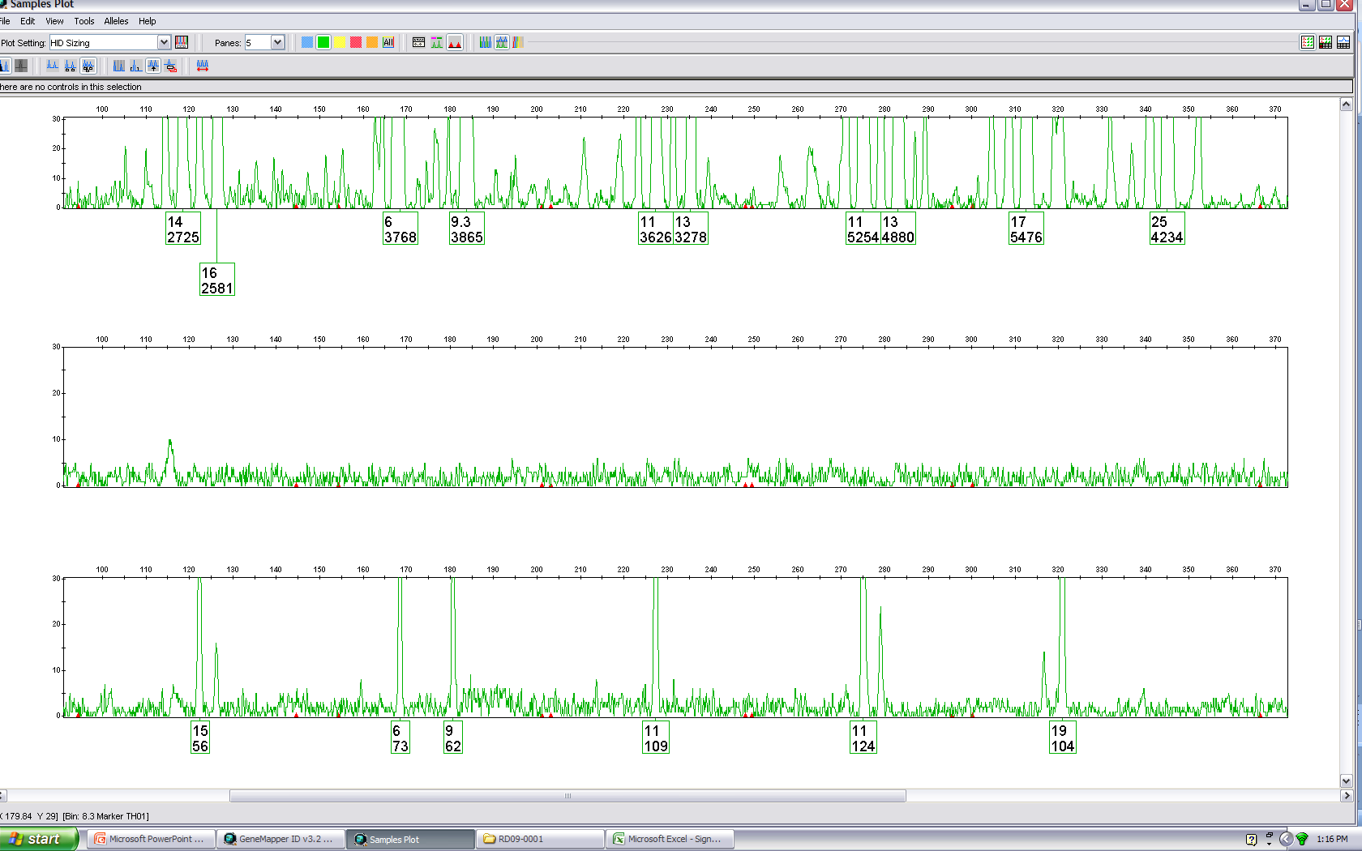
High input of DNA
30
0
30
0
Low input of DNA
30
0
Negative amp control
Notes:
Figure 2.5 Baseline noise levels can vary by amount of DNA template. With a high input of DNA (top panel), the baseline between alleles (indicated by arrow) exhibits more variation. A low input of DNA (middle panel) possesses baseline noise levels on the order of a negative control (bottom panel). Figure adapted from Bregu et al. 2013 courtesy of Catherine Grgicak (Boston University).
17

Slide 18
(a)
(b)
(c)
threshold
too high
real data
real data
FALSE NEGATIVE
FALSE POSITIVE
Signal
Signal
Uncertainty (Higher Risk)
Reliability (Lower Risk)
noise artifact
noise artifact
threshold
too low
Noise
Noise
Notes:
Figure 2.6 Relationship of thresholds (dashed horizontal line) with detected data. (a) If a detection (analytical) threshold is set too low, then noise artifacts can be classified with real data. (b) If a detection (analytical) threshold is set too high, then real data is falsely excluded along with noise artifacts. A signal-to-noise ratio of 3 or 10 are used in analytical chemistry to define limits of detection (LOD) or limits of quantitation (LOQ), respectively. (c) Reliability of data increases with signal strength essentially lowering the risk of falsely designating signal as noise or noise as signal. Conversely, data uncertainty increases with lower signal strength, which increases the risk of confusing signal and noise designations.

Slide 19
Upper Limit for Data Storage
off-scale data
+32,767
Flat-topped peaks
on-scale data
Dip caused by
spectral subtraction (matrix application)
(a)
(b)
(c)
Notes:
D.N.A. Box 2.1

Slide 20
Peak 2
LOQ
(average + 10 SD)
Peak 1
LOD
(average + 3 SD)
standard deviation of noise levels
noise
average of noise levels
baseline
Notes:
D.N.A. Box 2.3

Slide 21

95 % confidence interval ( ±2 σ)
Probability
99.7 % of values fall within 3 standard deviations (σ) of the mean (μ)
Notes:
D.N.A. Box 2.4
A normal (Gaussian) distribution or area under the “bell curve” showing that 99.7% of random, independent values fall within 3 standard deviations (σ) of the mean (μ). A 95% confidence interval reflects data within about 2 standards deviations of the mean. Figure from Wikipedia (based an original graph by Jeremy Kemp)
About 68.27% of the values lie within 1 standard deviation of the mean. Similarly, about 95.45% of the values lie within 2 standard deviations of the mean. Nearly all (99.73%) of the values lie within 3 standard deviations of the mean.
http://upload.wikimedia.org/wikipedia/commons/thumb/8/8c/Standard_deviation_diagram.svg/2000px-Standard_deviation_diagram.svg.png

Slide 22
1x relative signal RFU scaling
4x relative signal RFU scaling
Signal
(4x level)
Signal
(1x level)
Noise
3130
3500
Notes:
D.N.A. Box 2.5 (top) ABI 3500 signal is approximately 4-fold relative to the ABI 3130 signal. This theoretically means that noise levels may be higher on the ABI 3500.

Slide 23
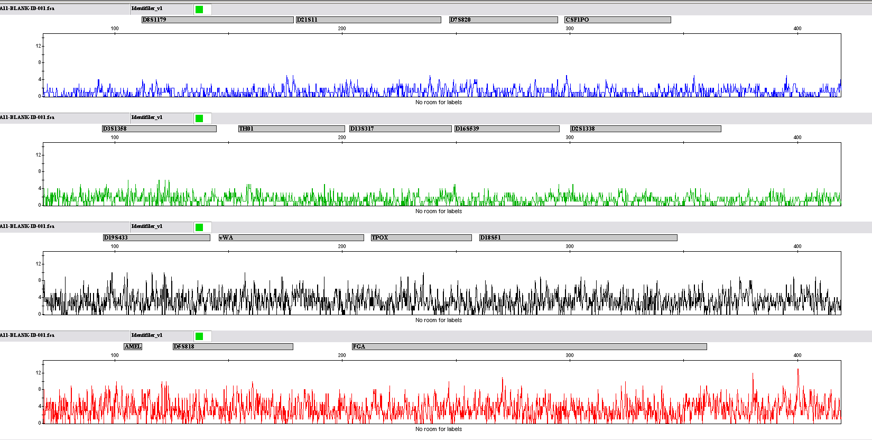
15
0
Baseline is never below 0 RFU
Processed data!
15
0
Green and Blue channels seem ‘quieter’ than yellow and red
15
0
15
0
Notes:
D.N.A. Box 2.5 (bottom) Negative control with the ABI 3130 and Identifiler courtesy of Catherine Grgicak (Boston University).
23

Slide 24
Chapter 3 – STR Alleles and Artifacts

Slide 25
STR Genotyping Steps
Allelic ladder
PCR-amplified sample
Data from CE instrument (prior to color separation and peak sizing)
Color separation and peak sizing
Color separation and peak sizing
Genotyping allele bins
(+/-0.5 bp around ladder allele)
Locus 1
Alleles (# repeats)
12
13
14
15
16
17
Color-separated and sized allele peaks for each locus
Internal size standard
Internal size standard
Genotype = 14, 16
All ladder alleles sized using internal size standard
All sample alleles sized using internal size standard
Genotyping performed by comparing allelic ladder to sample results
Notes:
Figure 3.1 Genotyping is performed through a comparison of sized peaks from PCR-amplified samples to allele size bins. These allele bins are defined with the genotyping software using size information from an allelic ladder run with each batch of samples. Any peak falling in a particular dye color and allele bin size range is designated as an allele for that locus. Peaks in both the allelic ladder and the PCR-amplified samples are sized using the same internal size standard so that they may be compared to one another.

Slide 26
10
11
12
13
14
Physical bins: 10, 11, 12, 13, 14
Virtual bins: 9, 10.2, 13.2, 15
Notes:
Figure 3.2 Illustration of allelic ladder data overlaid on physical and virtual bins. Any peak falling outside a bin window is labeled “off-ladder” and would need to be reviewed for consideration as a potential variant allele or an artifact.

Slide 27
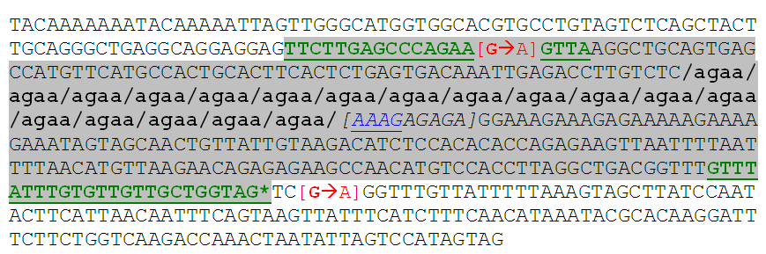
Notes:
Figure 3.3 DNA sequence of a D18S51 allele containing 18 AGAA repeats. The STR repeat sequence is included in lowercase font with breaks between each repeat unit for emphasis. This top strand of the reference sequence is the reverse complement of GenBank entry AP001534 available from http://www.cstl.nist.gov/strbase/seq_ref.htm. The green underlined regions indicate PowerPlex 16 primer binding sites (Krenke et al. 2002) with the shaded portion showing the PCR product. This 18 AGAA repeat allele has 86 bases in the 5′-flanking region (“upstream”), 72 bases (18 x 4) in the repeat region, and 169 bases in the 3′-flanking region (“downstream”). At the asterisk point there are an additional three nucleotides created in the PCR product because Promega includes an ATT sequence at the 5′end of their reverse primer to aid full adenylation. Thus, when amplified with PowerPlex 16 primers a 330 bp (86 + 72 + 169 + 3) PCR product is created.
Other known flanking region variations that can impact allele sizes or amplification with certain STR kits are also illustrated. The blue underlined AAAG sequence that is immediately 3′ of the repeat region is replaced with AG[AGAG] for x.2 alleles and A[AAAG] for x.1 alleles (Dauber et al. 2009). The bracketed nine nucleotides [AAAGAGAGA] are deleted to create a “5.3” allele from one that contains 8 AGAA repeats (Kline et al. 2011). A G→A mutation, shown in red font, 71 nucleotides upstream of the repeat (Vanderheyden et al. 2007) creates a primer binding site mutation in the PowerPlex 16 forward primer while a G→A mutation 172 bases downstream of the repeat region (Kline et al. 2011) causes allele dropout in Applied Biosystems kits such as SGM Plus (Clayton et al. 2004).

Slide 28
Different Internal Size Standards
DNA fragment size (nucleotides)
100
200
300
400
500
600
ABI GS500-ROX and GS500-LIZ
ABI GS600-LIZ
Promega ILS-600
Promega ILS-500
Qiagen 550 BTO
Notes:
Figure 3.4 (a) DNA fragments sizes for different internal size standards. Each rectangle represents a specific DNA fragment size. Sizing precision improves with additional peaks. Note that the ABI GS500-ROX and -LIZ line has an open rectangle for the 250 nucleotide (nt) fragment since its electrophoretic behavior is atypical and is generally not used for size determinations. The electrophoretic behavior of the 340 nt fragment shown with grey shading can also be anomalous. (b) Example result with ILS-500 size standard (Promega Corporation, Madison, WI) that contains 21 fragments labeled with orange dye (for a 5-dye detection system) and evenly-spaced DNA fragments enabling Local Southern sizing between 66 nucleotides and 474 nucleotides.

Slide 29
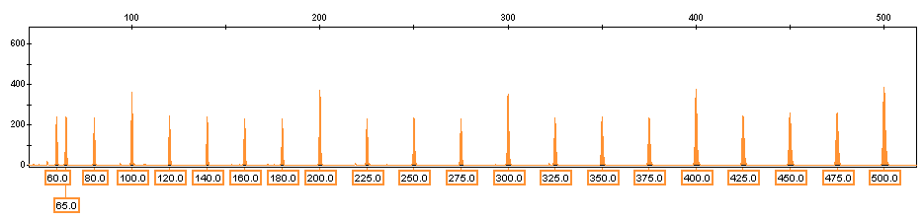
New Promega Size Standard
20 bp spacing
25 bp spacing
Labeled with 5-dye (orange)
Contains 21 fragments with even spacing
Low end: 60 & 65 bp
High end: 475 & 500 bp
Local Southern sizing possible from 66 bp to 474 bp
Notes:
Figure 3.4 (b) Example result with ILS-500 size standard (Promega Corporation, Madison, WI) that contains 21 fragments labeled with orange dye (for a 5-dye detection system) and evenly-spaced DNA fragments enabling Local Southern sizing between 66 nucleotides and 474 nucleotides.

Slide 30
Promega | PP16 |  | 8 | 9 | 10 | 10.2 | 11 | 12 | 13 | 13.2 | 14 |  | 15 | 16 | 17 |  | 18 |  | 19 | 20 | 21 |  | 22 | 23 | 24 | 25 | 26 | 27
Promega | ESI 17 Pro | 7 | 8 | 9 | 10 | 10.2 | 11 | 12 | 13 | 13.2 | 14 |  | 15 | 16 | 17 |  | 18 |  | 19 | 20 | 21 |  | 22 | 23 | 24 | 25 | 26 | 27
Promega | ESX 16/17 | 7 | 8 | 9 | 10 | 10.2 | 11 | 12 | 13 | 13.2 | 14 |  | 15 | 16 | 17 |  | 18 |  | 19 | 20 | 21 |  | 22 | 23 | 24 | 25 | 26 | 27
Promega | Fusion | 7 | 8 | 9 | 10 | 10.2 | 11 | 12 | 13 | 13.2 | 14 |  | 15 | 16 | 17 |  | 18 |  | 19 | 20 | 21 |  | 22 | 23 | 24 | 25 | 26 | 27
Life Tech | Profiler Plus |  |  | 9 | 10 | 10.2 | 11 | 12 | 13 | 13.2 | 14 | 14.2 | 15 | 16 | 17 |  | 18 |  | 19 | 20 | 21 |  | 22 | 23 | 24 | 25 | 26
Life Tech | Identifiler | 7 |  | 9 | 10 | 10.2 | 11 | 12 | 13 | 13.2 | 14 | 14.2 | 15 | 16 | 17 |  | 18 |  | 19 | 20 | 21 |  | 22 | 23 | 24 | 25 | 26 | 27
Life Tech | MiniFiler | 7 |  | 9 | 10 | 10.2 | 11 | 12 | 13 | 13.2 | 14 | 14.2 | 15 | 16 | 17 |  | 18 |  | 19 | 20 | 21 |  | 22 | 23 | 24 | 25 | 26 | 27
Life Tech | GlobalFiler | 7 |  | 9 | 10 | 10.2 | 11 | 12 | 13 | 13.2 | 14 | 14.2 | 15 | 16 | 17 |  | 18 |  | 19 | 20 | 21 |  | 22 | 23 | 24 | 25 | 26 | 27
Qiagen | IDplex |  | 8 | 9 | 10 | 10.2 | 11 | 12 | 13 |  | 14 |  | 15 | 16 | 17 | 17.2 | 18 | 18.2 | 19 | 20 | 21 | 21.2 | 22 | 23 | 24 | 25 | 26 | 27 | 28
Qiagen | ESSplex |  | 8 | 9 | 10 | 10.2 | 11 | 12 | 13 |  | 14 |  | 15 | 16 | 17 | 17.2 | 18 | 18.2 | 19 | 20 | 21 | 21.2 | 22 | 23 | 24 | 25 | 26 | 27 | 28
Notes:
Figure 3.5 Comparison of alleles present in D18S51 allelic ladders for various commercial STR kits. Dye-label colors are indicated as well as the specific alleles present.

Slide 31
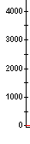
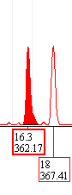

SE33 Differences Between STR Kits
NIST sample PT83864
PP ESI 17
(30 cycles)
PP ESX 17
(30 cycles)
NGM SElect
(29 cycles)
(“16.3”,18)
(16.2,18)
(16.2,18)
Notes:
Figure 3.6 Comparison of SE33 allele designations with various STR kits. A “16.3” is called with the original PowerPlex ESI 17 kit that encompassed a hairpin structure in the SE33 flanking region. The PowerPlex ESI 17 Pro kit moved the SE33 reverse primer to avoid amplifying this region – and now provides a concordant 16.2 allele call (data not shown). Data courtesy of Becky Hill, NIST.

Slide 32
16
?
Appearance in each kit
SGM Plus
D3S1358
vWA
D3: 16,16 vWA: OL, 17, 18 (tri-allele?)
ESX 17
D3S1358
TH01
D3: 16,16 TH01: OL, 9, 9.3 (tri-allele?)
ESI 17
D3S1358
D19S433
D3: 16,16 D19: OL, 13, 14 (tri-allele?)
NGM
D3S1358
D1S1656
D3: 16,16 D1: 9, 16, 17 (tri-allele?)
22 repeats from sequence analysis
TCTA (TCTG)₃ (TCTA)₄ TCTG (TCTA)₁₃
Raziel et al. (2012) FSI Genetics 6: 108-112
Notes:
Figure 3.7 Summary of results from Raziel et al. (2012) with a large D3S1358 allele. The largest D3S1358 allele in most STR kit allelic ladders contains either 19 or 20 repeats. Use of different STR kits including PowerPlex ESX 17, PowerPlex ESI 17, and AmpliSTR NGM, which have different loci adjacent to D3S1358, helped verify that the mystery allele was associated with a large D3S1358 allele because apparent tri-alleles changed with each STR kit result. Subsequent sequence analysis confirmed a 22 repeat D3S1358 allele.

Slide 33
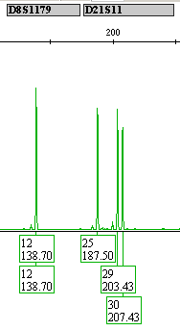
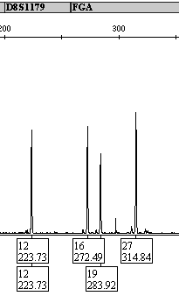
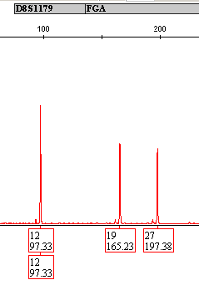
(a)
(b)
(c)
NGM SElect
PowerPlex ESX 17
PowerPlex ESI 17
False D21S11 tri-allele
25, 29,30
False FGA tri-allele
16, 19,27
Reverse primer internal to duplicated flanking region
No extra peak
(d)
D8S1179
repeat region
48 nt duplicated
ESI 17
NGM, ESX 17
Notes:
Figure 3.8 Impact of large D8S1179 allele on different STR kits. This large D8S1179 allele appeared as a D21S11 allele 25 with (a) AmpliSTR NGM SElect and as FGA allele 16 with (b) PowerPlex ESX 17. No large D8S1179 allele was observed with (c) PowerPlex ESI 17 because this kit’s reverse primer is internal to a duplicated flanking region as illustrated in (d). The large D8S1179 allele contains only 12 tetranucleotide repeats but has a 48 nucleotide (nt) duplication downstream of the repeat region. Data courtesy of Erica Butts, Becky Hill, and Margaret Kline, NIST.

Slide 34

(a)
Forward
Primer
Polymerase extension
5’
3’
3’
5’
Polymerase extension
Reverse
Primer
OR
5’
5’
A
5’
A
5’
(-A form)
(+A form)
(b)
Measurement result with dye labeled DNA strand
Incomplete adenylation
-A
full-length allele
(n)
+A
allele + 1 base (n+1)
+A
+A
-A
-A
+A
+A
-A
-A
Shoulder peak
Split peak
D8S1179
Notes:
Figure 3.9 Schematic of non-template nucleotide addition shown (a) with illustrated measurement result (b). DNA polymerases add an extra nucleotide beyond the 3’-end of the target sequence extension product. The amount of non-template addition is dependent on the sequence of the 5’-end of the opposing primer. In the case of dye labeled PCR products where the fluorescent dye is on the forward primer, the reverse primer sequence is the critical one.

Slide 35
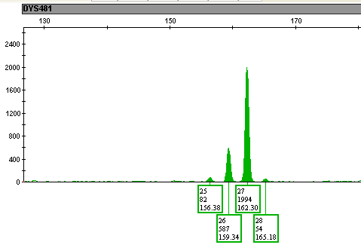
Allele contains 27 CTT repeats
N-3
587/1994
= 29.4%
N+3
54/1994
= 2.7%
N-6
82/1994
= 4.1%
Notes:
Figure 3.10 Stutter products observed at the trinucleotide Y-STR marker DYS481 from a single-source male DNA sample when amplified with the PowerPlex Y23 kit. Calculations of stutter percentages were performed using peak heights (no stutter filter was applied). Figure courtesy of Mike Coble, NIST.

Slide 36
Stutter Product Formation
Repeat unit bulges out when strand breathing occurs during replication
Allele
(tetranucleotide repeat,
size in nucleotides, N)
Reverse stutter
Forward stutter
Typically 5-15% of allele in tetranucleotide repeat STR loci
Typically <2% of allele in tetranucleotide repeat STR loci
N-4
stutter product
N+4 stutter product
Repeat Unit Deletion caused by slippage on the copied (bottom) strand
Repeat Unit Insertion caused by slippage of the copying (top) strand
Total allelic product
1
2
3
5
2’
5’
GATA
GATA
GATA
GATA
1
GATA
2
3’
CTAT
CTAT
CTAT
CTAT
CTAT
5’
GATA
GATA
1
2
3
C
5
6
T
T
3’
CTAT
CTAT
CTAT
A
4
1
2
3
Notes:
Figure 3.11 Illustration of stutter product formation due to repeat unit bulges when strand breathing occurs during replication. During replication the two DNA strands can easily come apart in the repeat region and since each repeat unit is the same, the two strands can reanneal out of register such that the two strands are off-set by a single repeat unit. If the repeat unit bulge occurs in the template strand, then the resulting synthesized strand is one repeat unit shorter than the full length STR allele and “reverse stutter” (N-4 stutter product) occurs. If a repeat unit bulges out on the new synthesized strand during extension then an insertion results in the next round of amplification and “forward stutter” (N+4 stutter product) results.

Slide 37
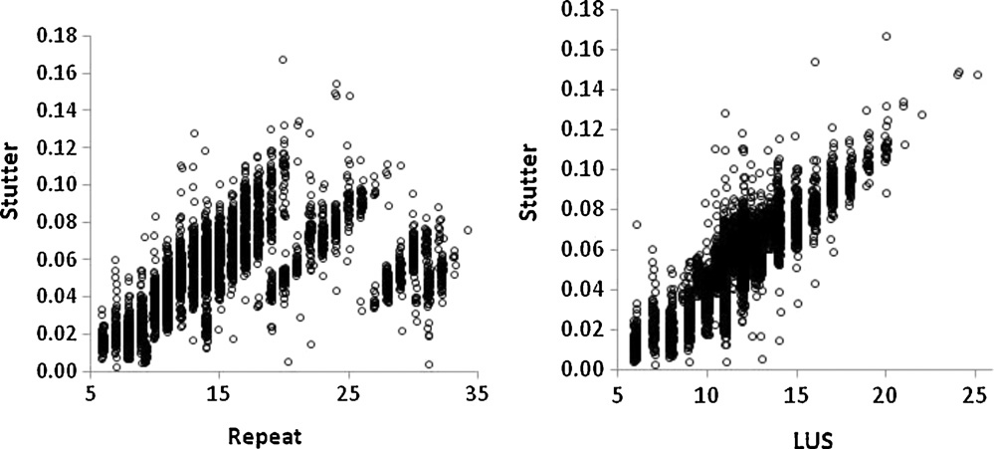
(a)
(b)
Notes:
Figure 3.12 A comparison of stutter ratio vs. (a) repeat allele designation and (b) longest uninterrupted stretch (LUS) of repeats for STR loci containing repeat units with the same A-T base content. This Identifiler data includes peak area information from 30 replicates each of FGA, vWA, D3S1358, D16S539, D18S51, D21S11, D8S1179, CSF1PO, D13S317, D5S818, D7S820, and TPOX. Reproduced with permission from (Brookes et al. 2012).

Slide 38
Tri-nucleotide repeat
Hexa-nucleotide repeat
Notes:
Figure 3.13 Stutter trends for Y-STR loci in PowerPlex Y23 shown on a repeat scale (using STR_StutterFreq program created by Dave Duewer, NIST). Note that loci with shorter repeat units, such as DYS392 and DYS481 which are tri-nucleotides, have a steeper growth in percent stutter with longer alleles than DYS448, which is a hexa-nucleotide repeat. Figure courtesy of Mike Coble, NIST.

Slide 39
Forward primer binding region
5’flanking region
STR
3’flanking region
Reverse primer binding region
Repeat region
(a)
*
Example:
TH01 9.3 allele
(-A in 7th repeat)
(b)
*
Example:
D18S51 13.2 allele
(+AG in 3’-flanking region)
(c)
*
Example:
Rare VWA allele amplified with AmpFlSTR primers
(A-to-T in 2nd base from 3’end of forward primer)
Notes:
Figure 3.14 Possible sequence variation in or around STR repeat regions and the impact on PCR amplification. The asterisk symbolizes a DNA difference (base change, insertion or deletion of a nucleotide) from a typical allele for a STR locus. In situation (a), the variation occurs within the repeat region and should have no impact on the primer binding and the subsequent PCR amplification (although the overall amplicon size may vary slightly). In situation (b), the sequence variation occurs just outside the repeat in the flanking region but interior to the primer annealing sites. Again, PCR should not be affected although the size of the PCR product may vary slightly. However, in situation (c) the PCR can fail due to a disruption in the annealing of a primer because the primer no longer perfectly matches the DNA template sequence.

Slide 40
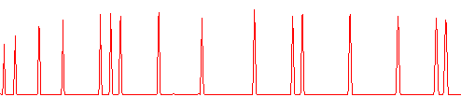
(a)
150
300
350
500
100
139
160
200
250
340
400
450
490
50
75
35
(b)
250
DNA Size
200
165.05 nt
160
147.32 nt
150
DNA fragment peaks are sized based on the sizing curve produced from the points on the internal size standard
139
100
Data Point
DNA fragment peaks in sample
Notes:
D.N.A. Box 3.1 Peak sizing with DNA fragment analysis. An internal size standard, such as GS500-ROX (a), is analyzed along with the DNA sample and used to calibrate the peak data points to their DNA size (b). This standard is labeled with a different color fluorescent dye, in this case ROX (detected as red), so that it can be spectrally distinguished from the STR alleles which are labeled in other colors.

Slide 41
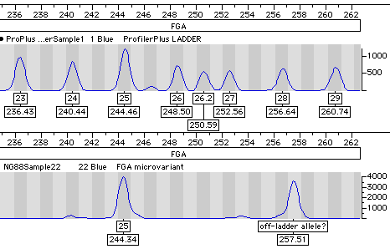
δ₁ = S₂₅-L₂₅ = 244.34 - 244.46 = -0.12 nt
δ₂ = S_{OL} - L₂₈ = 257.51-256.64 = +0.87 nt
c = |δ₁ -δ₂| = |-0.12-0.87| = 0.99 nt
28.1
Notes:
D.N.A. Box 3.2 Detection of a microvariant allele at the STR locus FGA. The sample in the bottom panel is compared to the allelic ladder shown in the top panel using Genotyper 2.5 software. Peaks are labeled with the allele category and the calculated fragment sizes using the internal sizing standard GS500-ROX.

Slide 42
Chapter 4 – STR Genotypes

Slide 43
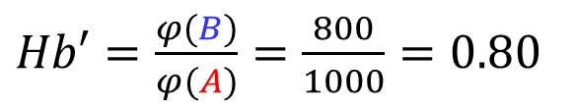
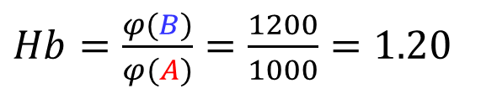
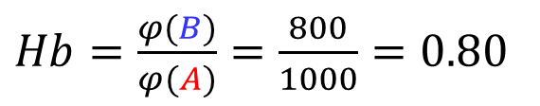
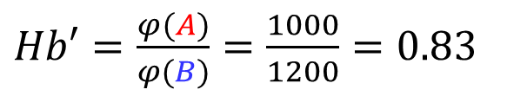
Situation #1
Situation #2
smaller-size
taller peak
smaller-size
shorter peak
larger-size
taller peak
larger-size
shorter peak
B
A
A
B
1000
800
1000
1200
Method #1
$Hb′=\frac{φ(B)}{φ(A)}=\frac{800}{1000}=0.80$
$Hb′=\frac{φ(A)}{φ(B)}=\frac{1000}{1200}=0.83$
Method #2
$Hb=\frac{φ(B)}{φ(A)}=\frac{800}{1000}=0.80$
$Hb=\frac{φ(B)}{φ(A)}=\frac{1200}{1000}=1.20$
Notes:
Figure 4.1 Two situations compared with two methods for calculating heterozygote balance (Hb). Method #2 retains more information as it reflects the position of the taller peak. When Hb is >1, then the taller peak is the larger-size allele. When the smaller-size allele is the tallest peak in the heterozygote, then Method #1 and Method #2 arrive at the same value.

Slide 44
D18S51
242 heterozygotes
(from 283 samples)
Notes:
Figure 4.2 D18S51 peak height ratio observations from 242 heterozygotes examined with PowerPlex 16HS using 30 cycles and a 1 ng target DNA template amount. Data courtesy of Becky Hill, NIST. Plot generated with STR_AlleleFreq available at http://www.cstl.nist.gov/strbase/software.htm. Fifteen samples (blue diamonds) fell between 60 % and 70 % PHR, four samples (green diamonds) were in the range of 50 % to 60 % PHR, and one sample (red diamond) fell below 50 % PHR.

Slide 45
1 ng
95 %
0.5 ng
80 %
0.2 ng
60 %
0.1 ng
40 %
Allele drop-out
0.05 ng
0 %
Notes:
Figure 4.3 Hypothetical heterozygous alleles illustrating the general trend that heterozygote balance decreases with DNA template levels until one of the alleles fails to be amplified. When allele drop-out occurs (shown here at the 0.05 ng DNA template level), then a false homozygote is observed. Here the PHR values are shown as a percentage of the shorter height allele to the taller height allele (see Method #1 in Figure 4.1).

Slide 46
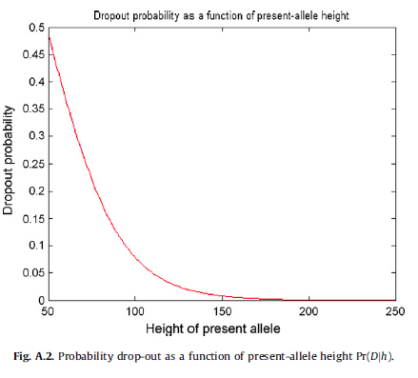
Setting a Stochastic Threshold is Essentially Establishing a Risk Assessment
Drop Out Probability as a Function of Surviving Sister Allele Peak Height
The position and shape of this curve may change based on anything that can impact peak detection (e.g., CE injection time, PCR cycle number, post-PCR cleanup).
“Currently, most laboratories use an arbitrary stochastic threshold. When a protocol is changed, especially if it is made more sensitive to low-level DNA, then the stochastic threshold must also change.”
Puch-Solis R, et al. (2011). Practical determination of the low template DNA threshold. Forensic Sci. Int. Genet. 5(5): 422-427.
With a single peak at 75 RFU, there is approximately a 22% chance of a sister heterozygous allele having dropped out (being below the analytical threshold)
With a single peak at 100 RFU, there is approximately a 7% chance of a sister heterozygous allele having dropped out (being below the analytical threshold)
Gill, P., et al. (2009). The low-template (stochastic) threshold-Its determination relative to risk analysis for national DNA databases. FSI Genetics, 3, 104-111.
Notes:
Figure 4.4 Probability of allele drop-out as a function of the surviving sister allele peak height. With a single detected peak at 100 RFU (blue arrows), there is approximately a 7 % chance of a sister heterozygous allele having dropped out (i.e., being below the analytical threshold). Likewise with a single peak at 75 RFU (green dotted arrows), there is approximately a 22 % chance of a sister heterozygous allele having dropped out. Adapted from Gill et al. 2009.

Slide 47
Stochastic and Analytical Thresholds
Impact Lowest Expected Peak Height Ratio
ST
Lowest Expected Peak Height Ratio
AT
Notes:
Figure 4.5 The stochastic threshold (ST) is fundamentally connected to the analytical threshold (AT) through the lowest expected peak height ratio. The peak on the left below the AT has effectively “dropped-out” because it is not designated as a real peak.

Slide 48
Heterozygous alleles are well balanced
6
8
No mutation
(a)
Imbalance in allele peak heights
Mutation in middle of primer binding site
6
8
(b)
*
8
*
Mutation at 3’-end of primer binding site (allele drop-out)
(c)
Allele 6 amplicon has “dropped out”
Notes:
Figure 4.6 Impact of a sequence polymorphism in the primer binding site illustrated with a hypothetical heterozygous individual. Heterozygous allele peaks may be (a) well-balanced, (b) slightly imbalanced due to some primer binding disruption, or (c) exhibit allele drop-out because a mutation near the 3’-end of the primer binding site fully disrupts appropriate primer annealing during the PCR amplification.

Slide 49
D18S51 Concordance Checking
D18S51 allele size ranges (nucleotides)
100
200
300
400
Profiler Plus
MiniFiler
SGM Plus
Identifiler
NGM
GlobalFiler
PowerPlex S5
PP ESI 17
PowerPlex 16
PowerPlex 21
PP ESX 17
PP Fusion
ESSplex
IDplex
Notes:
Figure 4.7 Relative size ranges and dye colors for D18S51 alleles (spanning 7 to 27 AGAA repeats) in 14 different STR kits.

Slide 50
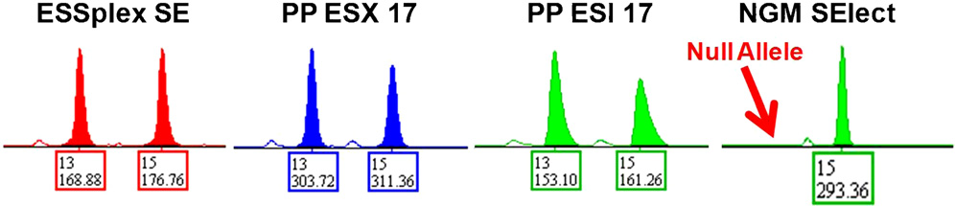
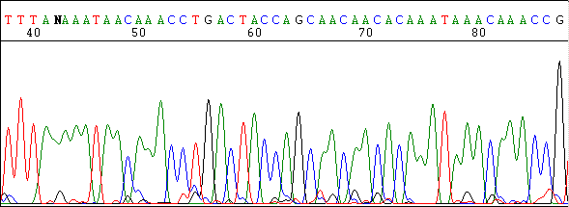
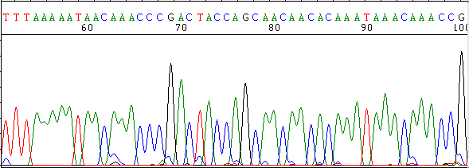
(a)
(b)
Allele 13
A
X
Allele 15
G
Notes:
Figure 4.8 (a) D18S51 typing results from three different STR kits. (b) Illustration of the two D18S51 alleles present in these samples with the relative positions of the reverse PCR primers for the various STR kits (with colors corresponding to the results in the top portion of the figure). The allele 13 possesses a G→A mutation at nucleotide position 172 downstream from the D18S51 repeat region. The NGM SElect kit reverse D18S51 primer spans this mutation and is disrupted from appropriately annealing thus causing an amplification failure that gives rise to the null allele. Data courtesy of Becky Hill, NIST (originally published in Hill et al. 2011b).

Slide 51
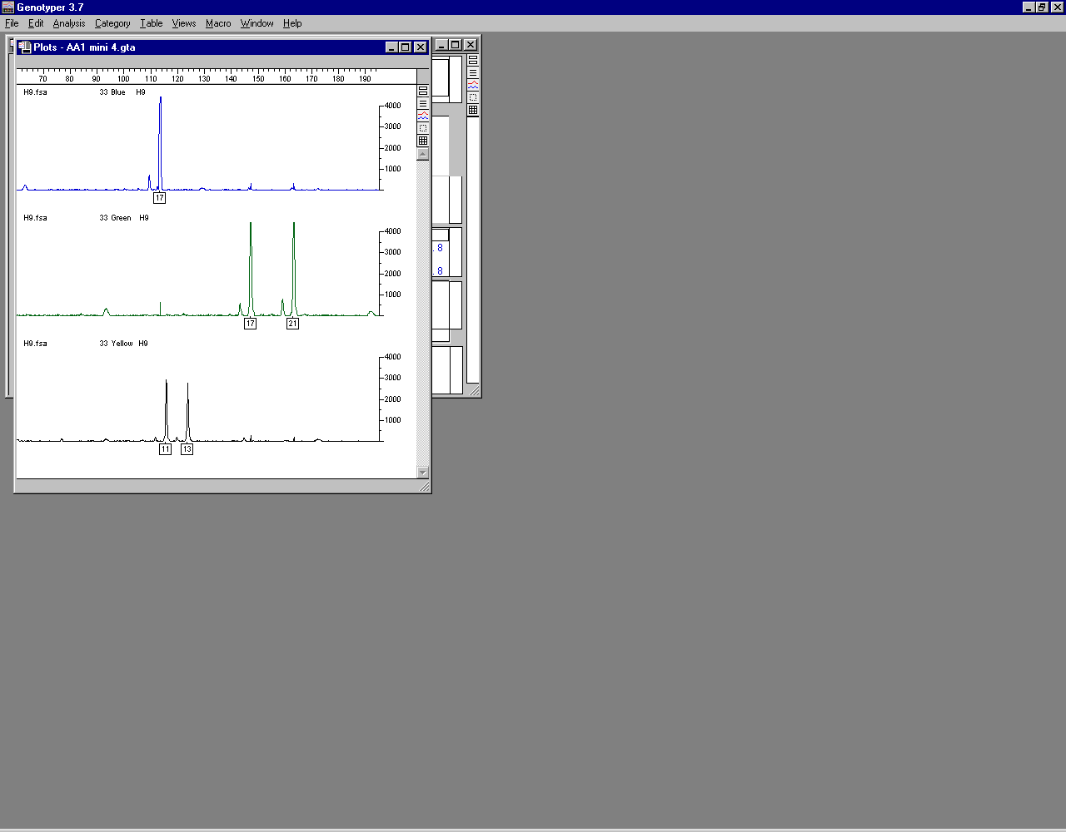
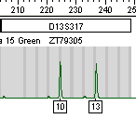
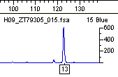
(a)
(b)
(c)
Identifiler kit
miniSTR assay
MiniFiler kit
D13S317
D13S317
Really “11-1” repeat
“Null” allele
10,13
11,13
13,13
Reverse primer is
outside deletion
Reverse primer is
inside deletion
Reverse primer is on top of deletion
4 bp deletion
(d)
16 bp from repeat
Notes:
Figure 4.9 Comparison of D13S317 STR typing results on the same DNA sample from (a) Identifiler kit, (b) a NIST-developed miniSTR assay, and (c) MiniFiler kit. Allele calls are impacted because PCR primers are in different locations relative to a 4 base pair (bp) deletion that is located 16 bp downstream of the D13S317 repeat (d). Adapted from Hill et al. 2007.

Slide 52
Chapter 5 – STR Profiles

Slide 53
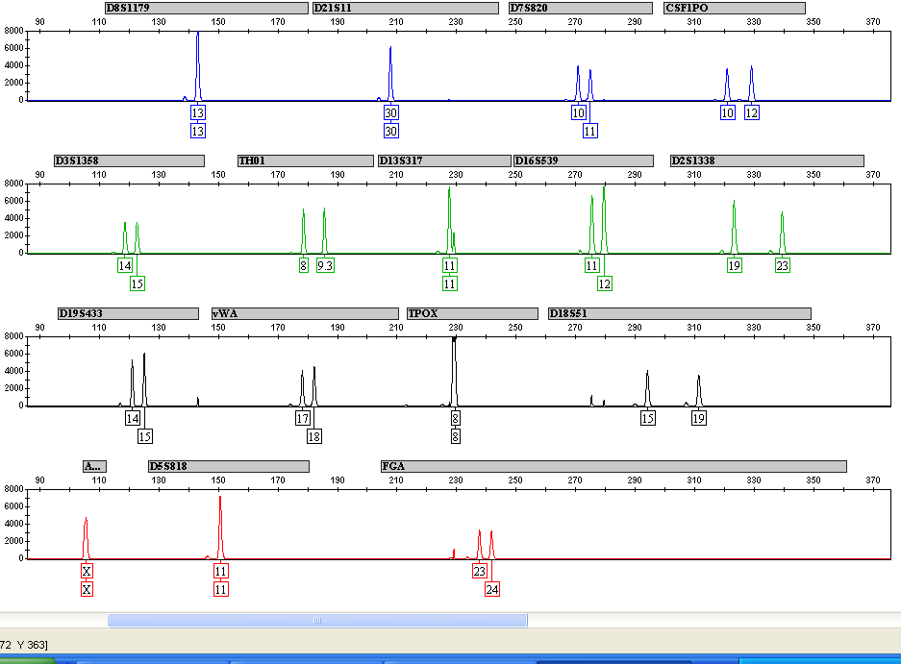
6-FAM label
(blue channel)
VIC label
(green channel)
NED label
(yellow channel)
PET label
(red channel)
Notes:
Figure 5.1 Identifiler kit STR profile from NIST SRM 2391b component 9 (9947A). Off-scale data leads to pull-up across dye channels (indicated by arrows). PCR conditions include 1 ng DNA template run at half-reaction and 28 cycles. Figure courtesy of Becky Hill, NIST.

Slide 54
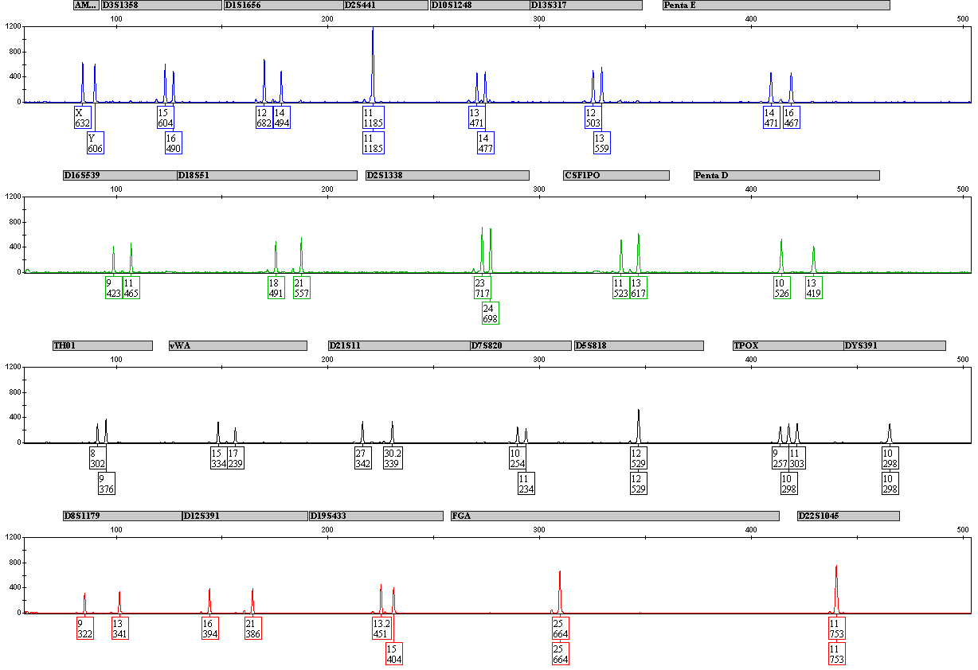
Notes:
Figure 5.2 STR profile from a single-source DNA sample amplified with the PowerPlex Fusion kit that exhibits a tri-allelic pattern at TPOX (see arrow). Figure courtesy of Becky Hill, NIST.

Slide 55
Types of Tri-Allelic Patterns
(a)
Type 1
(b)
Type 2
3
1
2
3
1
2
(1+2≈3)
(1≈2≈3)
Notes:
Figure 5.3 Illustration of tri-allelic patterns that are sometimes observed at a single locus in a multiplex STR profile. They may be classified into one of two different groups based on relative peak heights: (a) ‘Type 1’ where the sum of two peak heights is almost equal to the third (1+2≈3) or (b) ‘Type 2’ where fairly balanced peak heights are observed (1≈2≈3).

Slide 56
6 bp deletion
X
Y
Normal
Male: X,Y
X
Y
X
Normal Female: X,X
X
Male
(AMEL Y null)
Y
Male
(AMEL X null)
Notes:
Figure 5.4 Schematic of the amelogenin sex-typing assay. The X and Y chromosomes contain a high degree of sequence homology at the amelogenin (AMEL) locus and primers, as depicted by the arrows, can target a 6 bp deletion that is present only on the X chromosome (Sullivan et al. 1993). In most circumstances, the presence of a single X peak indicates that the sample comes from a female while two peaks identifies the sample’s source as male. Both AMEL Y and AMEL X null alleles have been reported.

Slide 57
Y
Mb
PAR1
SRY
p
5
AMEL Y
centromere
10
DYS391
q
15
Y-InDel (M175, rs203678)
20
Deletions of the Y-chromosome can encompass >1 Mb around the AMEL Y region (DYS458 is often lost in these situations)
25
heterochromatin
30
PAR2
Notes:
Figure 5.5 Relative positions of amelogenin (AMEL Y) and male confirmation markers found on the Y-chromosome. Red shading covers area that may be lost with AMEL Y null alleles due to deletion of that portion of the short arm of the Y-chromosome.

Slide 58
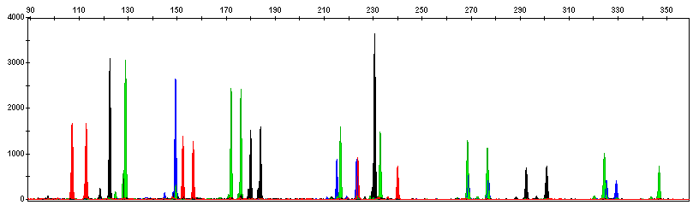
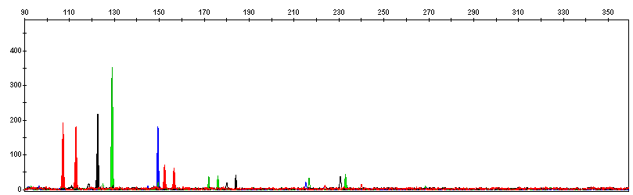
DNA size (bp) relative to an internal size standard (not shown)
(a)
Full Profile (Good Quality)
Relative fluorescence units (RFUs)
(b)
Partial Profile (Poor Quality)
Notes:
Figure 5.6 A comparison of DNA profiles originating from the same biological source but of different qualities. (a) Intact, good quality DNA yields a full profile. (b) Degraded, poor-quality DNA yields a partial profile with only the lower size PCR products producing detectable signal. With the degraded DNA sample shown in (b), information is lost at the larger sized STR loci. Also note the lower relative fluorescence units with the poor quality partial profile in (b). Figure courtesy of Margaret Kline, NIST.

Slide 59
Relative fluorescence units (RFU)
28%
11%
DNA size (nt)
Notes:
D.N.A. Box 5.3

Slide 60
Chapter 6 – DNA Mixtures

Slide 61
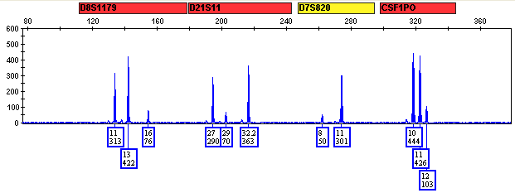
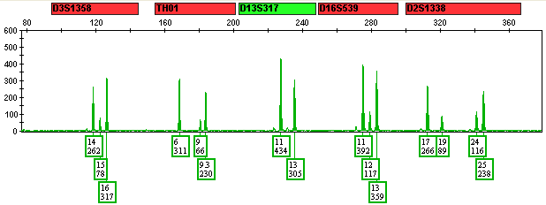
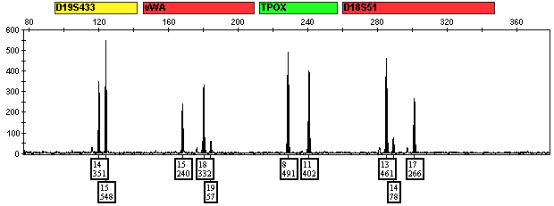
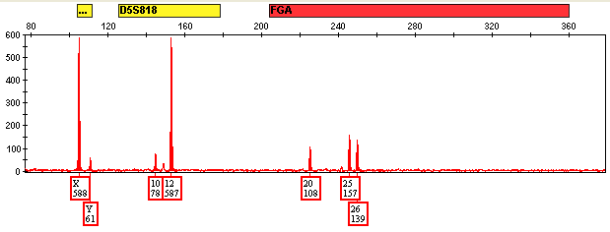
Notes:
Figure 6.1 Two-person mixture example. Data courtesy of Catherine Grgicak and Robin Cotton, Boston University. (ID_2_SAB_NG1_R1,4_A1_V1)

Slide 62
True Sample
Components
Sample Processing
DNA Data
Obtained
Potential STR alleles
portion of a CE electropherogram
Validation establishes variation and limits in the processes involved
12
13
14
15
16
17
18
19
D18S51
4x
Genotype
13,17
CE Injection
Total DNA amplified
Extraction
PCR
13
17
CE Detection
1x
Mixture Ratio of Components
13
14
Potential Allele Overlap & Stacking
Infer possible genotypes & determine sample components
From available data
Number of Contributors (sample components)
Goal of Interpretation
Notes:
Figure 6.2 DNA data obtained in the form of STR peak heights in electropherograms are a reflection of the true sample components and the sample processing involved. Validation studies help establish the expected variation and limits in the processes. These processes include DNA extraction (that impacts the amount of DNA available for testing), PCR amplification (with potential stochastic effects that can unevenly sample elements of the true components) and CE injection and detection (that impact the amount of signal obtained). Aspects of the true sample components that influence the available biological material to be evaluated include the number of contributors, mixture ratio of the components, potential allele overlap and stacking, and the total amount of DNA template amplified.

Slide 63
100 %
(a)
85%
Heterozygous peak region
>60 %
MIXTURE REGION
<15 %
9%
Stutter region
(b)
100 %
>60 %
Higher than typical stutter product (>15 %)
50 %
Smaller peak area than normally seen
with heterozygote partner alleles(< 60 %)
25 %
<15 %
10 %
Wrong side of allele to be typical stutter product
Notes:
Figure 6.3 Illustration of typical single-source (a) versus mixed sample (b) heterozygote peak patterns. The relative peak heights due to the measured fluorescent signal are useful indicators to decipher the presence of a sample mixture. If the highest peak at a locus is set at 100 %, then heterozygous alleles in single-source samples should have peak heights that are greater than about 60 % of the highest alleles. Stutter products are typically less than 15 % of their corresponding allele peak and shorter by four base pairs for tetranucleotide repeats.

Slide 64
Observedprofile
A
B
4 alleles
All heterozygotes and non-overlapping alleles
3 alleles
Heterozygote + heterozygote, one overlapping allele
Heterozygote + homozygote, no overlapping alleles
2 alleles
Heterozygote + heterozygote, two overlapping alleles
Heterozygote + homozygote, one overlapping allele
Homozygote + homozygote, no overlapping alleles
1 allele
Homozygote + homozygote, overlapping allele
Notes:
Figure 6.4 With mixtures containing DNA from two contributors, each individual STR locus can exhibit 1, 2, 3, or 4 different alleles. There are a total of 14 different combinations of homozgyotes and heterozygotes not considering the reciprocal possibilities (see Table 6.1). Hypothetical results from individual A are in red with individual B results in blue. In this example, the observed profile reflects relative peak height changes that would occur with allele stacking due to shared alleles and a 1:1 mixture ratio.

Slide 65
Step #1
Identify the Presence of a Mixture
Step #2
Designate Allele Peaks
Step #3
Identify the Number of Potential Contributors
Step #4
Estimate the Relative Ratio of the Individuals Contributing to the Mixture
Step #5
Consider All Possible Genotype Combinations
Step #6
Compare Reference Samples
Step #7
Determine statistical weight-of-evidence
Notes:
Figure 6.5 Steps in the interpretation of mixtures (Clayton et al. 1998).

Slide 66
Allele Q may not represent the “major” contributor
Q
P
R
PQ
Contributor A
QQ
Contributor B
QR
Contributor C
Notes:
Figure 6.6 Illustration of the impact of allele sharing. This type of result where allele Q appears to be from a “major” contributor is possible with a three-person mixture containing fairly equal amounts of each genotype (PQ + QQ + QR).

Slide 67
P
Q
S
R
stutter?
stutter?
stutter?
13
14
15
16
17
18
19
Notes:
Figure 6.7 Hypothetical example of STR mixture data at the D18S51 locus illustrating that when minor components are similar in peak height to stutter products of the major alleles these stutter products need to be considered as possible alleles from another minor contributor.

Slide 68
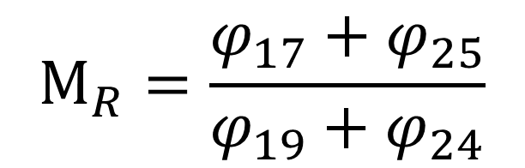
Mixture Ratio
D2S1338
$$M_{R}=\frac{φ_{17}+φ_{25}}{φ_{19}+φ_{24}}$$
Notes:
D.N.A. Box 6.2

Slide 69
Restricted vs Unrestricted
Unrestricted
genotype combinations
Example data
PQ & RS
13,16 & 14,15
RS & PQ
14,15 & 13,16
Q
P
PR & SQ
13,14 & 15,16
SQ & PR
15,16 & 13,14
PS & RQ
13,15 & 14,16
RQ & PS
14,16 & 13,15
S
R
13
16
Restricted
genotype combinations
14
15
14
16
PQ & RS
13,16 & 14,15
RS & PQ
14,15 & 13,16
Suspect genotype
Notes:
D.N.A. Box 6.3
With unrestricted: all combinations of genotypes are deemed possible because relative peak height differences are not utilized
With restricted: based on relative peak heights, allele are paired into potential genotypes only where specific combinations are deemed possible using relative peak height information and validated heterozygote balance and stutter ratio ranges

Slide 70
Type A
Type B
Type C
Notes:
D.N.A. Box 6.4 (figure)

Slide 71
Is the sample a mixture?
>2 alleles at a locus, except tri-alleles?
NO
Single Source DNA Sample
Likelihood Ratio [LR]
Determine STR profile and compute RMP
YES
YES
Assume number of contributors?
Mixed DNA Sample
Probability of Exclusion [CPE] “RMNE”
NO
Differentiate a Major/Minor Component?
Stochastic Effects ? Possible Low Level DNA) ?
NO
NO
TYPE A
YES
A biostatistical analysis must be performed
YES
TYPE B
TYPE C
Determine component profile(s) and compute RMP for major
A biostatistical analysis should not be performed
Notes:
D.N.A. Box 6.4 (figure) mixture classification flowchart

Slide 72
Chapter 7 – Low-level DNA and Complex Mixtures

Slide 73
Allele stacking with overlapping genotypes
10
(a)
11
12
observed data
(b)
contributor genotypes
10,11
overlapping genotypes result in shared, stacked alleles
10,12
1:1:1:2
10,10
11,12
Notes:
Figure 7.1 Illustration of (a) hypothetical observed data from a complex mixture for a single STR locus exhibiting alleles 10, 11, and 12 and (b) allele stacking from a set of contributor genotypes present in a 1:1:1:2 ratio.

Slide 74
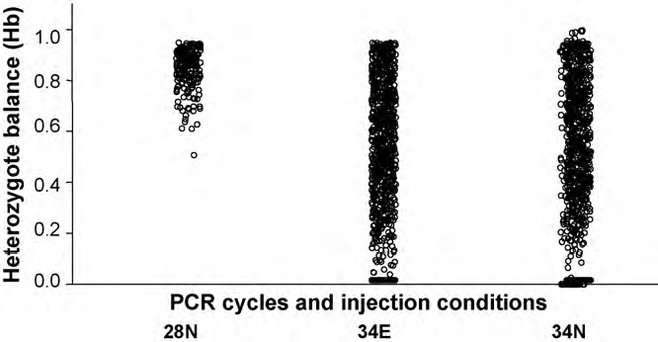
(a)
N = 422 heterozygous loci
N = 1688 heterozygous loci
60 % PHR
Hb = 0 represents allele drop-out
Notes:
Figure 7.2 (a) Heterozygote balance across 10 STR loci in 20 fully heterozygous samples tested with SGM Plus at the ESR Laboratory in New Zealand compared among three sets of conditions: 28N = 1 ng target DNA tested with 28 PCR cycles and normal CE injection (10s @ 3kV); 34E = 12.5 pg and 25 pg target DNA tested in duplicate with 34 PCR cycles and enhanced CE injection (15 s @ 5 kV); 34N = 12.5 pg and 25 pg target DNA tested in duplicate with 34 PCR cycles and normal CE injection. Adapted from Petricevic et al. 2010.

Slide 75
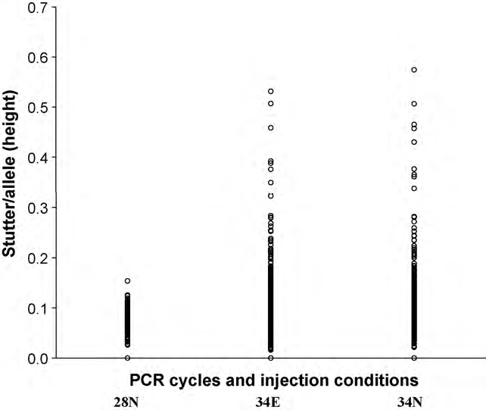
(b)
15 % stutter
Notes:
Figure 7.2 (b) Stutter ratio data under the same conditions. Adapted from Petricevic et al. 2010.

Slide 76
Impact of Template DNA Amount on Variation in Peak Height Ratio
(a)
PHRs with optimal DNA amounts (e.g., 1 ng)
(b)
PHRs with low DNA amounts (e.g., 100 pg)
100%
100%
Hb
Hb
0%
SR
0%
SR
This gap between the stutter ratio (SR) and the heterozygote balance (H_{b}) is what enables mixture deconvolution through assuming restricted genotype combinations
The overlap that occurs between H′_{b} and SR with low level DNA (e.g., minor components in mixture results) creates greater uncertainty in reliably associating alleles into genotypes
Notes:
Figure 7.3 Impact of template DNA amount on variation in peak height ratios (PHRs). The observed spread in stutter ratio (SR) and heterozygous balance (Hb) are illustrated using box and whisker plots with (a) optimal versus (b) lower levels of DNA template being amplified. The gap between the SR and Hb (noted with the large grey arrow) is what enables mixture deconvolution through assuming restricted genotype combinations. The larger box and longer whiskers in the low-level DNA plot (b) reflect a larger variance causing the potential ranges of Hb and SR to overlap (noted by red brackets) and therefore greater uncertainty exists in reliably associating alleles into genotypes due to inherent stochastic effects during PCR.

Slide 77
Notes:
Figure 7.4 Display of 150 potential genotype combinations with a 3-person mixture organized by the number of detected alleles. There are 23 different classes or groupings of genotype combinations with the first one in each group being highlighted in yellow. Adapted from Overson 2009 (allele nomenclature changed from ABCDEF to PQRSTU).

Slide 78
P
Q
R
Replicate #1
P
Q
R
Replicate #2
Q
P
S
R
Replicate #3
P
Q
R
S
Composite Profile
(all alleles seen)
P
Q
R
Consensus Profile
(repeated alleles)
Notes:
Figure 7.5 Replicate amplifications are often performed with low-template DNA (LTDNA) samples to aid overall result reproducibility. Detected alleles are labeled P, Q, R, and S. A composite profile contains all detected alleles (P, Q, R, and S) whereas a consensus profile only includes alleles that occur in more than one replicate amplification (P, Q, and R).

Slide 79
Notes:
D.N.A. Box 7.2

Slide 80
Chapter 8 – Troubleshooting Data Collection

Slide 81
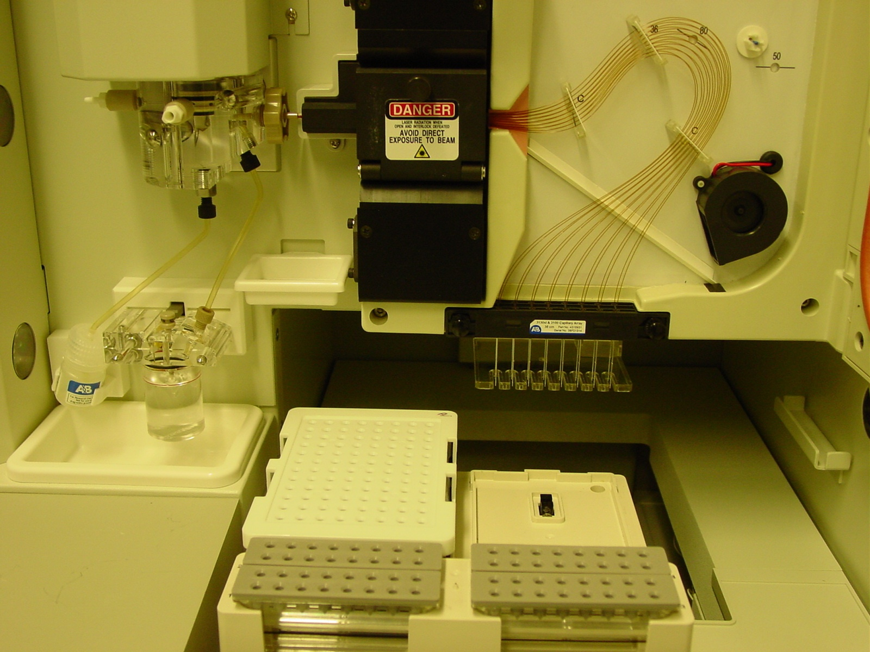
Mechanical pump
(with polymer)
Detection window
Capillary
array
Oven
Lower gel block
Fan
electrodes
Polymer bottle
Outlet buffer reservoir
Sample tray
Autosampler
Inlet buffer reservoir
Notes:
Figure 8.1 (a)
Photograph of ABI 3130xl Genetic Analyzer with a 16-capillary array.

Slide 82
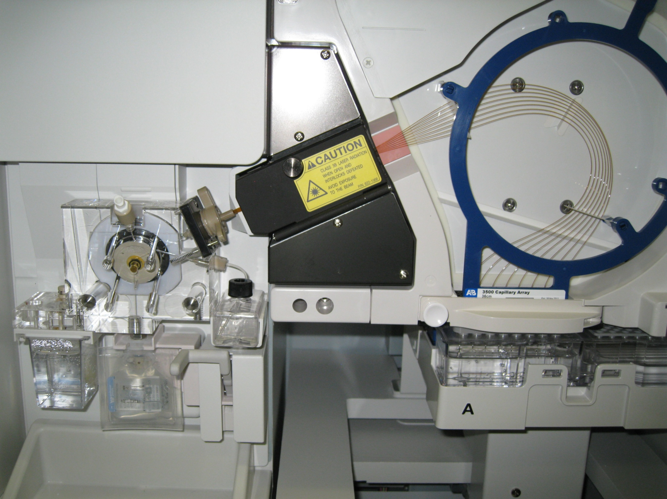
Detection window
Mechanical pump
(with polymer)
Capillary
array
Autosampler
Inlet buffer reservoir
Sample tray
Outlet buffer reservoir (with RFID)
Polymer pack
Notes:
Figure 8.1 (b)
Photograph of ABI 3500 Genetic Analyzer with an 8-capillary array.

Slide 83
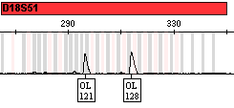
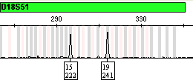
(a)
(b)
Notes:
Figure 8.2
Results from a positive control 9947A sample at the STR locus D18S51 using (a) poor quality formamide versus (b) fresh high quality formamide. Peak labels indicate allele call and height in relative fluorescence units. Note that in (a) the STR alleles are not typed correctly (called as off-ladder ‘OL’ alleles) and have a smaller peak height. The peak tailing and wider peaks with lower peak heights is indicative of an injection from a salty sample. Figure courtesy of Amy Decker.
83

Slide 84
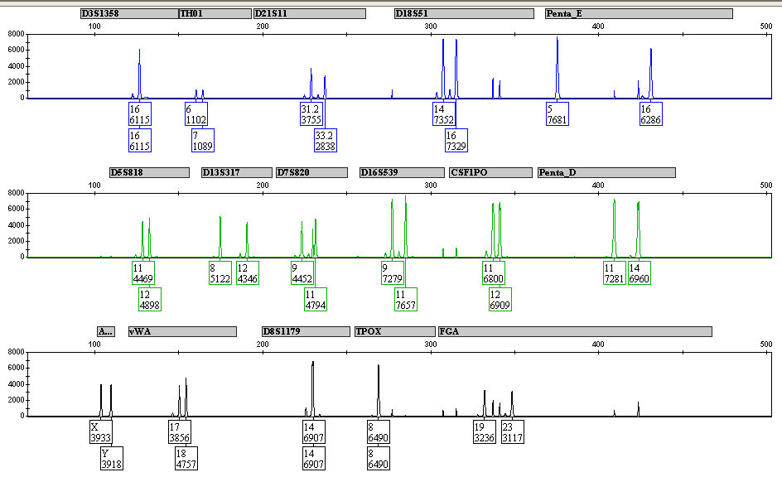
Notes:
Figure 8.3
PowerPlex 16 profile exhibiting pull-up (circled peaks) due to off-scale data at several loci. Figure courtesy of Becky Hill, NIST.

Slide 85
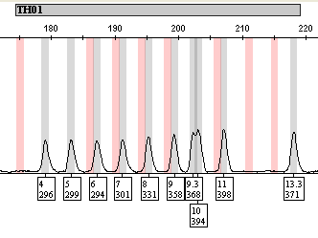
Notes:
Figure 8.4
Poor resolution of TH01 alleles 9.3 and 10 in NGM SElect STR kit allelic ladder. The broad peak bases suggest that the capillary array needs to be replaced. Data courtesy of Becky Hill, NIST.

Slide 86
Re-hybridized complementary DNA strand
Labeled DNA strand
Fluorescent dye
STR allele
(ssDNA)
STR allele
(dsDNA)
Stutter
product
Shadow peak
STR amplicon
Notes:
Figure 8.5
Double-stranded DNA (dsDNA) molecules, which are more rigid than their corresponding single-stranded DNA (ssDNA) counterparts, migrate more quickly through the polymer network inside of a capillary. When CE conditions permit re-hybridization of the complementary strand, then a shadow peak occurs in front of its corresponding labeled STR allele (or internal size standard DNA fragment).

Slide 87
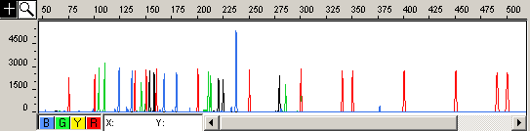
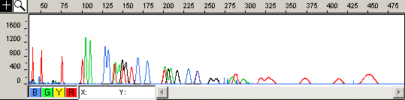
(a) Poor quality data due to loss of resolution – a “meltdown”
(b) High quality data
Notes:
Figure 8.6
Comparison of (a) poor quality data and (b) high quality data from sequential injections on an ABI 310. The loss of resolution in panel (a), termed a “meltdown”, comes from incomplete filling of the capillary with polymer due to a leaky syringe. Data courtesy of Margaret Kline, NIST.

Slide 88
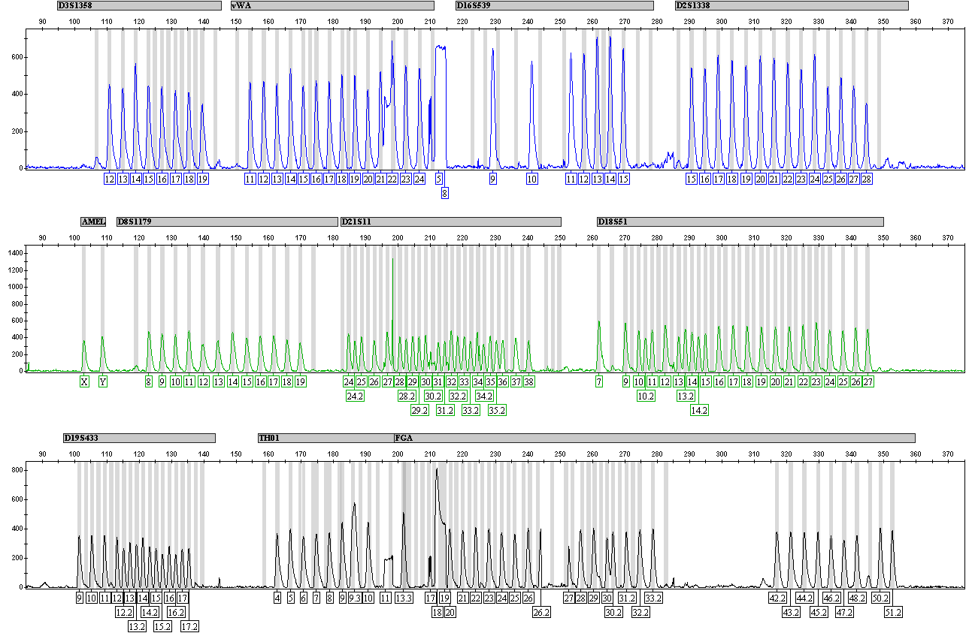
Notes:
Figure 8.7
SGM Plus allelic ladder result just before a faulty CCD camera was replaced. Figure courtesy of Becky Hill, NIST.

Slide 89

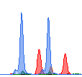
(a)
(b)
ABI 3100
Data Collection v1.0.1
ABI 3130xl
Data Collection v3.0
Notes:
D.N.A. Box 8.1
A portion of the same Identifiler DNA profile analyzed using different ABI 3100 and 3130xl data collection versions. The relative peak height differences (y-axis) are due to ‘variable binning’ with newer ABI data collection versions that increase the amount of emitted light collected from the red dye region to improve the balance between the color channels in a DNA profile. The difference in STR allele relative mobilities as exhibited by the relative peak positions (x-axis) in this particular example are due to using different polymers for separation (POP-6 with the ABI 3100 and POP-7 with the ABI 3130xl).

Slide 90
SD (LIZ 500): 0.061 nt
SD (LIZ 600): 0.049 nt
Notes:
D.N.A. Box 8.2
ABI 3500 data from 16 Identifiler allelic ladders. Figure courtesy of Erica Butts, NIST.

Slide 91
Chapter 9 – Statistical Interpretation Overview

Slide 92
Population allele frequencies
Rarity estimate of DNA profile
(e.g., RMP or LR)
DNA Profile
(with specific alleles)
Genetic formulas
Notes:
Figure 9.1 The rarity estimate for a specific DNA profile (in the form of a random match probability, RMP, or likelihood ratio, LR) is determined based on the alleles present in the profile, the population allele frequencies used, and genetic formulas that account for population substructure or degree of relatedness.

Slide 93
Bayesian approach
Combines LR with prior odds (or prior probability)
Likelihood Ratio (LR)
Bayes’ Theorem
Frequentist approach
Considers only a single hypothesis (e.g., Pr(E|H₂) = RMP) or the LR involving two mutually exclusive hypotheses
Notes:
Figure 9.2 An illustration of the relationship between different statistical approaches to the evaluation of forensic DNA results. The frequentist approach considers either a single hypothesis (H) and probability of the evidence given the hypothesis, Pr(E|H), which is the random match probability (RMP) of a DNA profile in a single-source sample, or the likelihood ratio Pr(E|H₁)/Pr(E|H₂) involving two mutually exclusive hypotheses. The Bayesian approach allows for the inclusion of prior beliefs about the truth of H₁ and H₂, and updates these with the evidence (via Bayes’ formula), to produce posterior odds of the two hypotheses given the evidence.

Slide 94
Notes:
Figure 9.3 Flow chart illustrating the steps in hypothesis testing. The null hypothesis (H₀) is mutually exclusive of the alternative hypothesis (H₁). Adapted from Graham (2003).

Slide 95
Notes:
Figure 9.4 (a) Comparison of decisions based on hypothesis testing and the relationship of type I and type II errors. (b) Example demonstrating how type I and type II errors correlate to false positive and false negative results. Adapted from Graham (2003).

Slide 96
Chapter 10 – STR Population
Data Analysis

Slide 97
Sex chromosome
Maternal Contribution
Egg
(haploid)
1
2
3
4
5
6
7
8
9
10
11
12
13
14
15
16
17
18
19
20
21
22
X
mtDNA
John M. Butler (2009) Fundamentals of Forensic DNA Typing, Figure 2.7
Paternal Contribution
Sex chromosome
Sperm
(haploid)
or
1
2
3
4
5
6
7
8
9
10
11
12
13
14
15
16
17
18
19
20
21
22
Y
X
Nuclear DNA
Mitochondrial DNA
Sex chromosomes
Zygote
(diploid)
Autosomes
1
2
3
4
5
6
7
8
9
10
11
12
13
14
15
16
17
18
19
20
21
22
X
Y
mtDNA
Male Child’s Full Genome
Notes:
Figure 10.1 Human genome and inheritance. The haploid complement of chromosomes from a female’s egg combines with the haploid chromosomal complement of a male’s sperm to create a fully diploid zygote, which eventually develops into a child whose non-gamete cells each contain the same genome. Half of the 22 autosomes come from each parent while mtDNA is only inherited from the mother. The father’s contribution of either an X or a Y chromosome determines the child’s sex.

Slide 98
Punnett Square
Resulting genotype combinations and frequencies
Mother gametes (egg)
A
AA
a
p
q
p²
AA
aA
A
p²
qp
Aa
p
Father gametes (sperm)
2pq
a
Aa
aa
q
pq
q²
aa
Punnett square
q²
Freq (A) = p
Freq (a) = q
p + q = 1
(p + q)² = p² + 2pq + q²
Notes:
Figure 10.2 A cross-multiplication (Punnett) square showing Hardy-Weinberg frequencies resulting from combining two alleles A and a with frequencies p and q, respectively. Note that p + q = 1 and that the Hardy-Weinberg genotype proportions are simply a binomial expansion of (p+q)², or p² + 2pq + q².

Slide 99
Relationship between Allele Frequency and Genotype Frequency
Frequency of A allele (p)
1.0
0.8
0.6
0.4
0.2
0.0
AA
aa
0.8
p²
q²
Aa
0.6
2pq
Frequency of genotype in population
0.4
0.2
0.0
0.2
0.4
0.6
0.8
1.0
Frequency of a allele (q)
Notes:
Figure 10.3 Graph depicting genotype frequencies for AA, Aa, and aa when Hardy-Weinberg equilibrium conditions are met. The highest amount of heterozygotes Aa are observed when alleles frequencies for both A and a are 0.5. Adapted from Hartl and Clark (1997).

Slide 100
Decide on number of samples and ethnic/racial grouping
Usually >100 per group
Often anonymous samples from a blood bank
Gather samples
Analyze samples at desired genetic loci
Summarize DNA types
Determine allele frequencies for each locus
See D.N.A. Box 10.2 and Appendix 1
Perform statistical tests on population data
Hardy-Weinberg equilibrium for allele independence
Linkage equilibrium for locus independence
Ethnic/ Racial Group 1
Ethnic/ Racial Group 2
Examine genetic distance between populations
Use Pop. Database(s) to Estimate an Observed DNA Profile Frequency
See Chapter 11
Notes:
Figure 10.4 Steps in generating and validating a population database that can then be used to estimate the frequency of an observed DNA profile in the population.

Slide 101
U.S. Population Data
Notes:
Figure 10.5 Comparison of D18S51 allele frequencies observed in four U.S. population groups (see Appendix 1).

Slide 102
Paternal Allele
Maternal Allele
Paternal Allele
Maternal Allele
Paternal Allele
Maternal Allele
HWE
Genotype
Genotype
Genotype
Locus 1
Locus 2
Locus 3
Linkage Equilibrium (product rule)
DNA Profile
Notes:
Figure 10.6 A DNA profile is made up of genotypes from individual genetic loci. The genotype at each locus results from inheritance of paternal and maternal alleles. Hardy-Weinberg equilibrium (HWE) tests evaluate the independence of alleles within a genetic locus while linkage equilibrium tests ascertain the independence of alleles between loci. Independent loci and alleles enable use of the product rule.

Slide 103
Chapter 11 – DNA Profile Frequency Estimates and Match Probabilities
No figures in Chapter 11

Slide 104
Chapter 12 – DNA Mixture Statistics

Slide 105
Notes:
Figure 12.1 Comparison of sample types and challenges in terms of the amount of DNA available for testing and the potential number of contributors. Sexual assault samples typically involve DNA mixtures with people that are not related whereas touch evidence (e.g., a item from a home) may very well have related people in a complex mixture. Statistical interpretation information in Chapter 11 focused on single-source samples with high amounts of DNA, information in Chapter 12 is directed primarily to two-person mixtures with high amounts of DNA, principles explained in Chapter 13 deal with low-amounts of DNA that may be seen in complex mixtures or compromised samples from disaster victim identification (DVI) efforts.

Slide 106
Notes:
Figure 12.2 Hypothetical example of STR mixture data at the D18S51 locus. (a) The crime scene evidence data possesses alleles 14,16,18, and 19. Additional peaks at allele positions 13, 15, and 17 could be stutter products of the observed alleles or potentially alleles from other contributor(s) depending on the number of contributors present in the mixture. The suspect is 14,16 and the victim is 18,19. (b) Assuming two contributors, the mixture profile from (a) can be divided (deconvoluted) into major and minor components using relative peak height ratios to determine genotype combinations. Assuming this result is from a two-person mixture, the best explanation for peaks labeled with asterisks (*) is that they are stutter products.

Slide 107
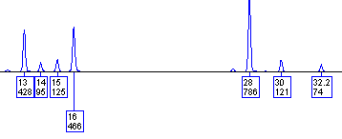
Notes:
D.N.A. Box 12.2

Slide 108
Chapter 13 – Coping with Potential Missing Alleles

Slide 109
Program Name | Type | Creator(s) | Availability
LRmix | Discrete (semi-continuous) | Hinda Haned & Peter Gill | Open-source https://sites.google.com/site/forensicdnastatistics/PCR-simulation/lrmix
Lab Retriever | Discrete (semi-continuous) | David Balding then Norah Rudin and colleagues | Open-source http://www.scieg.org/lab_retriever.html
likeLTD | Discrete (semi-continuous) | David Balding | Open-source https://sites.google.com/site/baldingstatisticalgenetics/software/likeltd-r-forensic-dna-r-code
FST | Discrete (semi-continuous) | Adele Mitchell | Not currently available outside of NYC OCME Forensic Biology Laboratory
Armed Xpert | Discrete (semi-continuous) | USACIL then NicheVision | Commercial product http://www.armedxpert.com/
TrueAllele | Fully-continuous | Mark Perlin | Commercial product http://www.cybgen.com/
STRmix | Fully-continuous | Duncan Taylor, Jo-Anne Bright, John Buckleton | Commercial product http://strmix.esr.cri.nz/
DNA View Mixture Solution | Fully-continuous | Charles Brenner | Commercial product http://dna-view.com/
Notes:
Table 13.1

Slide 110
Notes:
Figure 13.1 Potential evidence-to-suspect comparisons with a hypothetical heterozygous locus. (a) Evidence PQ genotype matches suspect PQ genotype. (b) Evidence PR genotype fails to match suspect PQ genotype and would be excluded. (c) Evidence P- does not match suspect PQ possibly because the Q allele dropped out due to a stochastic failure to amplify a low-level allele.

Slide 111
Notes:
Figure 13.2 Representation of a question (Q) to known (K) profile comparison where loci in the Q profile were disqualified from consideration due to alleles being observed below a stochastic threshold. By reducing the points of comparison on the Q profile through disqualifying and eliminating loci with low-level data, a partial profile may be artificially created. This reduction in the possible points of comparison between the Q and K profile reduces the ability to exclude innocent suspects.

Slide 112
Chapter 14 – Kinship and Parentage Analysis

Slide 113
(a)
Parentage (Paternity) Testing
Random man
Alleged father
Mother
(known parent)
?
Rules of Inheritance
Child has two alleles for each autosomal marker (one from mother and one from biological father)
Child will have mother’s mitochondrial DNA haplotype (barring mutation)
Child, if a son, will have father’s Y-chromosome haplotype (barring mutation)
child
(b)
Reverse Parentage Testing (Missing Persons Investigation)
Alleged father
Alleged mother
?
Missing child
Notes:
Figure 14.1 Illustration of question being asked with (a) parentage testing and (b) reverse parentage testing. The most common form of parentage testing, namely paternity testing, uses results from a mother and a child to answer the question if the alleged father could have fathered the child versus a random man. With a reverse parentage test, DNA types from one or both parents are used to determine if an observed type could have resulted from a child of the alleged father and mother.

Slide 114
mother
father
(a) Mendelian Inheritance
P,Q
R,S
Q,R
child
28, 30
31, 32.2
(b) Example pedigree
30, 32.2
28, 31
28, 32.2
30, 31
30, 32.2
Obligate paternal allele
30
28
28
30
30
Notes:
Figure 14.2 (a) Mendelian inheritance patterns with a mother possessing alleles A and B contributing one of them to the child while the father who possesses alleles C and D also contributes one of his alleles to the child. (b) An example pedigree for a family where the parents possess different alleles enabling identification of the obligate paternal allele in each of the children. This scenario can become more complicated to interpret if mutations occur or maternal and paternal alleles are shared.

Slide 115


(c) Example data
Father
Obligate paternal allele
Maternal allele
Child #1
Obligate paternal allele
Maternal allele
Child #2
Mother
Notes:
Figure 14.2 (c) Example data showing family inheritance at the STR locus D21S11 and identification of the obligate paternal allele once the mother’s alleles are compared to the tested children (shown with red arrows).

Slide 116
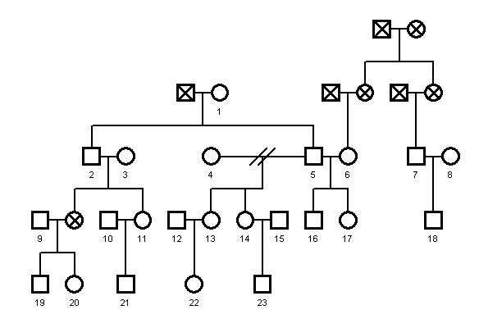
NIST Standard Reference Family Pedigree
Male
Female
Divorce
No data
Notes:
Figure 14.3 NIST standard reference family pedigree containing 23 individuals with genotype information at 46 autosomal STRs and 17 Y-STRs available at http://www.cstl.nist.gov/strbase/kinship.htm.

Slide 117
Mutation Observed in Family Trio
(a)
(b)
father
mother
14,18
15,17
14,18
15,17
son
15,18
13,17
Normal Transmission of Alleles (No Mutation)
Paternal Mutation
Notes:
Figure 14.4 STR results illustrated for two different family trios where (a) normal transmission of alleles occurred versus (b) a mutation of paternal allele 14 into the child’s allele 13.

Slide 118
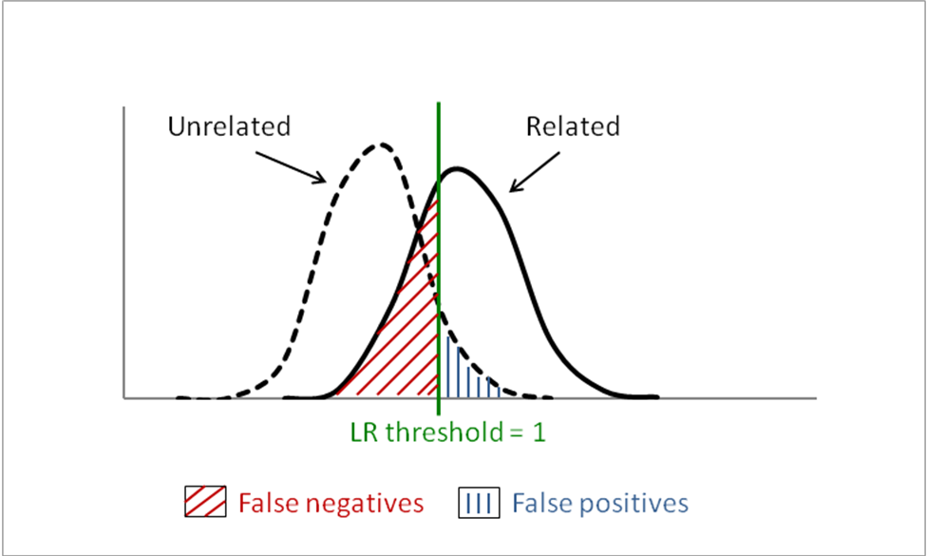
Notes:
Figure 14.5 Illustration of the overlap in likelihood ratio distributions between related and unrelated individuals showing where false positives and false negatives can arise. Figure courtesy of Kristen O’Connor, former NIST postdoc.

Slide 119
Unrelated
Related
Parent-Offspring
(1000 simulations)
Parent-offspring comparisons:
No overlap between unrelated and related LR distributions
Full sibling comparisons:
False positive rate = 0.027
False negative rate = 0.033
Half sibling comparisons:
False positive rate = 0.155
False negative rate = 0.168
median LR=2.7E-13
median LR=10,000
Full Siblings
(5000 simulations)
Proportion of simulations using U.S. Caucasian allele frequencies
median LR=1.5E-3
median LR=2400
Half Siblings
(1000 simulations)
median LR=0.14
median LR=6.9
LR threshold = 1
log₁₀(LR)
Notes:
Figure 14.6 Illustration of the overlap in likelihood ratio distributions between related and unrelated individuals showing where false positives and false negatives can arise. The degree of overlap corresponds with possible values for false positive or false negative results. Full siblings and half siblings may have true relatives with LR <1 because these individuals may not share any alleles at a locus. Figure courtesy of Kristen O’Connor, former NIST postdoc.
119

Slide 120
A Three-Generation Family Pedigree with Genetic Results from a Single STR Marker (FGA)
(a)
1
2
20,22
23.2,
25
17
6
3
4
7
5
8
22,22
22,
23.2
20,25
20,22
20,25
20,22
9
10
11
12
13
14
15
16
22,24
22,
23.2
22,
23.2
22,25
20,22
20,25
20,22
22,25
(b)
#2
#4
(c)
Mother’s alleles
Mother’s alleles
23.2
25
20
25
20,23.2
20,25
20,20
20,25
20
20
#1
#7
Father’s alleles
#4
#5
Father’s alleles
#14
22,23.2
22,25
20,22
22,25
22
22
#3
#13
#12
Notes:
D.N.A. Box 14.1 (a) A three generation family pedigree with results from a single genetic locus (STR marker FGA). Squares represent males and circles females. (b) A Punnett square showing the possible allele combinations for offspring of individuals #1 and #2 in the pedigree. Individual #3 is 22,23.2 and inherited the 22 allele from his father and the 23.2 allele from his mother. (c) A Punnett square for one of the families in the second generation showing possible allele combinations for offspring of individuals #4 and #7.

Slide 121
Chapter 15 – Statistical Treatment of Lineage Markers

Slide 122
Different Inheritance Patterns
(a)
Autosomal Markers
Lineage Markers
13 CODIS STR Loci
12 or 17 Y-STRs
mtDNA control region
22 pairs of autosomes
(passed on in part,
from all ancestors)
Y-Chromosome
(passed on complete, but only by sons)
Mitochondrial
(passed on complete,
but only by daughters)
Notes:
Figure 15.1 (a) Illustration of inheritance patterns from recombining autosomal genetic markers and the lineage markers from the Y-chromosome and mitochondrial DNA.

Slide 123
Differences between Autosomal and Lineage Markers
(b)
Lineage Markers
ChrY
Parent
Paternal Allele
Maternal Allele
Paternal Allele
Maternal Allele
Paternal Allele
Maternal Allele
mtDNA
Uniparental inheritance
Offspring
Allele
Allele
Allele
Locus 1
Locus 2
Locus 3
Assume linkage
and no recombination
(cannot use the product rule)
Haplotype
Notes:
Figure 15.1 (b) Lineage markers involve uniparental inheritance and assume linkage so that the product rule cannot be used. Essentially Y‑STRs and mtDNA can each be treated as a single genetic locus with many alleles (haplotypes).

Slide 124
Possible Genetic Contributors to a Son and Daughter with mtDNA, X- or Y-chromosome Information
Paternal
grandfather
Paternal
grandmother
Maternal
grandfather
Maternal
grandmother
Y
X†
X
X’
mtDNA
Y
X’
Father
Mother
mtDNA
X†
X
X
Y
or
X’
X
X†
or
mtDNA
mtDNA
X†
Specific alleles with autosomal loci can be contributed by any or none of the grandparents
Son
Daughter
Notes:
Figure 15.2 Possible genetic contributors to a son and daughter with mtDNA, X- or Y-chromosomei. Specific alleles with autosomal loci can be contributed by any or none of the grandparents

Slide 125

Summary of Issues
Want good quality data going into database
population studies
Real-World
Population Variation
mtDNA sequence
(or difference from reference)
HV1/HV2
control region
mtGenome
Can θ correction help with this sampling issue?
Online
Population Database
Forensic Sample
Y-STR Profile
Assume pop data representative of real-world
1
2
EMPOP
YHRD
US YSTR
PP Y
Yfiler
PPY23
3
Counting method
?
Sampling confidence interval
(normal or C-P; 1-tail or 2-tail)
What the court wants to know…
Primary Steps Involved:
1 - Generate profile (Y or mtDNA)
2 - Query population database
3 - Report frequency estimate
Haplotype Frequency Estimate
(of lineage not the individual)
Notes:
Figure 15.3 Summary of issues faced with lineage markers. A Y-STR profile or mtDNA sequence haplotype is generated from a forensic evidence sample. An online population database is queried (EMPOP for mtDNA or YHRD /USYSTR for Y-STRs). The number of matching haplotypes is counted and a haplotype frequency estimate provided often with a sampling confidence interval or a subpopulation theta correction. This approach assumes that the population database reliably represents the real-world variation for the haplotype lineage being measured.

Slide 126
YHRD
Release 46
(Dec 2013)
US YSTR
Release 3.3
(Feb 2014)
http://www.yhrd.org
http://www.usystrdatabase.org
126,931 samples
120k
9 MHL
125,148 samples
10,321 Caucasian
9,257 African American
5,156 Hispanic
4,192 Native American
4,046 Asian
876 Populations (>100 countries)
100k
99,823 samples
11 SWGDAM
Focus is on U.S. samples
80k
12 PPY
83,280 samples
71,235 samples
17 Yfiler
60k
40k
32,972 samples
11 SWGDAM
29,904 samples
# Samples in Database
# Samples in Database
12 PPY
19,592 samples
23,169 samples
20k
17 Yfiler
23 PPY23
4,837 samples
23 PPY23
# Loci in Haplotype
# Loci in Haplotype
Notes:
Figure 15.4 Comparison of two forensic Y-STR haplotype databases illustrating numbers of samples with various sets of Y-STR markers (as of March 2014).

Slide 127
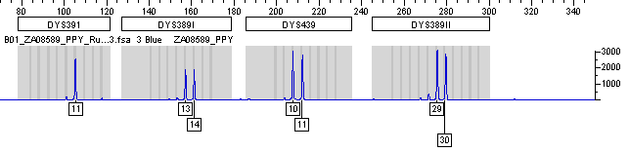


DYS389I
DYS439
DYS389II
DYS437
Notes:
D.N.A. Box 15.1 Y-chromosome duplication

Slide 128


Locus Triplication
Locus Deletion
DYS448
DYS439
Father
Son
Father
Son
Notes:
D.N.A. Box 15.1 Y-STR duplication and deletion

Slide 129
Chapter 16 – Laboratory Reports: Communicating Results and Conclusions

Slide 130
(a)
 | Q sample | K sample
Locus 1 | 12,14 | 12,14
Locus 2 | 13,13 | 13,13
Locus 3 | 8,10 | 8,10
Locus 4 | 14,15 | 14,15
“Match”
Complete correlation and agreement with genotypes obtained between two single-source DNA profiles
Less uncertainty
(b)
 | Q sample | K sample
Locus 1 | 12,14 | 12,14
Locus 2 | 13,-- | 13,13
Locus 3 | 8,10 | 8,10
Locus 4 | -- | 14,15
“Is consistent with”
Agreement with genotypes observed in the Q profile, which is incomplete (partial profile) due to poor quality evidentiary material
(c)
 | Q sample | K sample
Locus 1 | 12,14,15 | 12,14
Locus 2 | 11,12,13 | 13,13
Locus 3 | 8,10,11 | 8,10
Locus 4 | 14,15,16,17 | 14,15
“Cannot be excluded from”
Alleles (and likely genotypes) from the K profile are present in an evidentiary Q profile mixture
Greater uncertainty
Notes:
Figure 16.1 Illustration of several categories of Q-to-K comparisons with terms or phrases that can be used to define a relationship between the Q and K profile results. Some ambiguity or uncertainty exists when the phrase “cannot be excluded from” is used with DNA mixtures, which is why it is crucial to provide a statistical weight-of-evidence to these results.

Slide 131
Surface
Surface
Surface
Primary
(1º) Transfer
Secondary (2º) Transfer
Tertiary
(3º) Transfer
Notes:
Figure 16.2 Illustration of transfer levels

Slide 132
Provided by investigator
Evidence sample(s)
Provided back to investigator
Reference sample(s)
Generated by forensic lab
Electronic data, electropherogram
(Data)
Bench notes,
worksheets
(Interpretation)
Written Report
(Conclusions)
Case file
Often requested by the defense as part of discovery
Notes:
Figure 16.3 An investigator supplies evidence and reference samples to a forensic laboratory for testing. Following the DNA testing process, the laboratory provides the investigator with a summary of results in the form of a written report. This report is based on sample electropherogram data, bench notes and worksheets created during data interpretation, and conclusions drawn from evaluation of the evidence results and comparisons to reference sample(s) were suitable. While the written report is the primary means of communicating results obtained, electronic data and bench notes are often requested by the defense during discovery in order to evaluate information underlying the report conclusions. As specialized software is required to view the electronic data, it is not always requested during discovery (dotted outline of box).

Slide 133
Appendix 4 – Worked Mixture Example by Dr. Michael D. Coble

Slide 134

D8S1179
D21S11
D7S820
CSF1PO
D3S1358
TH01
D13S317
D16S539
D2S1338
D19S433
vWA
TPOX
D18S51
Amelogenin
D5S818
FGA
Notes:
Figure A4.1 Mixture profile using the Identifiler STR kit and 1 ng input DNA. Profile courtesy of Dr. Robin Cotton and Dr. Catherine Grgicak, Boston University.
(ID_2_SAB_NG1_R1,4_A1_V1)

Slide 135
Notes:
Figure A4.2 A portion of the electropherogram shown in Figure A4.1 displaying the four alleles observed at STR locus D2S1338. The top value in the box underneath each peak is the allele (number of STR repeats) and the bottom value is the peak height in relative fluorescence units (RFU).

Slide 136
Notes:
Figure A4.3 A portion of the electropherogram shown in Figure A4.1 displaying the three alleles observed at STR locus D8S1179.

Slide 137
(a)
11* (Perp) 176 RFU
13 (Vict) 522 RFU
11* (Vict) 237 RFU
16 (Perp) 176 RFU
13* (Perp) 176 RFU
(b)
11 (Vict) 413 RFU
13* (Vict) 346 RFU
16 (Perp) 176 RFU
(c)
13 (Vict) 522 RFU
11 (Vict) 413 RFU
16 (Perp) 176 RFU
Notes:
Figure A4.4 An illustration to show the process of restricting genotypes for the perpetrator (Perp) using PHR information from the female victim’s (Victim) genotype (11, 13). (a) Considering the possibility that a portion of the 11 allele (11*) is shared between the victim and the perpetrator (if we assume a balanced sharing of the 11 and 16 alleles of the perpetrator). (b) Considering the possibility that a portion of the 13 allele (13*) is shared between the victim and the perpetrator (if we assume a balanced sharing of the 13 and 16 alleles of the perpetrator). (c) Assuming that the perpetrator genotype is homozygous 16, 16.

